Slide 1
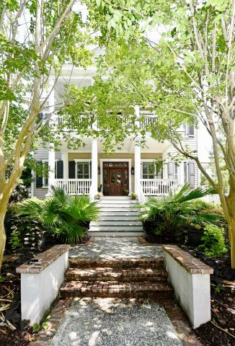
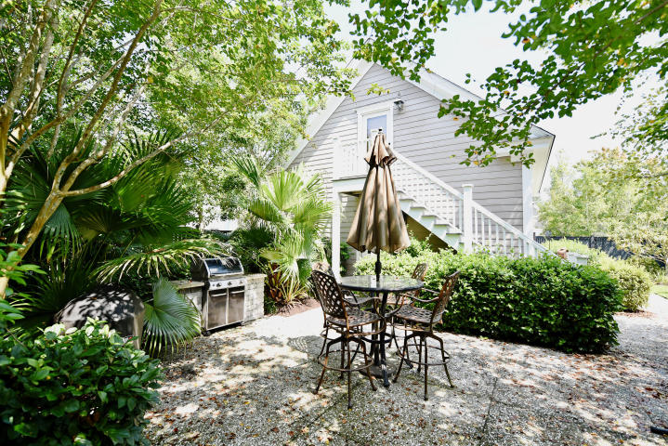
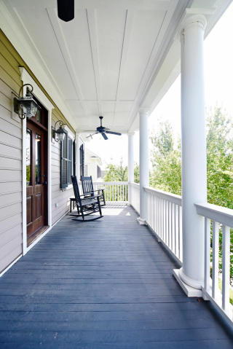
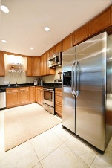
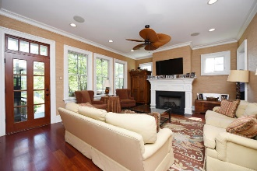
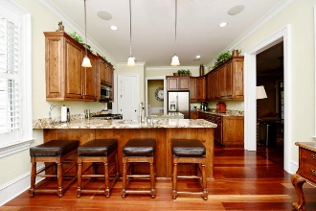
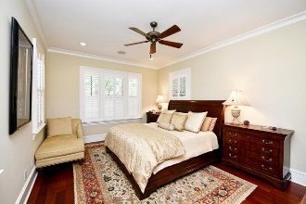
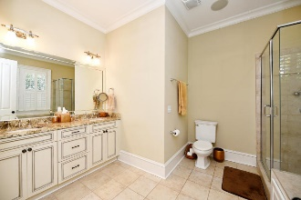
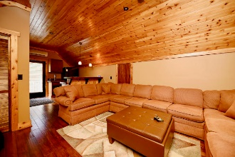
New Listing in Smythe Park @ Daniel Island
2014 Purcell Lane ~ Charleston, SC 29492
MLS# 17020908 ~ $849,000
Gorgeous Daniel Island home with grand ceilings and charming details! Centrally located in Smythe Park, you are close to everything on the island. The entrance greets you with a beautifully landscaped yard, spacious double porches with custom shutters, and 10' ceilings with 8' doors on the first level. The home features an open floorpan with wonderful windows offering natural light, trim and wainscoting throughout. The eat-in kitchen can host multiple seats at the counter height bar, solid wood cabinets, stainless steel appliances, granite countertops, island, pantry, and more. The downstairs conveniently also holds the Living room with a gas burning fireplace, surround sound entertainment system, The Master Suite, Personal Office, Guest Powder Room, and screened porch. Upstairs also boasts 10' ceilings and 8' doors, has four bedrooms with custom closets, and two bathrooms. The backyard oasis is irrigated and showcases an outdoor brick bbq grilling and entertaining area with plenty of yard for playing and seating. Moving on to the detached two car garage, above it you will find a finished apartment with a kitchen and bathroom. The beautiful cedar wood lined space is perfect for a home office, workout gym, in-law suit, or guest house!
Trey Morrison
trey@landsouthofcharleston.com
Mobile 843-697-6849
Land South of Charleston, LLC | 409 King St | Charleston, SC 29403

