Slide 1

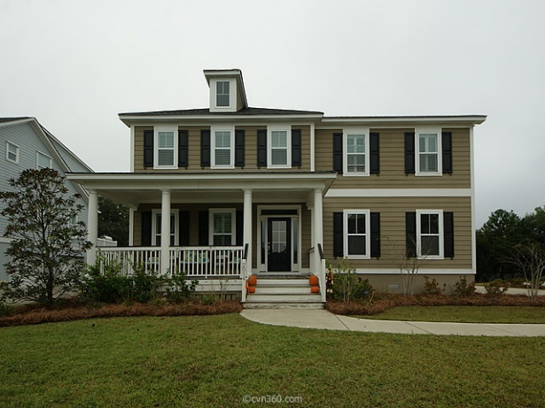
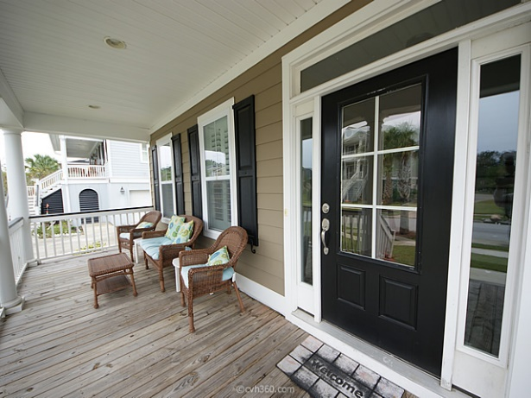
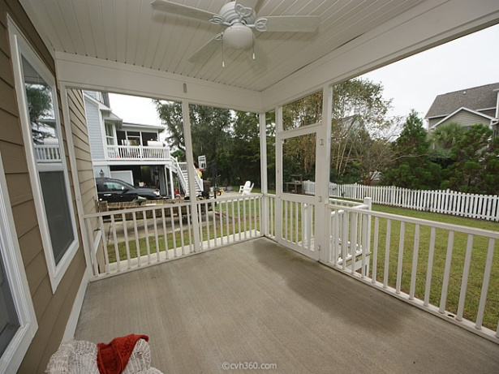
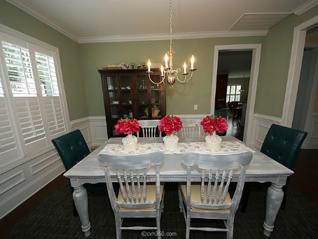
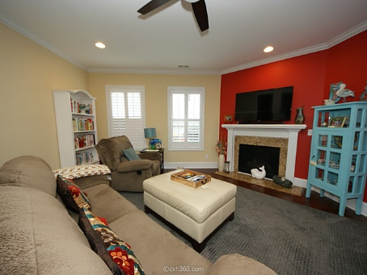
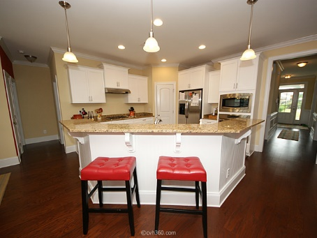
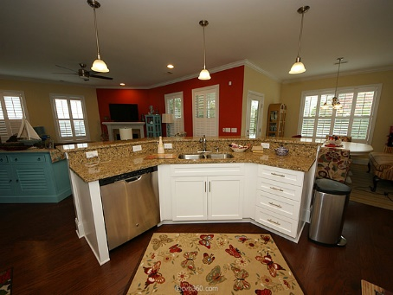
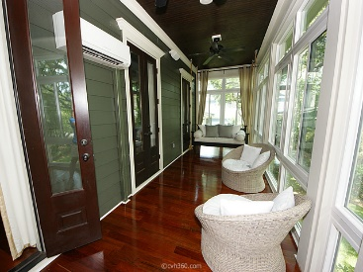
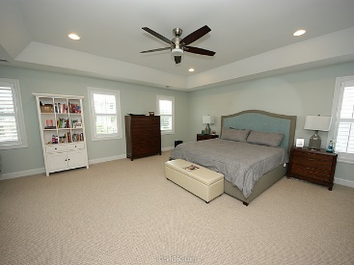
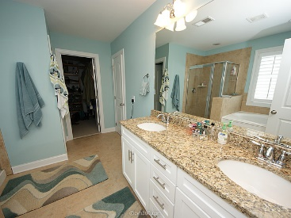
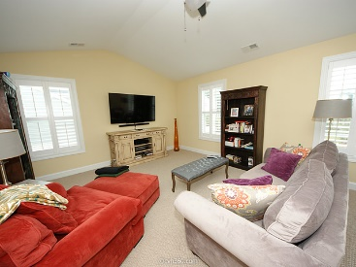
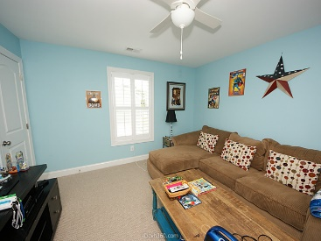
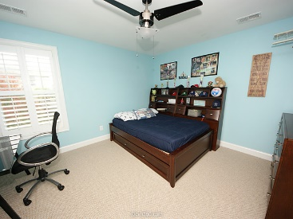


5 Bedrooms in Rivertowne
Don’t Miss This One!
2014 Shields Lane
Rivertowne On The Wando | Mount Pleasant, SC 29466 | MLS# 15028285 | $619,000
Hard to find 5 bedroom home with 3 full baths and a perfect blend of open space and privacy. Please view all the pictures and show how well this floor plan lays out and you would never know how big it truly is from the outside. In the middle of a street, this home is ideal for families with children of all ages or families that have aging or disabled family members due to a down stairs bedroom tucked away with a full bathroom across the hall. A great HOA with activities (see pictures for more info) An extremely large Master Bedroom is upstairs with an open area for media/family or even an office. Plantation shutters, custom organized closet in the master bedroom. Laundry is upstairs close to the bedrooms. This home is not elevated and is on a crawlspace in the Rivertowne on the Wando. Subdivision which has a community pool, tennis courts, playgrounds and open space throughout the area. An active HOA association makes for a lively place for people of all ages.
Apx. SqFt: 3,229
Area: 41 - Mt Pleasant N of IOP Connector
Bedrooms: 5
Baths - Total: 3
County: Charleston
Tax Map #: 583-05-00-287
Year Built: 2013
Legal Description: Lot 2014

