Slide 1
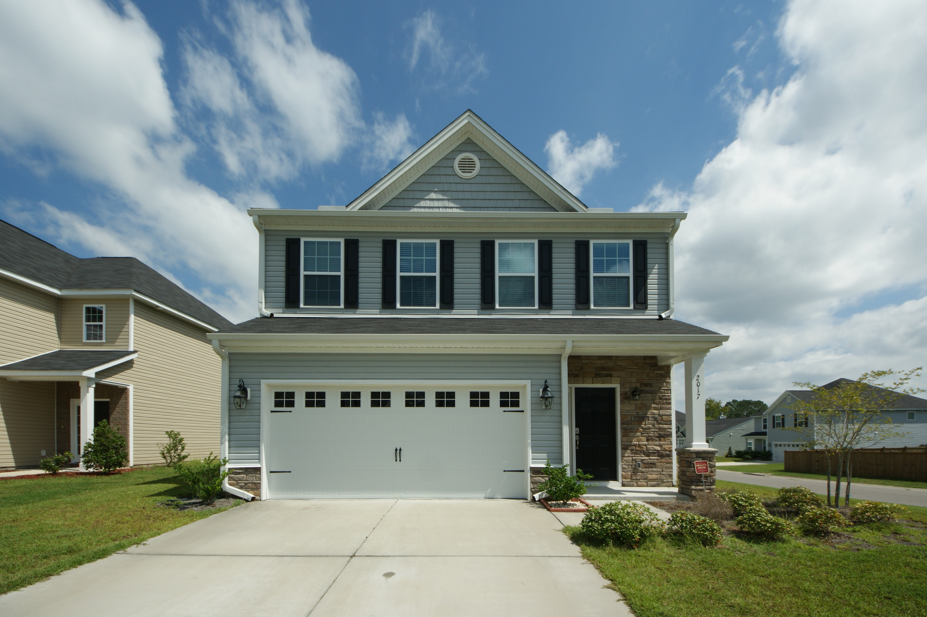
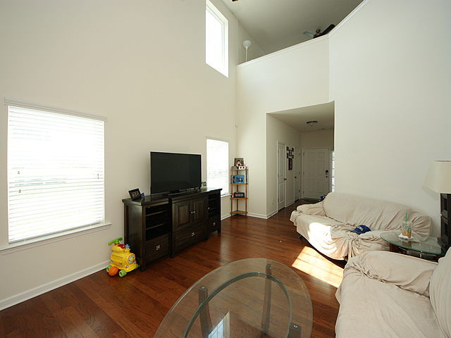
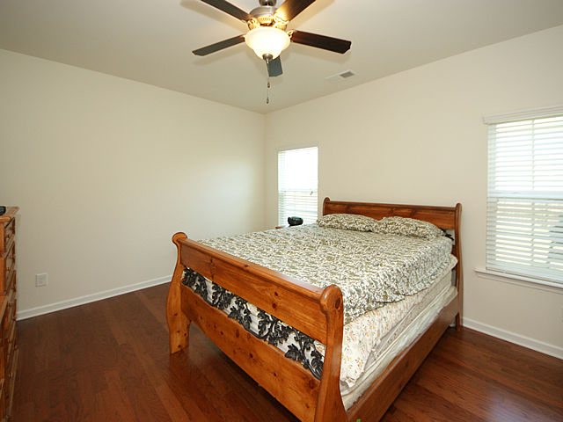
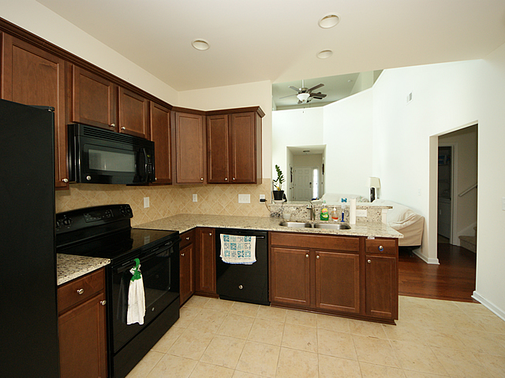
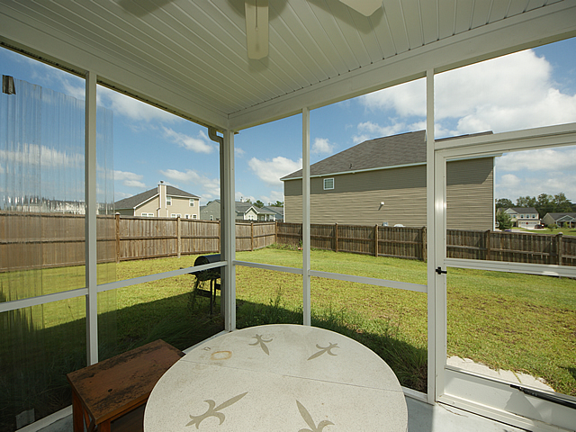
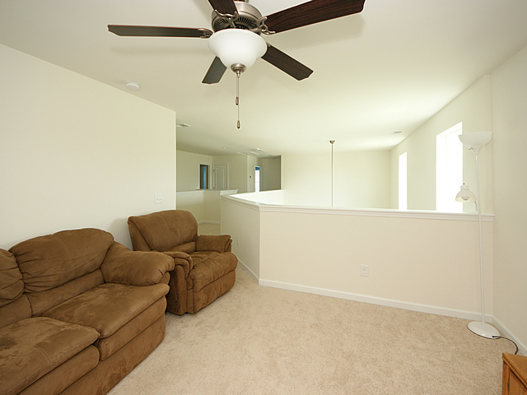
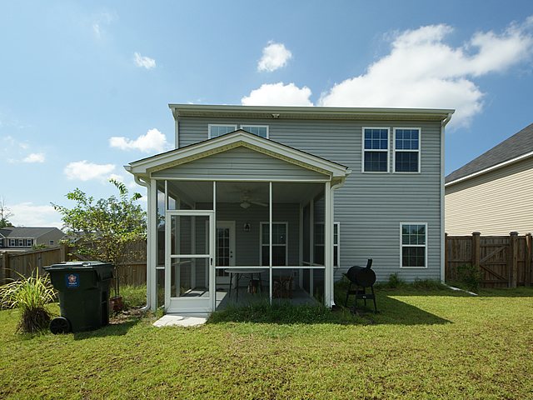


Reduced Again in Hunters Bend!!
2017 Hunters Bend Trail ~ Ladson ~ MLS# 16025255 ~ $213,900
A 2014 Home, LIKE NEW! ~~~ Don't WAIT on new construction for months on end!! This 4BR, 2.5BR home has been well-maintained & still smells like new. This FLORENCE floor plan has a grand 2-story living room that is open to below from the 2nd floor LOFT, a luxurious OWNER'S SUITE DOWNSTAIRS, plus 3 bedrooms upstairs. The front door opens to a 2-story LR. There is hardwood flooring throughout the main level, including the master and closet. The guest bath comes w/ a pedestal sink & elongated toilet. The kitchen has a great open layout, maple cabinets, recessed lighting, pantry, and a large eat-in kitchen. The family rm. is spacious and perfect for entertaining. A 2 car garage leads to the laundry/mudroom. The kitchen leads to a screened-in porch and large backyard. This home has all the upgrades, plus a few more updates that a new construction home doesn't offer. There are granite countertops in the kitchen, and ceiling fans throughout, including the porch. There is a built in security system. A privacy fence has been installed, along with gutters around the entire house. Another $2K was invested for plantation blinds. Energy Star Air Filtration, and HERS Rated green features. This home has been very SOFTLY lived in, with no signs of wear/tear. This 2014 home sits on a CORNER lot, with neighbors only on one side. It's like new, and ready for its new owners! Hunters Bend is a nice, quiet, newer community, with the benefits of being located off the beaten path, but still within a couple miles of 17A and the I-26. Don't miss out on this opportunity to own a like-new home WITHOUT the months-long wait of new construction. Seller will consider providing closing cost assistance with reasonable offer!! Schedule your showing TODAY!
Tammy Thompson
843-412-1856 tammylthompson@live.com
Keller Williams Realty
496 Bramson Ct Ste 200
Mt. Pleasant, SC 29464

