Slide 1
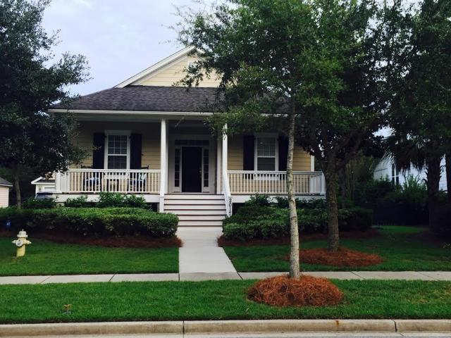
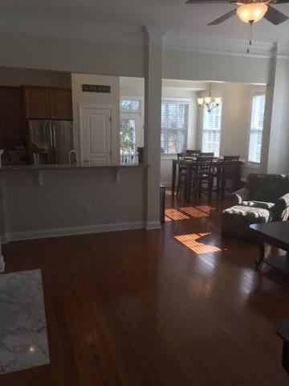
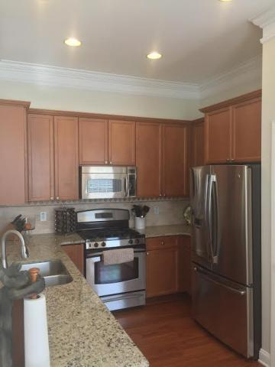
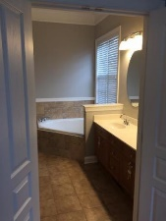

Move-in Ready One-Story Home on Beautiful Daniel Island
2017 Pierce St
Center Park
Daniel Island
MLS# 16003574
$525,000
137 Beaufain Street
MLS# 15000837 - $1,150,000
Check out the virtual tour for more pix!
Check out the virtual tour for more pix!
Located on a quiet street, this charming single story cottage is better than brand new. Outside painted 6 months ago. All of the inside painted within the past month. Crown molding in all rooms except two front bedrooms. New carpet in guest bedrooms. New wood flooring in all other rooms. Master bath has all new tile in bath plus around tub and in shower. The functional floor plan offers two guest bedrooms at the front of the home that share a full bath and a master bedroom in the back of house for added privacy. Granite and bead board installed in laundry room and kitchen. New fridge and dishwasher in past 6 months. Gas fire logs in family room. New AC/gas heat pack installed in July 2014. Built in shelves and work space in garage. Manicured and established lawn. This house is a must see!
Lynda Crozier
(843) 834-3899
lyndabcrozier@gmail.com
www.lyndacozier.com
RE/MAX Tattersall
429 W Coleman Blvd
Mt. Pleasant, SC 29464

