Slide 1

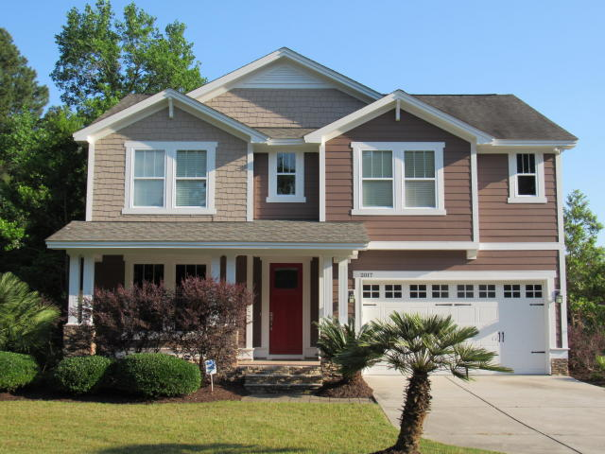
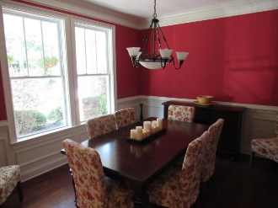
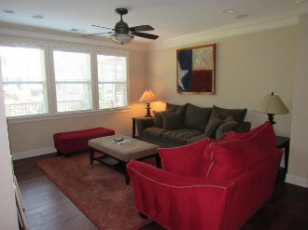
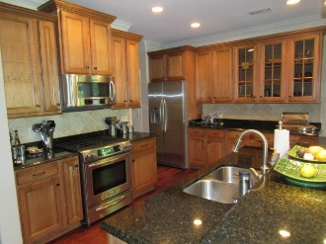
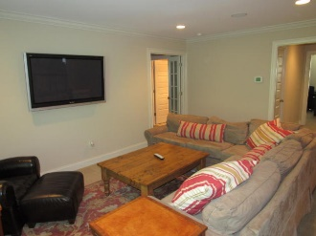
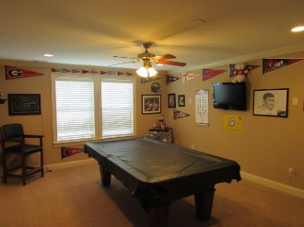
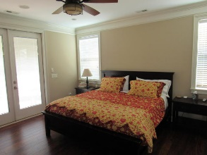
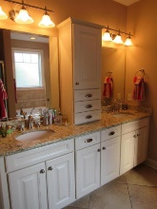
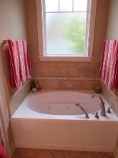
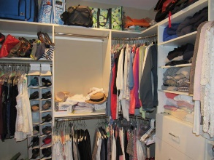
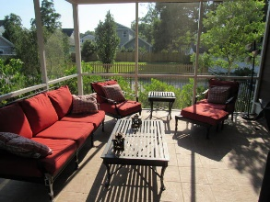
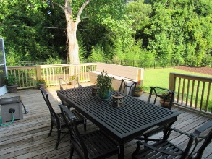
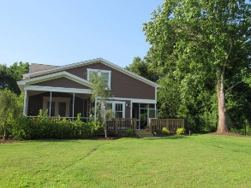


Reduced $25k! Custom James Island Home
2017 Woodland Shores Rd
Stono Shores
Charleston, SC 29412
MLS# 16016967
$550,000
3,500 SF
5 Bedrooms :: 4½ Bath
5 bedrooms 4 1/2 baths, 3500 sq feet of nothing but upgrades! Custom cabinets, hickory wood floors, granite counter tops, 2 surround sound zones, built in books cases, large butler's pantry, large loft media area, game room (that could be a 6th bedroom), 2 screened porches, back deck, fenced in back yard, irrigation, tankless water heater 2 car garage. Entire new paint inside and out! 1st Floor master bedroom has direct outside access to a screened porch. The master bath has jetted tube, separate custom tiled shower with glass door, granite vanities, water closet, huge walk in closet with wood closet system. Lots of extra storage throughout. SUPER fast access to downtown or Folly Beach. Mature landscaping. Transferable termite bond.
Eric Draper
(843) 442-7118
eric.draper@gmail.com
www.charlestonrealestategroup.com
Charleston Real Estate Group | 792 Folly Rd. C1 | Charleston, SC 29412

