Slide 1
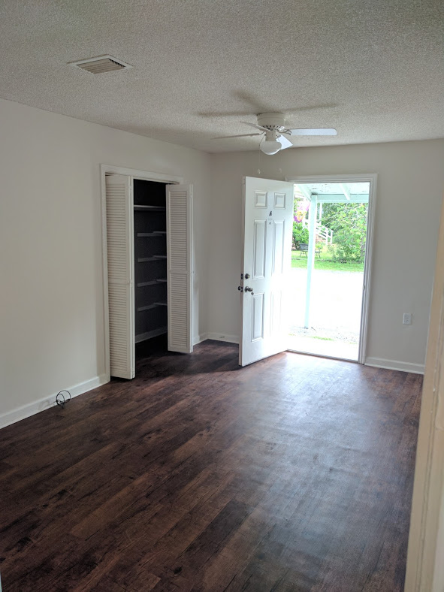
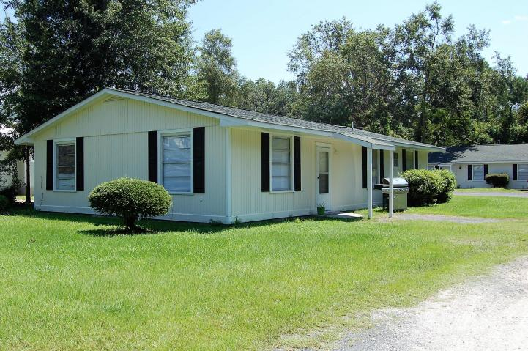
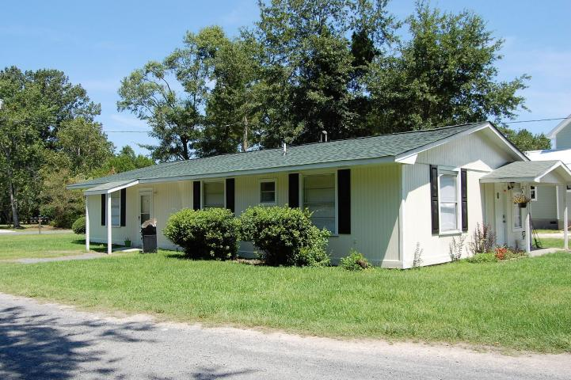
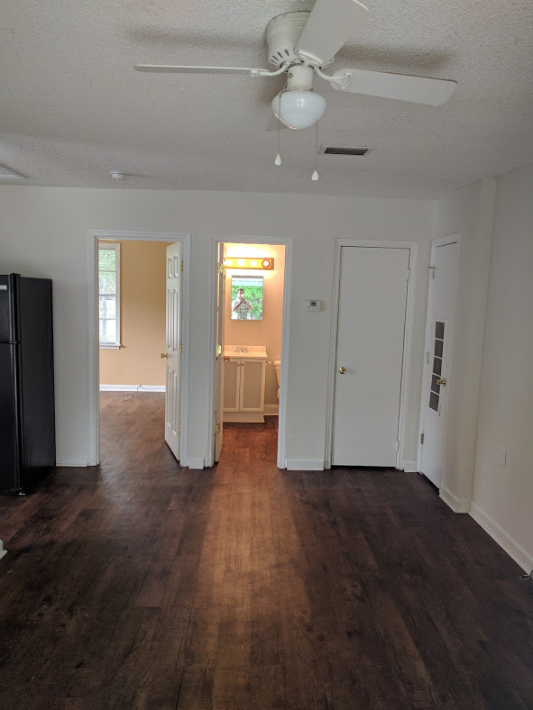
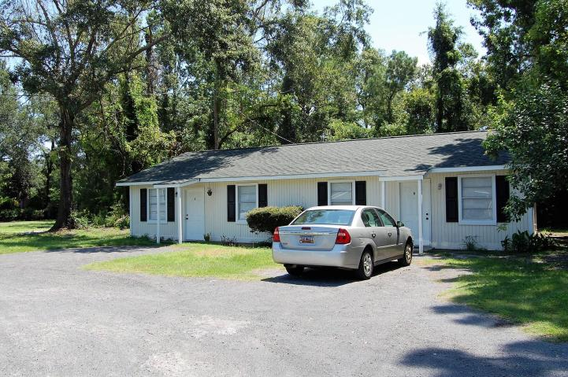
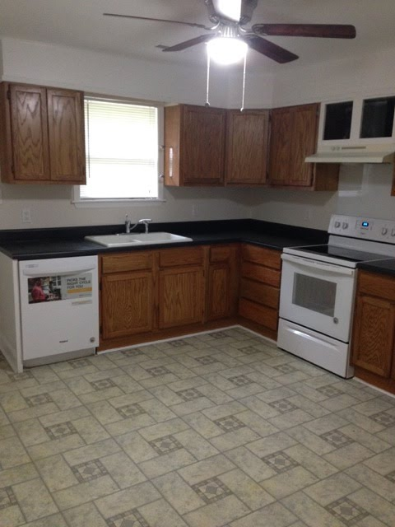
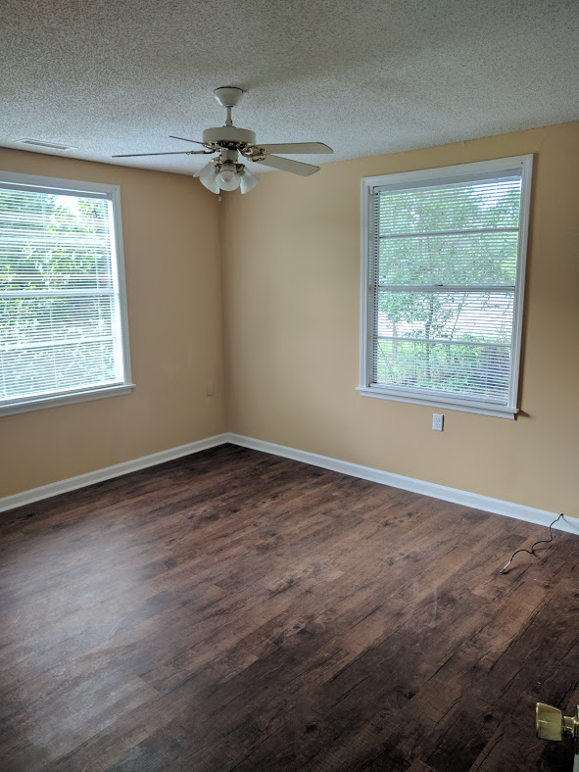
2018 Pinopolis Road
Pinopolis, SC 29469
MLS# 17012862
$320,000
GREAT INVESTMENT OPPORTUNITY! STEADY INCOME.
GREAT INVESTMENT OPPORTUNITY!
STEADY INCOME.
Four freshly renovated units including new appliances, fresh paint inside and out, new AC/HV units, as well as exterior paint, and brand new roofs minimizing maintenance for years to come. Great investment potential with $37K of income per year, a very profitable 10% R.O.I. in a rapidly growing area near the Volvo plant and surrounding businesses.Plenty of off street parking, includes a laundry room with washer and dryer for tenant use. Beautiful historic area with access to a public boat ramp on Lake Moultrie. Added bonus, there is enough room to build another building for additional income. These units are a must see, with great tenants and long term leases. Don't miss this investor's dream opportunity!Please submit pre-qualification letter with all offers.
Christopher Watson
(843) 471-0956
chris@chriswatson.com
Harbourtowne Real Estate
672 Marina Drive, Ste 110 | Daniel Island, SC 29492

