Slide 1

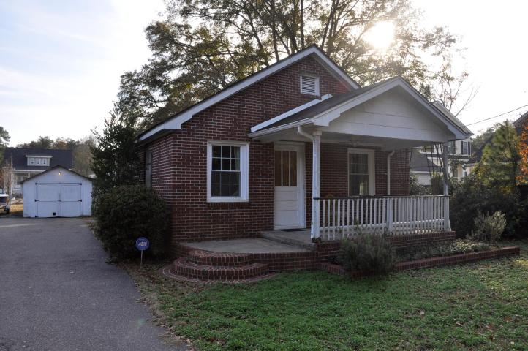
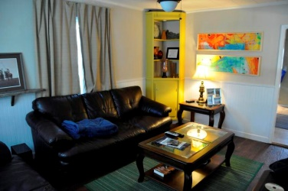
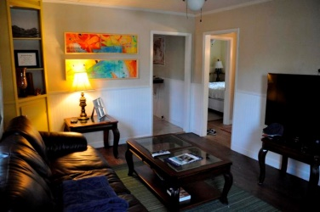
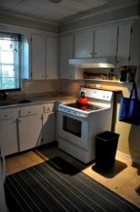
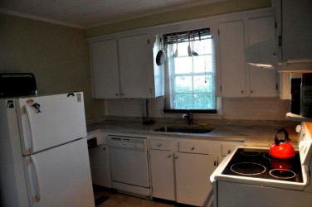
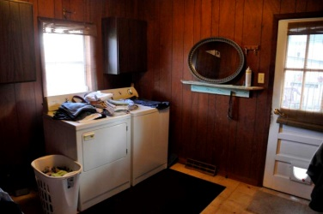
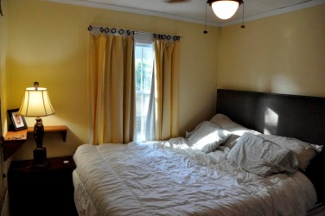
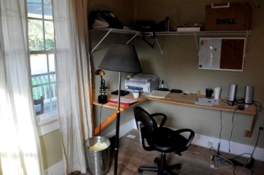
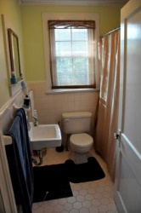
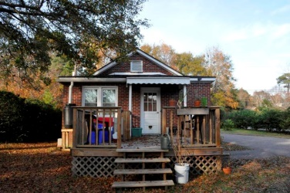
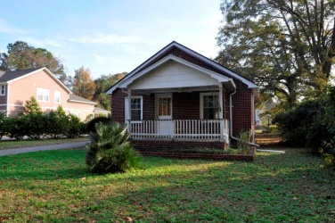



This price is no joke!
2019 Woodland Shores Rd
Stono Shores
Charleston, SC 29412
MLS# 14029177
$175,000
907 SF
3 Bedrooms :: 1 Bath
Cute as a button! Well cared for older brick home on large lot with 2 large oak trees providing afternoon shade! The house has been UPDATED and has several GREEN features, including new sprayed insulation.
3 bedroom 1 bath home with hardwood floors, NEW WINDOWS, new TANKLESS water heater, GRANITE countertops in the kitchen, bead board in the living rooms, new switches, outlets, ceiling fans & rain catcher water barrels for the vegetable garden, newer back deck, covered front porch, detached garage/workshop on
.39 acre lot! Located on dead end street...surrounded by houses that sell for $500K+++ AE flood zone. No elevation cert at this time. Survey is located in the picture section.
Lizzie H Ray
(843) 452-9298
lizzieray1122@gmail.com
Eric Draper
(843) 442-7118
eric.draper@gmail.com
www.charlestonrealestategroup.com
Charleston Real Estate Partners. LLC | 792 Folly Rd. C1 | Charleston, SC 29412

