Slide 1
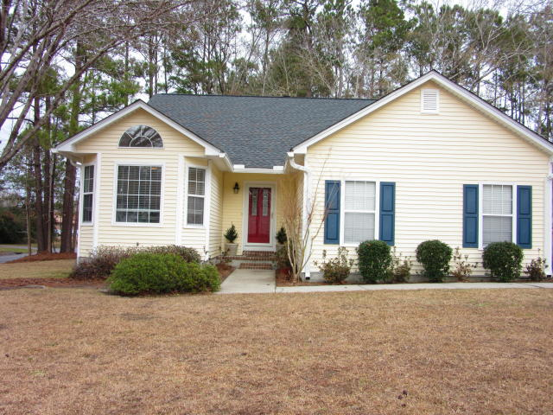
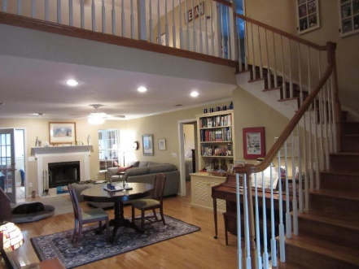
JUST LISTED
Summerville/Gahagan
$249,850
$40,000
Price Reduction!
201 Factors Walk ~ MLS# 18000738
WOW!!!! Owners have found another home they want to purchase and have priced this home to sell quickly! The home is across the street about a half a block from the Sawmill Branch Trail which creates a wooded buffer and lots of privacy. Yes, there is a 6 ft. privacy fence in the rear yard. You are only a 5 minute drive to downtown Summerville...7-10 Minutes to I-26 and 30 minutes to downtown Charleston. Owners have updated/upgraded/improved this home in many ways to include...Last Summer the sunroom at the rear of the home was enclosed with glass has pergo flooring, added insulation, ceiling fan and fresh paint. Sunroom also has brand-spank'n new split AC/Heat system.
There are hardwood floors throughout the house, Bathrooms are newly tiled and also laundry room has new flooring. Upstairs loft area has built-in bookshelves across the entire back wall. The home has hardwood floors throughout. Bathrooms and laundry room are newly tiled. Home has new HVAC (2010), Roof (2011), tankless hot water heater, front door and storm door. In the last 6 months installation of new kitchen appliances, kitchen cabinets, tiled backsplash and quartz countertops. Front and Back Doors Lighting is Auto Sensored to alert you someone is there and provide lighting to the guests. Home also has new guttering. House has been very well maintained and will provide a lot of comfort to your family. The home has an open floorplan and has a warm and inviting layout...Better hurry this will not last long.
Rick Willis
843-327-3017 Rick@RickWillis.com The Group, LLC

