Slide 1
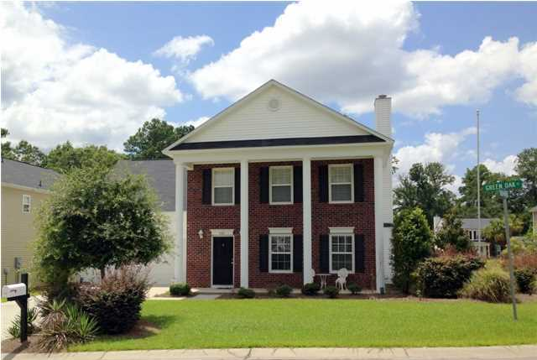
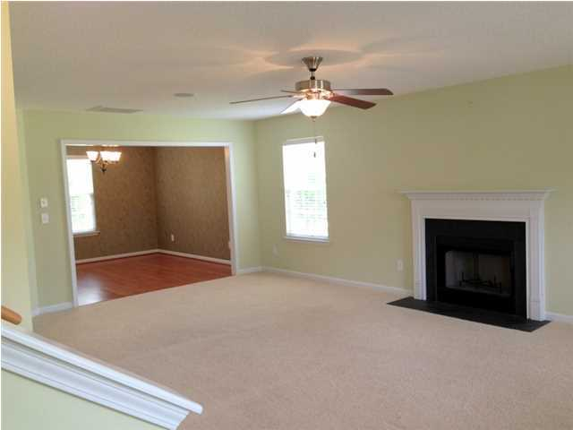
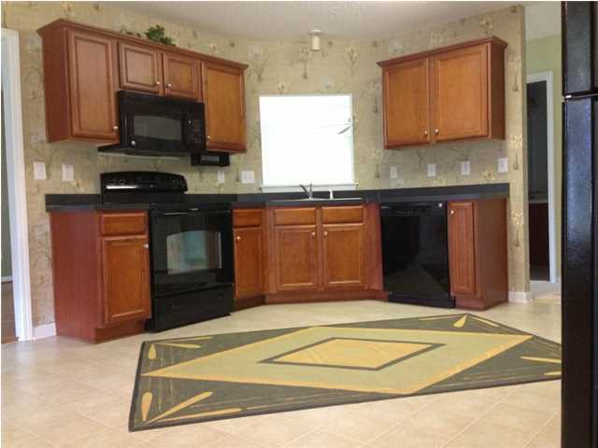
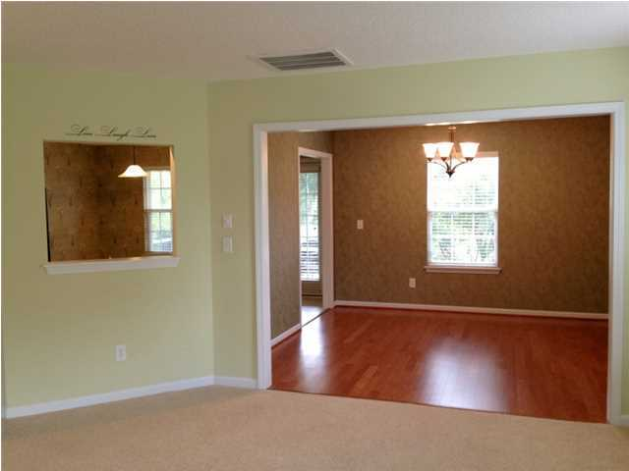
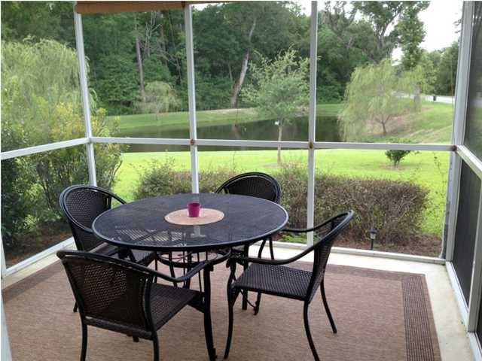
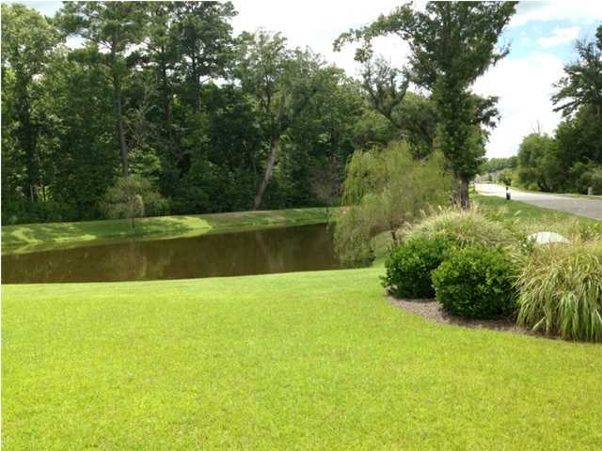



201 Green Oak Court
Brickhope Greens ~ Goose Creek ~ MLS# 18019007 ~ $238,000
2,344 Sq. Ft. | 3 Bed | 2 ½ Bath
Just Listed!
Agent Preview/Luncheon
Preview this great home before going live on MLS!
Wednesday, April 25th ~ 12:00-2:00
Traditional southern style home with stately curb appeal! This beautiful home is located on the corner of a cul-de-sac, with woods for privacy, and a scenic pond for your viewing pleasure. This was the model home for the neighborhood and has many upgrades. Graceful open floorplan with 3 bedrooms, plus a huge Bonus Room which could be a 4th bedroom, ceiling fans throughout, hardwood flooring in foyer and formal dining room, wood burning fireplace in great room, built-in sound system, 2 in. faux wood blinds, large eat-in kitchen with maple cabinets, master suite with walk-in closet, master bath with garden tub, separate shower, and double vanities. Upstairs has a computer nook in hallway, 2 car garage with built-in cabinets and garage door opener, security system, screened porch overlooking the pond, and a full front porch with 17 ft. columns. Centrally located to shopping, dining, Air Force Base, Boeing, Volvo and Naval Weapons Station.
Come see this amazing home!
Jennifer Nipper, Realtor®
(843) 478-1800 | jen@AgentOwned.com
www.AgentOwned.com
The AgentOwned Realty Co | 824 Johnnie Dodds Blvd | Mt. Pleasant, SC 29464
Real Estate • Mortgage • Insurance

