Slide 1
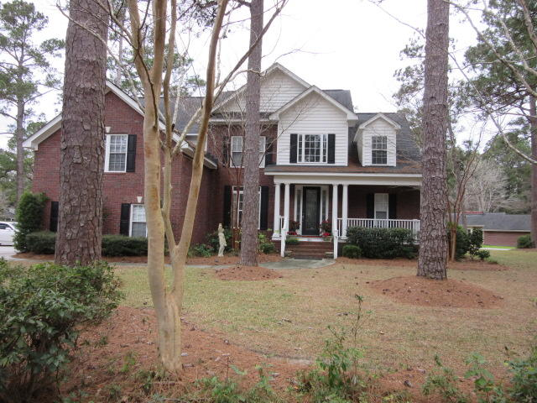
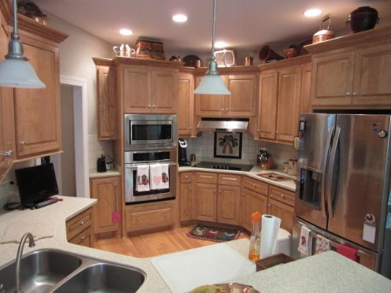
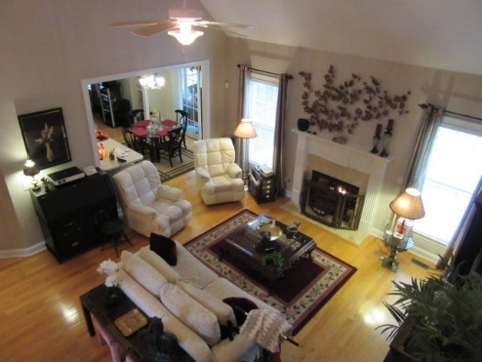
Seeking Back Up Offer
$40,000
Price Reduction!
Contingent on Buyer’s Home Sale
201 Parkwood Drive
Shepard Park ~ Summerville, SC 29483
MLS# 19004129 ~ $479,000
No HOA...No Covenants and Restrictions! This brick home exudes quality in every way and is located just a short 5 minute drive to downtown Summerville. The home has a public park across the street and lots of mature landscaping for lots of privacy. The home has an aluminum fence around the rear yard for your kids and pets safety...and even a double gate entry from the side street to allow your boat or camper to be parked in the rear yard. As you enter the home you are immediately impressed with the open foyer and high ceiling...which leads to the large living room with a wood burning fireplace. The kitchen has stainless steel appliances and hard surface countertops. The first floor has beautiful light colored oak floors that shine as light enters. There is a large first floor master bedroom with a large walk-in closet and garden tub. Upstairs are 4 additional bedrooms with one large enough with its own bathroom to be considered a mother-in-law- suite...its huge!
Rick Willis
843-327-3017 Rick@RickWillis.com The Group, LLC

