Slide 1
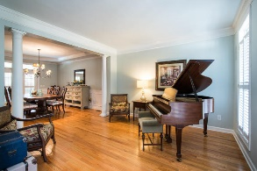
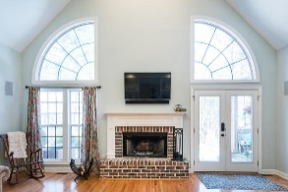
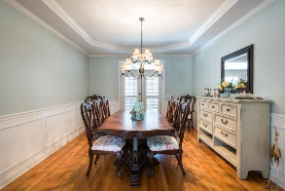
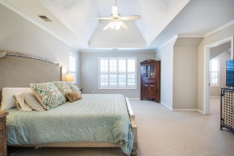
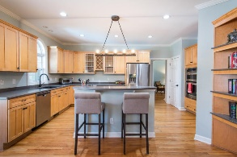
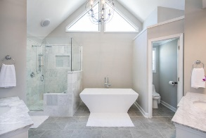
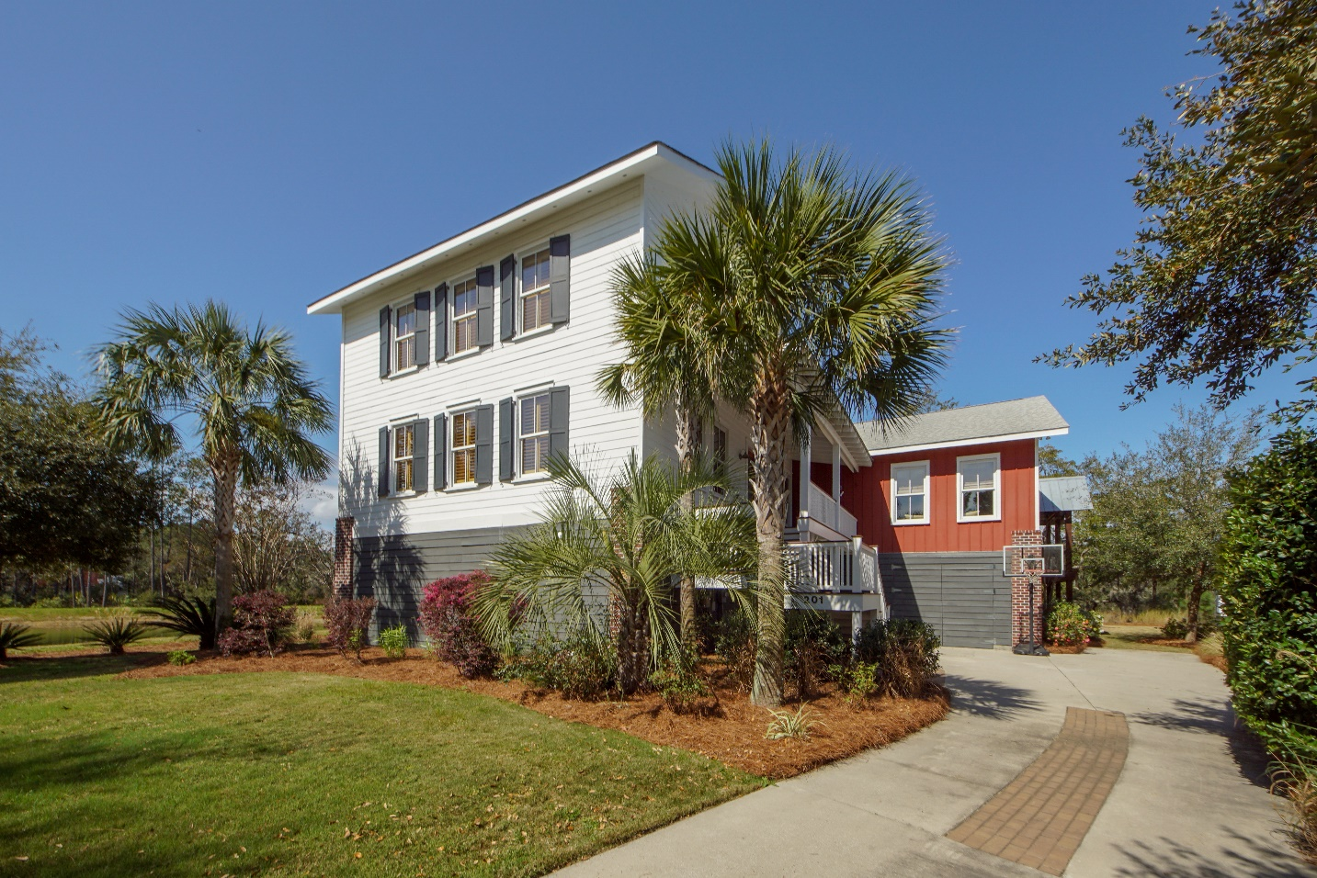
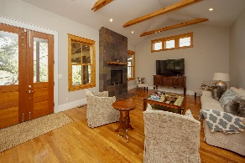
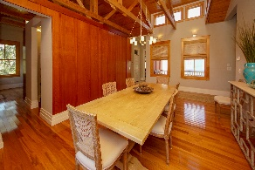
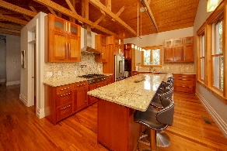
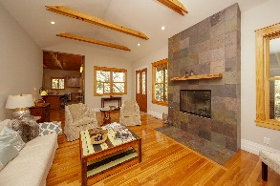
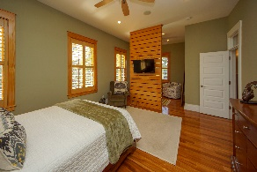
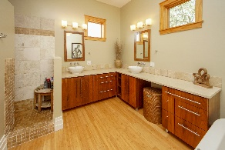
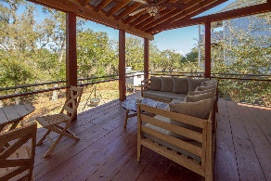
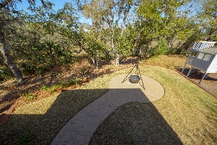
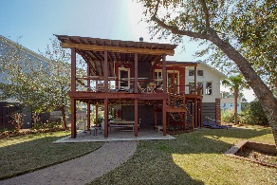


201 River Oak Drive
Grassy Creek ~ Mount Pleasant, SC 29464 ~ MLS# 19007644
NEW PRICE! $750,000
Rent to Own!
Stunning, one-of-a-kind, custom built home! This is a must see! IPE decking and large front porch welcome you into this contemporary home. You are greeted by a large dining room with expansive cathedral ceiling of pine tongue and groove exposed trusses and a wall of cherry paneling, simply gorgeous! The gourmet kitchen in this home is beautiful with continued cathedral ceilings of pine and exposed trusses. Stainless steel appliances including a 36'' Thermador gas range with griddle and exhaust hood, double wall convection ovens and a built-in wine cooler. Solid granite countertops throughout the kitchen and wet bar. The travertine mosaic backsplash compliments the granite countertops and custom cherry inset cabinets with under cabinet lighting. Enjoy the 3'x10' granite island with bar stool seating for casual dining. You will find a large pantry and full wet bar with a wine fridge and sink in between the kitchen and formal dining room. Oversized family room has a slate gas fireplace with a nearly 200 year old heart pine mantle. Double doors off the kitchen and family room lead you to the covered deck overlooking the marsh. Home has a fully irrigated, well-manicured lawn. Patio has a gas hookup for the grill, a perfect space for entertaining! Master bedroom and office located downstairs. Master bedroom has a seating area. Master bath has Bamboo flooring, walnut cabinetry, marble and travertine walk-in shower with body sprays, and free-standing soaking tub with air-jets. In addition, you will find a custom walnut floor-to-ceiling closet system (walk-in) with built-in walnut dresser. The downstairs office has floor-to-ceiling cherry bookshelves and a full bath with slate floors & subway tiled shower. All exterior doors in the home are made of solid Spanish cedar and interior doors on first floor have gorgeous transom windows. Solid teak hardwood floors span the 1st floor. An unbelievable stairway with cable rails leads you to the 2nd floor where you will find a built-in "cubby" & coat rack. Three bedrooms and two full bathrooms located upstairs. Upstairs bathrooms have custom cherry cabinets with marble counters and marble showers, EVERY detail in this home is high quality. Extras include an integrated sound system with speakers in the master suite, dining room, and kitchen. Rinnai tankless gas water heater. Efficient, top-of-the-line Pinnacle wood clad Windsor windows with loE glass, filled with argon, double pane glazing. This is an INCREDIBLE home centrally located in Grassy Creek. Community has a park, pavilion, and crabbing dock.
Cathy Sembower
843-259-1350
csembower@carolinaone.com
www.cathysembower.com
Carolina One Real Estate
195 W Coleman Blvd
Mt Pleasant, SC 29464-3495

