Slide 1
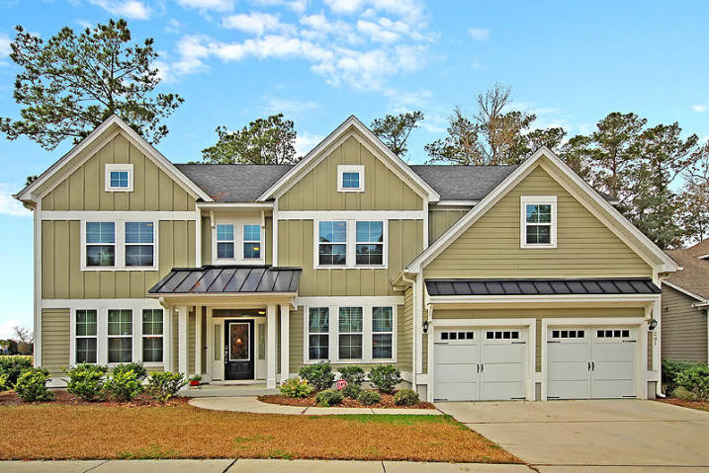
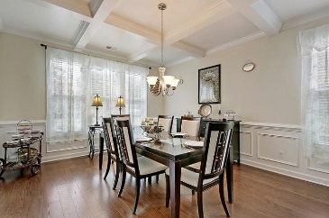
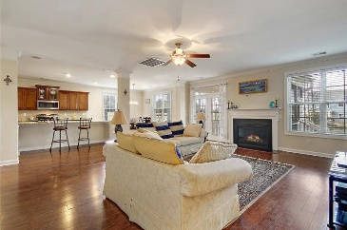
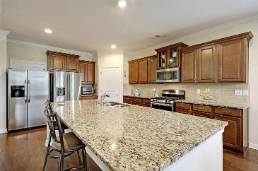
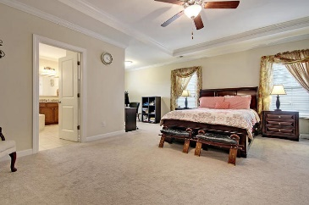
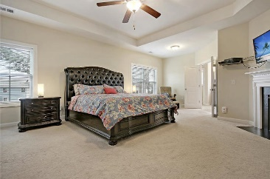
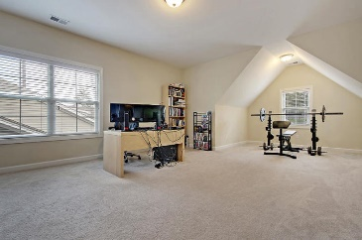
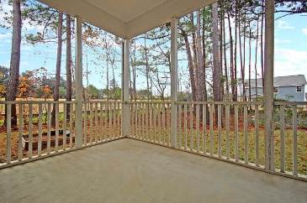
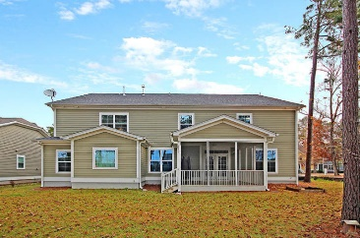

201 Weston Hall Drive
Summerville, SC 29483
MLS# 18033258 · $499,000
New To The Market
New Price in The Ponds
STUNNING 5+ bedroom, 4.5 bath, 4648 sqft, with TRUE DUAL MASTER BEDROOM SUITES home! When entering this home you will be greeted with handsome hardwood floors, two story GRAND FOYER with heavy crown moldings and columns, a formal dining room and formal living room, all with tons of natural light. A stunning spacious gourmet eat-in kitchen with stainless appliances, gas range, HUGE ISLAND, and granite countertops. Family room with gas fireplace. FIRST FLOOR MASTER SUITE w/ sitting area has an ensuite SPA-LIKE bath with relaxing soaking tub, separate shower, dual vanities, and walk-in closet. The SECOND FLOOR MASTER SUITE includes a gas fireplace, his and her walk-in closets, sitting area and a large SPA-LIKE master bath with soaking tub, separate shower, and dual sinks.
Altogether, this home includes 5 bedrooms each with a walk-in closet, plus a bonus room! The home has plenty of room for everyone to spread out and be comfortable. Also, enjoy the built-in music speakers when entertaining or relaxing after a long days work. There is gas central heat on the main floor and heat pump upstairs. Enjoy the view, and nature sounds The Ponds has to offer on from your private corner lot and screened porch. The Ponds is a beautiful master planned community that has the perfect balance between a small southern town and natural beauty. There is a YMCA and an 1,100 acre preserve accounts for more than one half the total land at the Ponds. The Ponds has its own historic farmhouse amenity center, picnic pavilion, pool, amphitheater and miles of trails all in walking distance from your home!
Stan Huff
843-670-2835
stan.huff@agentowned.com
Jill Marcacci
843-297-5590
jill@agentowned.com
www.agentownedrealty.com
AgentOwned Realty Co. Preferred Group, Inc. | 824 Johnnie Dodds Blvd | Mt Pleasant, SC 29464

