Slide 1
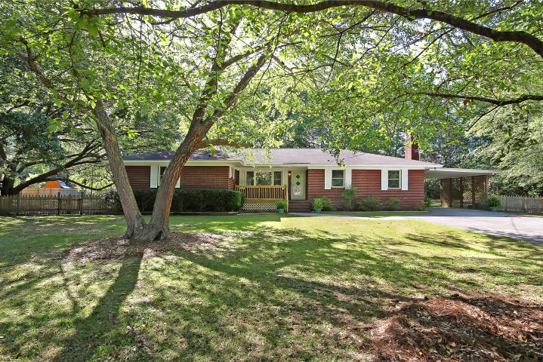
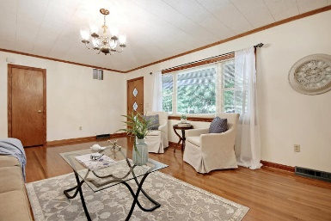
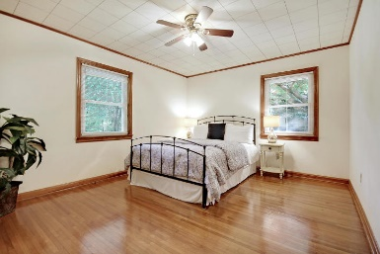
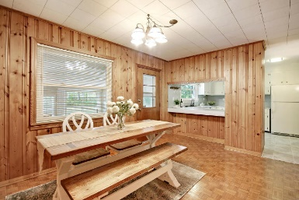
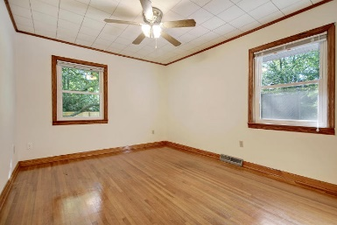
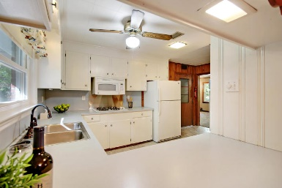
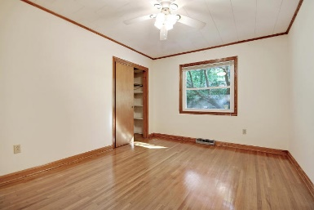
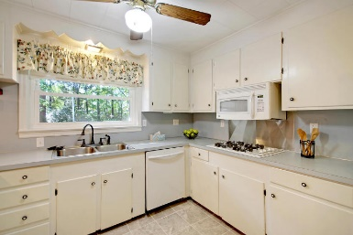
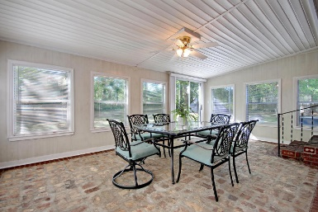
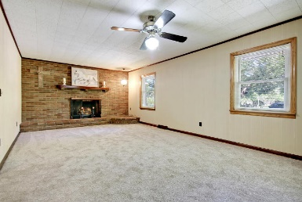
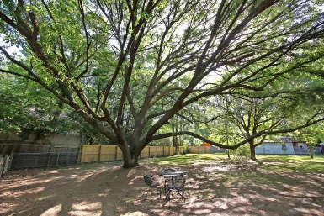

$7,000 Upgrade Allowance Offered At Closing!
201 Wilson Drive
Millwood ~ Summerville, SC 29483 ~ MLS# 18012710 ~ $274,900
This beautiful home close to downtown Summerville will be an oasis for your family. The charming home has so many wonderful details! Original hardwood floors, pine walls, fun vintage bathroom tile, and much, much more. This home has a fantastic floorplan and flow. Walk into the mudroom and drop your shoes and bags and come straight into the kitchen. Off of the kitchen you can hang out in the large den, complete with new carpet, and cozy up in front of the gas fireplace. You won't want to stay indoors for long though! The large sunroom will be the perfect spot to hang out and unwind...or even better, you can sit under the stunning grand oak tree in the sprawling backyard. Imagine watching the sun set while your kids run and play and swing under the trees!
Additional features include:
Spacious bedrooms with beautiful hardwood floors.
Large double paned windows with views of the beautiful oak tree.
Unique vintage tile in both bathrooms.
Beautiful large yard with metal and wood fences, pecan, fig, plum, and pear trees and blueberry bushes
552 sq ft workshop/garage, 8'x10' metal shed
Large tiled sunroom.
Beautiful brick fireplace
Den added in 1969; sunroom added in 1973.
Laundry room with deep sink and folding table added in 2018.
Oak parquet flooring in the dining room, 1.25" oak flooring throughout the house, new carpet in the family room, and new ceramic tile in the kitchen and utility room
Gas hot water heater
Mop sink
Deep well for water flowers, washing cars, etc.
Ideal location with easy access to I-26.
Book your showing soon!
Dwayne Moody dwayne@mattoneillteam.com (843) 864-9973

