Slide 1
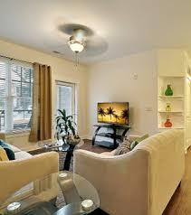
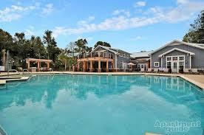
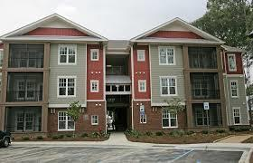
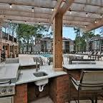
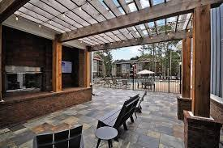


2020 Proximity Dr #201 Charleston, SC 29414 MLS# 16002283 $1,650
Sub Tenant Opportunity For Resort Style Apartment
THIS SUBLEASE OPPORTUNITY IS ONE APARTMENT BEHIND THE POOL CLUB HOUSE ACCESS.
Bob Glover & Zachary Glover
843-693-1837 (Bob) | 843-810-9891 (Zachary)
bobglover08@gmail.com | zachary@matthewryancompany.com
Matthew Ryan Company, 104 Berkeley Square, PMB 59, Goose Creek, 29445

