Slide 1
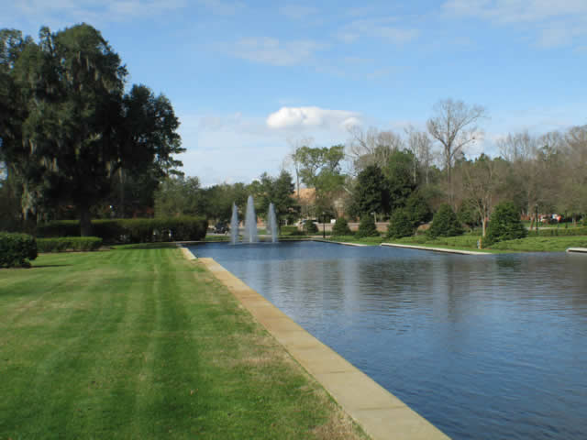
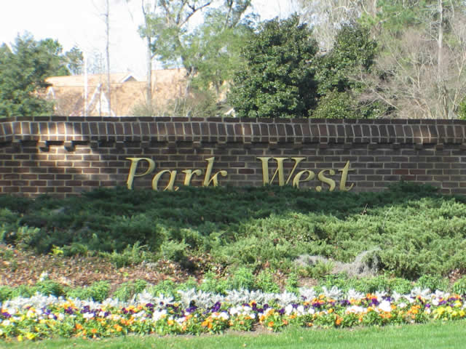
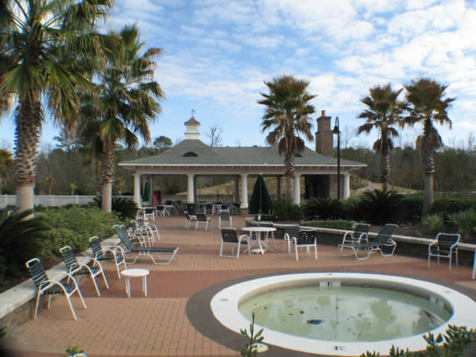
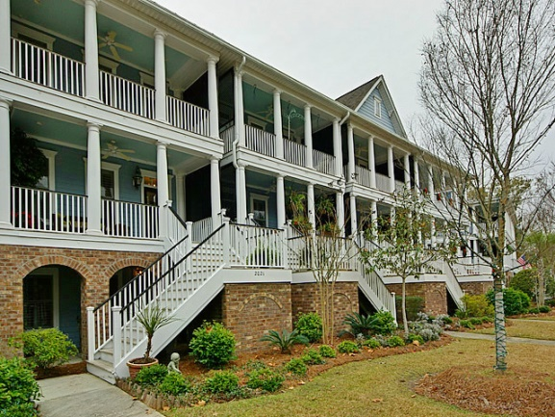
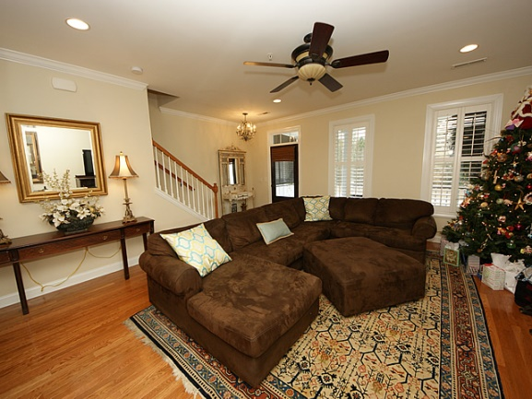
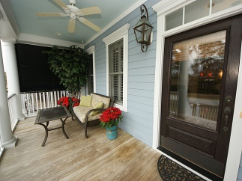
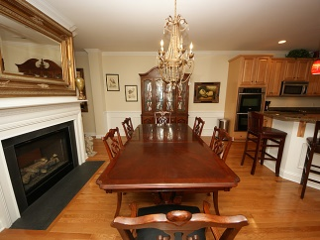
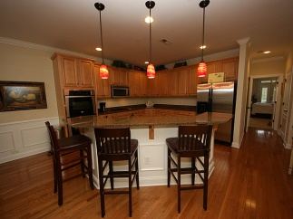
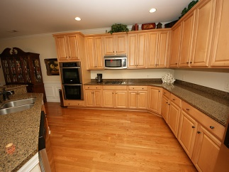
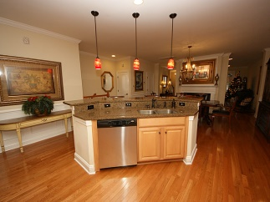
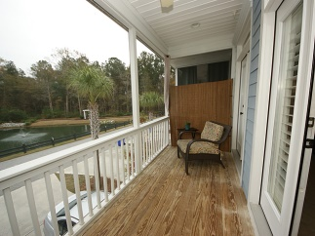
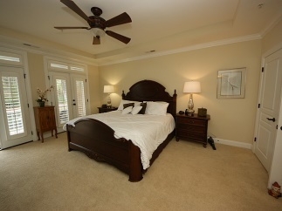
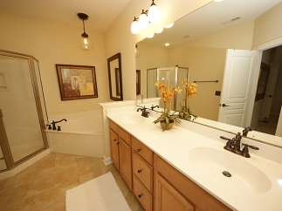
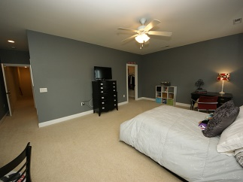
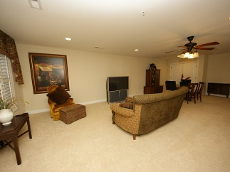
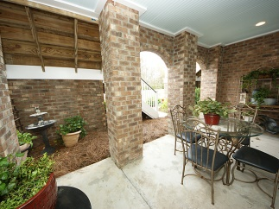
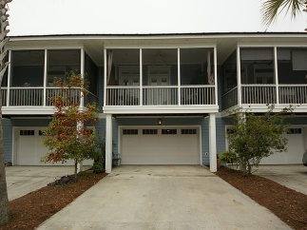


$120 Sq. Ft. in Park West...No Way!
2021 Grey Marsh Road
Mount Pleasant
MLS# 14030977
$440,000
If you are wanting luxurious space with low maintenance then this home is your answer! As you enter this 4 bedroom, 3.5 bath home you will be impressed! The main level features the family room, dining with a double sided fireplace, gourmet kitchen with stainless steel appliances, double ovens, gas cook top and granite counter tops. The master suite features a walk in closet, a bonus closet, master en-suite and a private screened porch. The 3rd level boast a mini master suite also with a private porch, a 3rd enormous bedroom features a walk in closet and a full bath which is shared with the current 4th bedroom. The ground level recreational room can be used as a mother in law suite with its own private porch and half bath. Plantation shutters, 2.5 + car. Dining chandelier does not convey!
Michelle Hodson
843-452-1609
tmhodson@comcast.net
www.southernlivingre.com
Southern Living Real Estate 2249 Salt Wind Way, Mt. Pleasant, SC 29466

