Slide 1
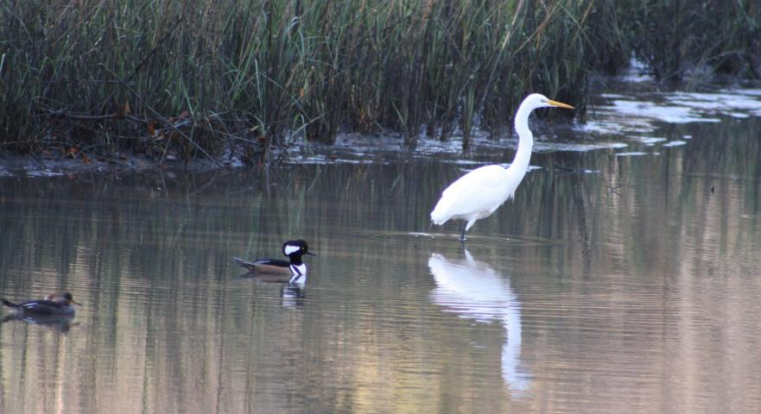
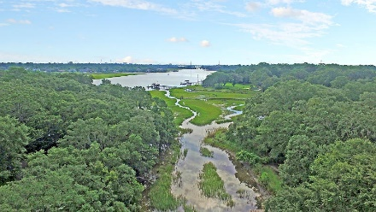
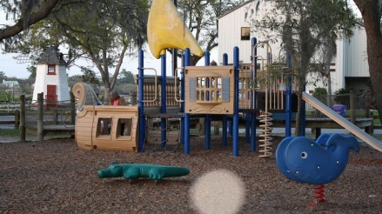
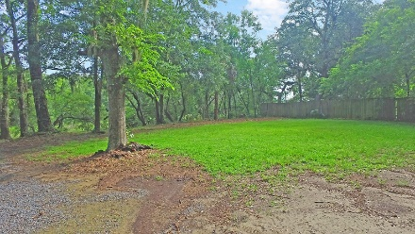
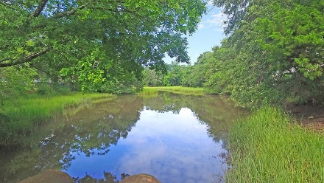
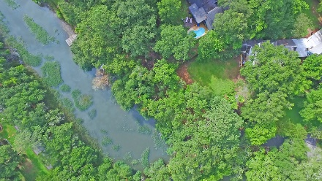
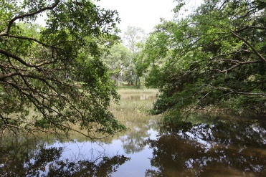
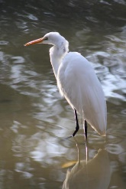
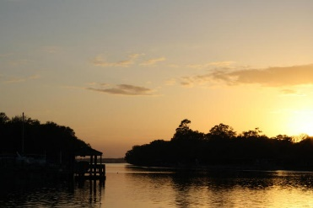
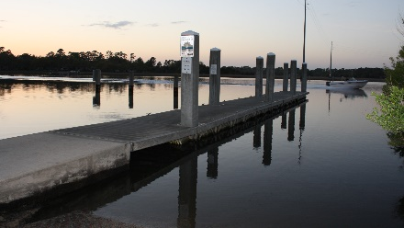
2021 Lakeshore Drive
Charleston, SC 29412
MLS# 17014944
$358,000
Riverland Terrace Tidal Creek Lot
Ready for building that dream home!
Pristine wildlife sanctuary and views. 3 blocks to boat landing, playground, picnic areas and ballfield. 2 blocks to Terrace plaza, theater, music venues, restaurants, bars, shops, churches and Sunday Farmer's Market. Great spot for cast netting, crabbing, fishing, launching kayaks, paddleboards, John boat, etc. Small easement for pedestrians in back corner. Survey online or in brochure box. Lot extends to within required setback of 15 feet from adjacent house .
Riverland Terrace Rare Waterfront Tidal Creek Lot!
Only 5 Lots To The Intracoastal Waterway!
.29 Acres Of High Land In Minimal Flood Zone.
Just 6 Miles To Downtown Charleston.
Preliminary Dock Approval And Subdivision.
Accommodate Any Size Home.
Very Quiet Heavily Wooded Area With Many Grand Oaks.
Crystal Carlson
(843) 270-8080 | crystaljcarlson@hotmail.com
Brand Name Real Estate | 4 Carriage Lane Suite 106 | Charleston, SC 29407

