Slide 1
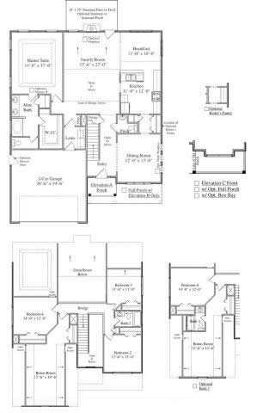
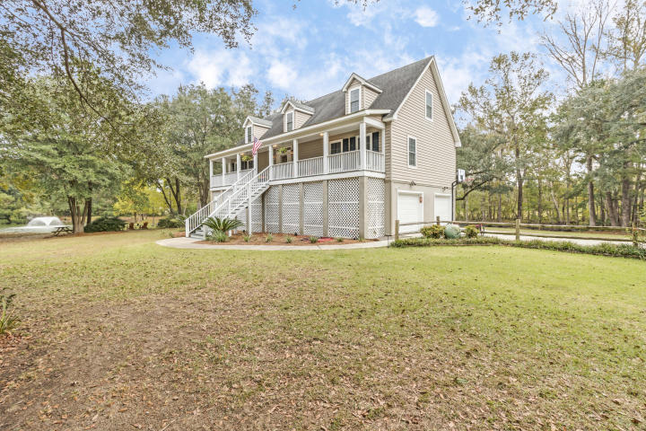
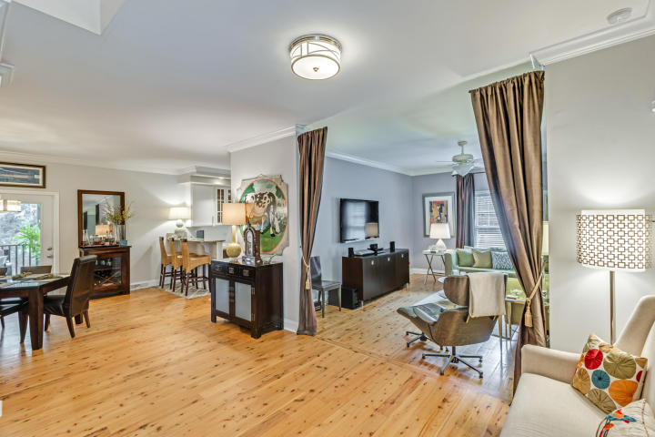
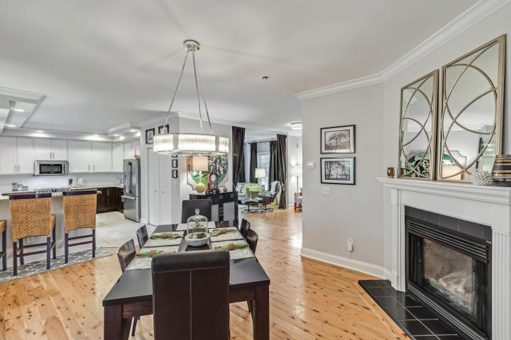


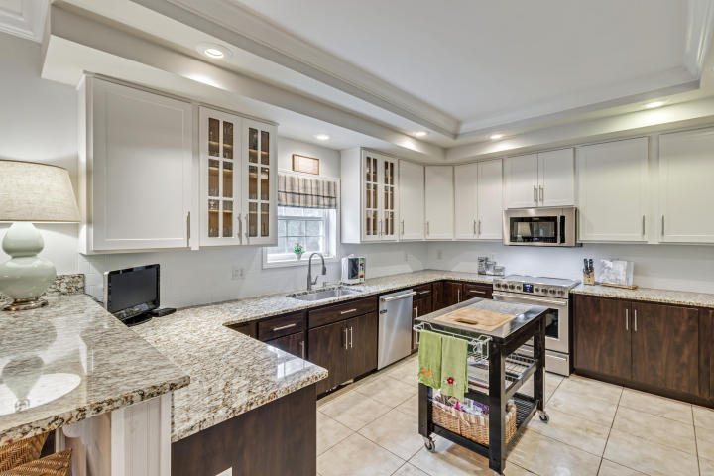
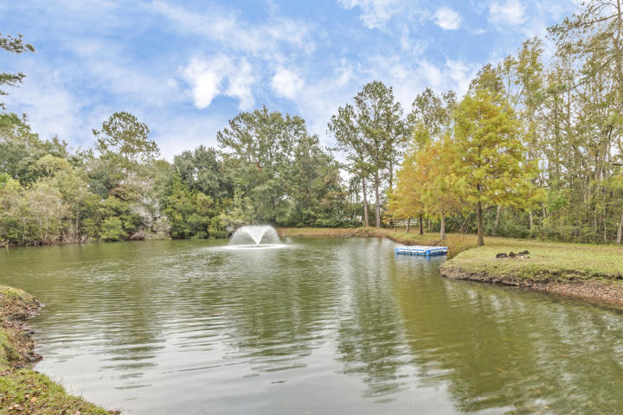

2022 Cedar Springs Lane Cedar Hills ~ Johns Island ~ MLS# 16027942 ~ $599,990
Picture Perfect Low Country Living perfectly situated on 5.01 peaceful and private acres. Be away from it all but close to everything! Enjoy views of your private pond with fountain from your rocking chair on the full front porch. This elevated 3 bedroom, 4 bathroom low country home awaits you. The home has been beautifully decorated throughout and many rooms have seen recent updates. The main level of the home boasts gracious living spaces with gorgeous Australian Cypress floors, a newly renovated kitchen with custom cabinetry, granite counters and professional stainless appliances. There's also a grand first floor master suite with an enormous closet and master bath featuring a custom designed steam shower with two shower heads and beautiful standing tub. You'll love the tranquility of the rear screened porch overlooking the woodlands. Upstairs are two additional spacious bedrooms, a large loft and full bathroom. A portion of the ground level has been tastefully finished and is fully ventilated ~ the area includes a billiard room, office, sauna and 1/2 bath. The ground level also includes a 2 car extended garage with ample storage space.
Don't miss this unique Johns Island home situated on a private road and cul-de-sac. There are only 7 lots on this road all of which have substantial acreage.

