Slide 1
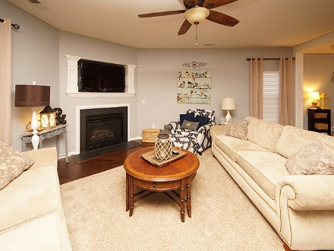
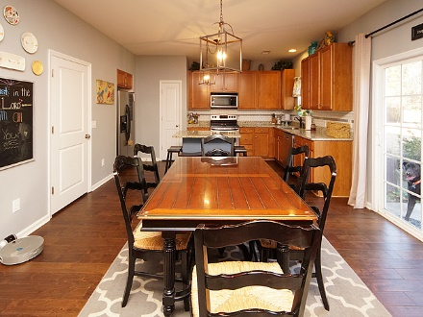
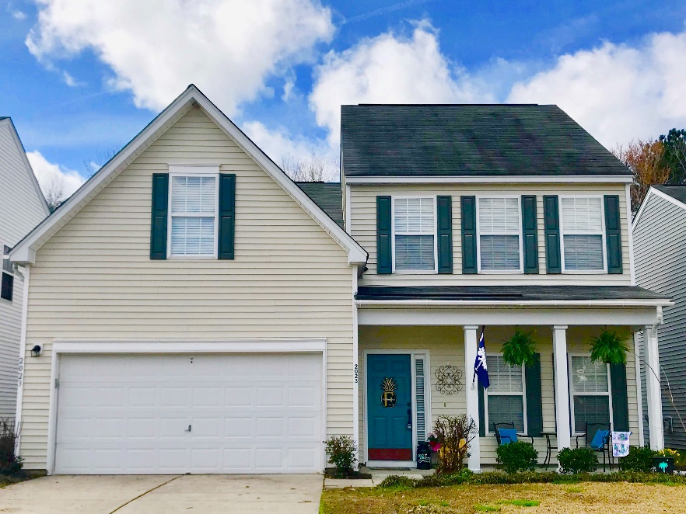
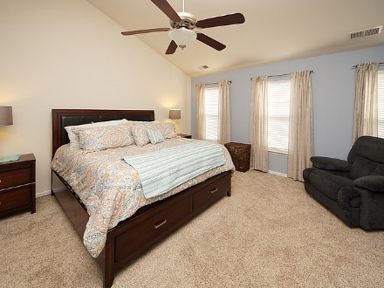
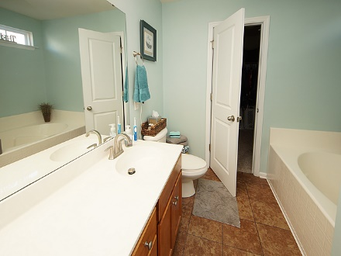
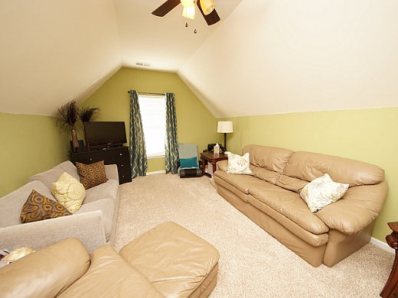
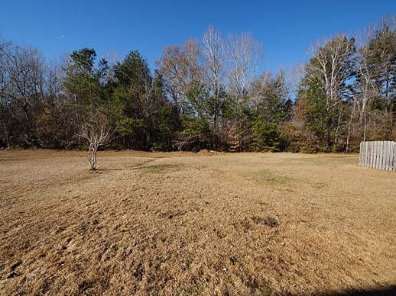
Agent OPEN HOUSE 11A-1p Friday 2/23
2023 Asher Loop
Legend Oaks Plantation
Summerville, SC 29485
MLS# 18001209
$265,000
3 Bedroom ~ 2½ Baths
FROG ~ 2,267 Square Feet
Welcome home to this BEAUTIFUL property located in the Providence section of the desirable Legend Oaks Plantation neighborhood. Enter the home to gleaming hardwood floors installed within the last year and open floor plan. Living room offers plenty of space and a gas fireplace for these chilly winter nights. You will find newly installed Santa Cecilia granite counter tops, back splash, stainless steel appliances to include BRAND NEW stove and faucet in the kitchen. Brand new light fixtures and faux wood blinds throughout the downstairs. BRAND NEW tankless water heater just installed. Home was freshly painted throughout within the last year with neutral tones to complement anyone's taste. Upstairs you will find a very spacious master bedroom that includes a small sitting area/reading nook offers plenty of functional space. Both secondary bedrooms have walk in closets and lots of wall space for furniture. The FROG is huge and perfect for guests or play area. This room can easily be finished as a 4th bedroom. Enjoy quite nights on your back patio overlooking the woods. Legend Oaks is a golf course community and allows you access to join the clubhouse, pool and tennis courts. Not to mention the food is delicious! Beech Hill Elementary school is within walking distance of this home. Don't miss out on this great opportunity!
Jennifer Laffey-Foster, MRP
Real Estate Agent
Miler Properties
Office: 843-821-1111
Cell: 843-708-1582
jlfoster86@gmail.com
www.milerproperties.com

