Slide 1
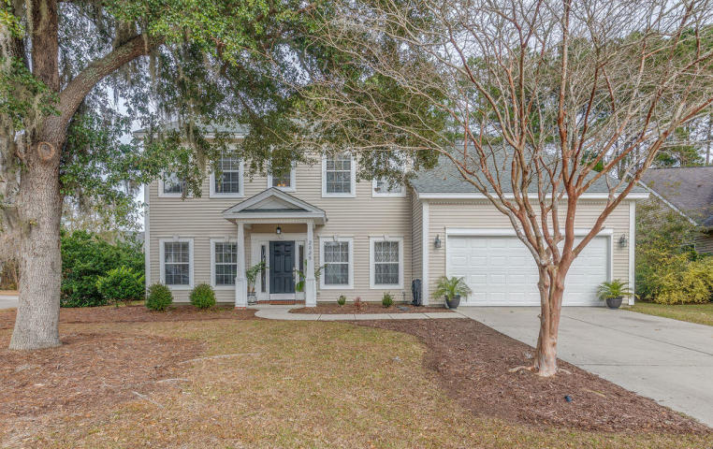
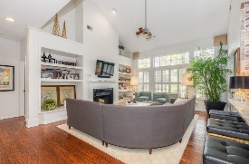
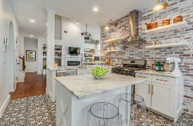
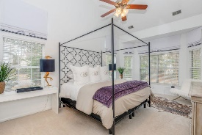
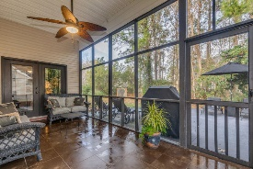
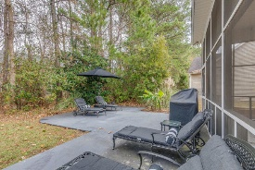

Stunning Park West Home
Come see it today!
2028 Andover Way
Mount Pleasant ~ MLS# 19001836 ~ $448,000
You'll love this Beautiful 4 bdrm, 2.5 BA, plus FROG, home located in desirable Park West. Stunning kitchen remodel in 2018 featuring Brazilian quartzite counters, brick feature wall, artisan porcelain tile floor,bright white shaker doors and drawers with soft close hinges & brushed gold hardware. Custom window treatments and designer lighting throughout house, all conveys! Enjoy the large screened in porch and outdoor patio while looking over your very private, wooded backyard. Great for entertaining! Plus, freshly painted throughout, new HVAC and garage door in 2017, new hot water heater 2016, New roof 2013 and many more upgrades and designer touches throughout! Very well maintained and move in ready.
Angela Armstrong
843-224-2595
angela.armstrong2010@gmail.com

