Slide 1
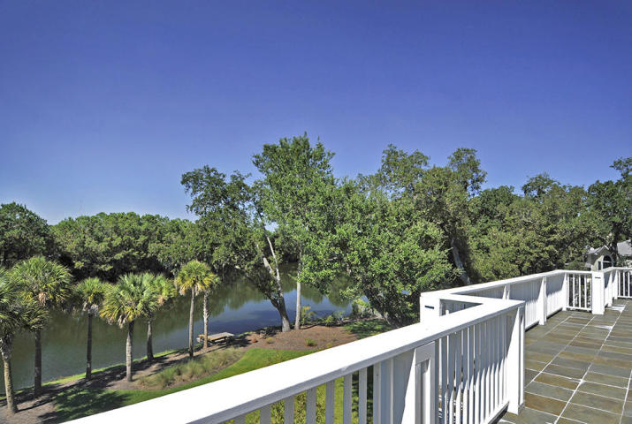
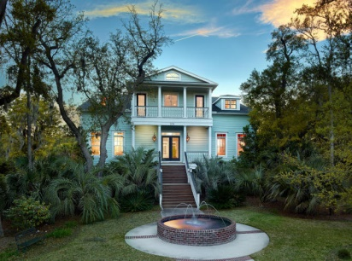
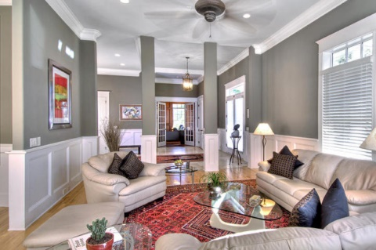
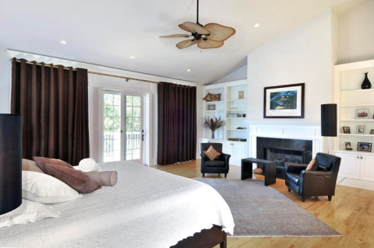
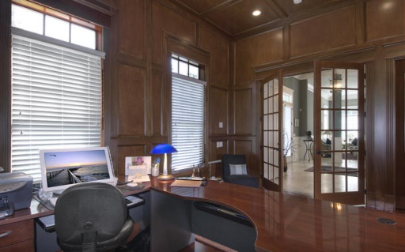
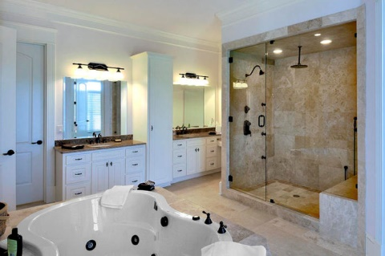
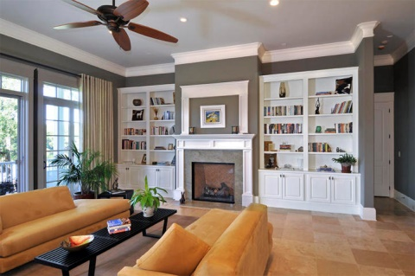
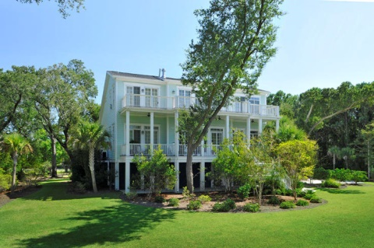
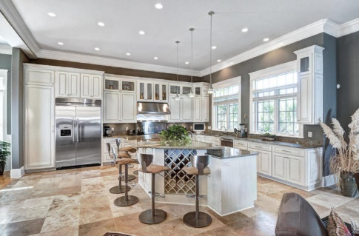
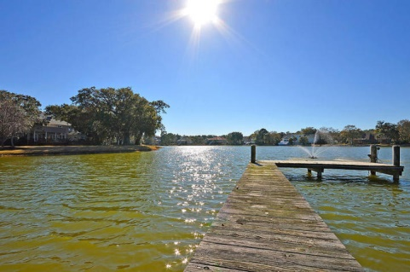
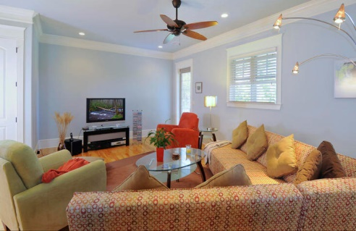
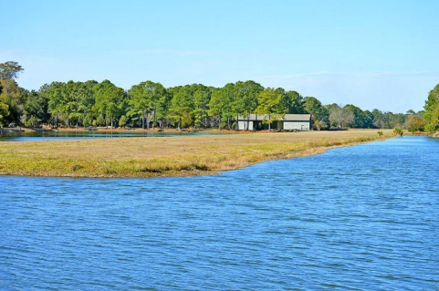

Reduced by $100k
2028 Azimuth Court
Ravens Run ~ Mount Pleasant ~ MLS# 15006712 ~ $1,495,000
This breathtaking lake-view 5 bedroom, 5.5 bath custom home is located in the Raven's Run community, Mount Pleasant's only fly in/out community that features its very own private airstrip. The house offers all of the relaxation a classic Lowcountry home has to offer. Entering into the home, you are instantly taken aback by the welcoming, open floor plan that provides ample natural light. The gourmet kitchen opens up to the dining area and spacious living room centered on the cozy fireplace. The kitchen boasts stainless steel Thermador appliances, a center island that seats up to six, and easy access to an outdoor deck fully equipped with a grill, sink, and small refrigerator. The first floor also features a stately study with wood paneling, which can also be used as an extra bedroom, and a full bedroom suiteâ€”ideal for out-of-town guests. The hydraulic elevator whisks you to the second floor to the sprawling master suite, which impresses with its own fireplace, terrace, and walk-in closets. The master bathroom is truly a dream come true. It highlights a large custom stone shower and enormous Jacuzzi tub that is centered between gorgeous white columns. The second floor also has 2 additional guest suites and a media room, which also offers lovely lake views from the second floor verandas. The large yard boasts lakefront vistas, a private dock, and beautiful landscaping. For collectors, the garage holds 8-10 cars and offers ample storage room. Raven's Run is a diverse and exciting gated community offering innumerable amenities including tennis, racquetball, basketball and volleyball courts. The neighborhood also offers complimentary boat storage for owners, allowing easy access to the water via a number of boat launches in the area. The lake offers fishing and crabbing both from private homeowners' docks and off a private island in the lake only accessible by boat. This Mount Pleasant oasis is within walking distance to Towne Centre, only 2 miles from the beaches of Isle of Palms and Sullivan's Island, and a short 15-minute drive from Downtown Charleston. Buyer pays a transfer fee of 0.25% of sales price.
Nate Gainey nate@mattoneillteam.com 843-513-2038

