Slide 1
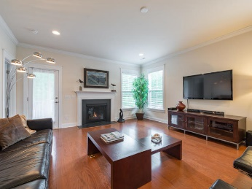
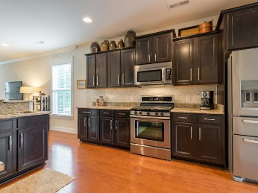
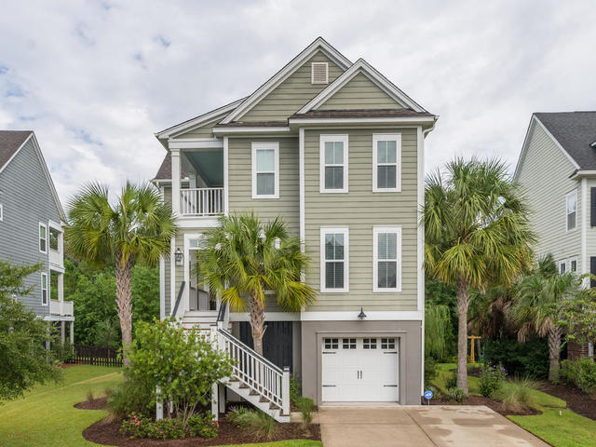
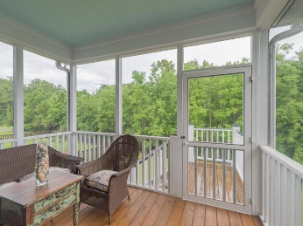
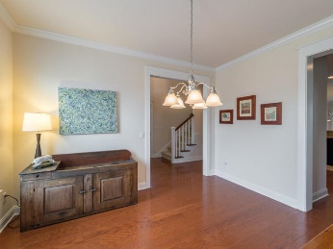
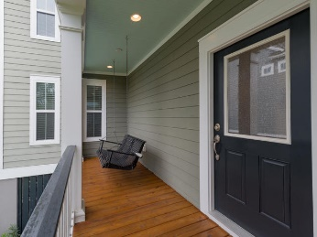
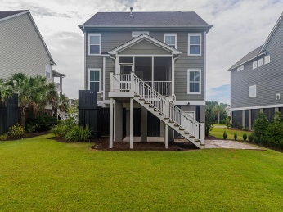
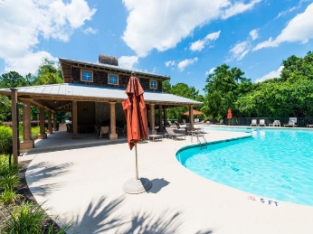
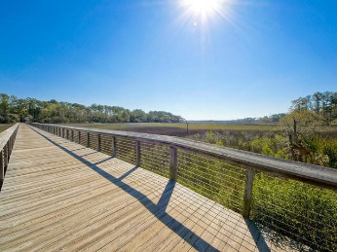

Just Listed: Daniel Island Area - Shellring at St. Thomas
202 Clouter Creek Drive
Charleston ~ MLS# 16025087 ~ $517,500
202 Clouter Creek Drive is located in the high demand subdivision of Shellring at St. Thomas within The Daniel Island area ~ Home has been barely lived in and has been impeccably maintained ~ One of the more private lots in Shellring ~ This subdivision is zoned for Daniel Island schools ~ Curb and interior appeal at every turn ~ Gas lanterns, palms blowing in the breeze ~ Elevated style 4 bedroom, 3.5 baths with garage parking for 2 cars, boat storage, kayaks and much more ~ $30,000 in owner paid builder upgrades including extra wide driveway for parking, gas stove, screened porch, cultured marble bath counters, raised hall bath vanity, brushed stainless steel fixtures, upgraded lighting, upgraded shower, door levers, HD TV pre-wiring, garage upgrades, 5" hardwood flooring, upgraded carpet, additional crown molding, upgraded cabinets, and additional granite ~ Owner has also spent $14,000 in additional upgrades after move-in ~ $10,000 landscaping, $2,000 window treatments, $1500 marble chicklet kitchen backsplash, and $500 backyard patio ~ Dining room has beautiful transom windows ~ Kitchen has lots of cabinetry for storage plus a large pantry, a breakfast bar, granite counter-tops, whirlpool stainless steel appliances including a gas stove ~ Den which is open to the kitchen has a gas fireplace ~ Master suite is spacious and is fully equipped ~ Upstairs features include a huge bonus room with side porch, 3 bedrooms with walk-in closets, 2 full baths (one of which is a Jack-and-Jill), and a laundry closet ~
Other items of note: a Rinnai tankless hot water heater, open floor plan, plenty of natural light, lots of extra storage on each floor, dual HVAC controls, large walk-in closets, termite contract with bait system ~ Serene views from the screened in porch of the private, wooded backyard including a pond with a lovely footbridge to the left ~ The neighborhood pool is only approximately 300 yards away ~ The side trail next to the pool connects to the 27 miles of Daniel Island trails, perfect for taking a ride on your golf cart to Governor's Park or the clubhouse, walking/ jogging trails, fishing pier, shopping, the Wando River boardwalk, library, grocery, schools, restaurants, and the popular Volvo Car Stadium for events and concerts ~
Aviles Real Estate Brokerage
Susan Aviles
843-697-2383
www.Aviles-RealEstate.com

