Slide 1
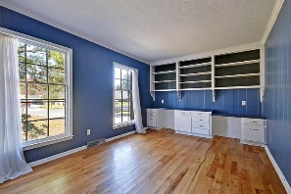
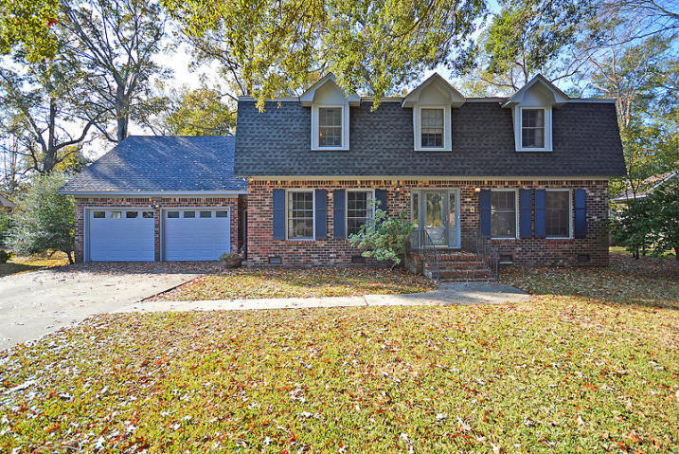
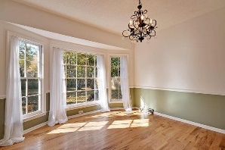
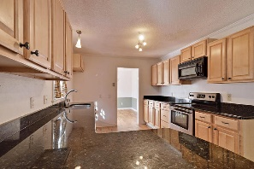
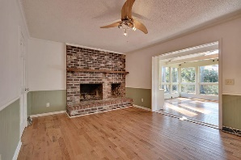
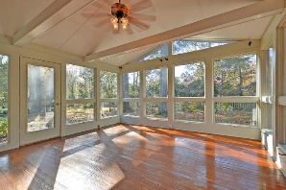
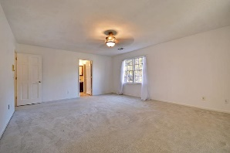
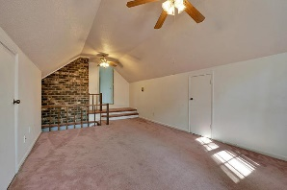
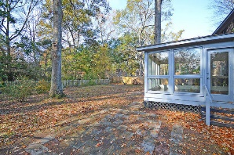
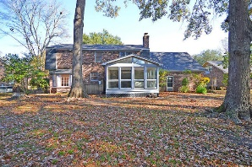

202 Fort Street Ashborough ~ Summerville, SC 29485 MLS# 16030736 ~ $279,999
Gorgeous Yard in Ashborough!
Loaded with Updates
Beautiful 4 bedroom, 2.5 bath home is Ashborough! The majestic Live Oak Tree in the front yard is breathtaking! When entering the home you are greeted with handsome hardwood floors throughout the main level.
Many upgrades-granite and stainless steel appliances in kitchen, updated guest bath, updated master bath! FROG could be 5th bedroom! The sun room is perfect for having a second eating/entertaining area that overlooks a private backyard. NEW ROOF in 2016! NO DAMAGE 100 yr. rain or Hurricane Matthew!
Ashborough is a wonderful community with a play park, tennis courts and pool! The neighborhood is close to local shopping and is a short drive to downtown Charleston with 5-star restaurants, world class shopping and iconic history and a short drive to the beaches, the airport, and Boeing!
Stan Huff
843-670-2835 stan.huff@agentowned.com
Jill Marcacci
843-297-5590 jill@agentowned.com
www.agentownedrealty.com
AgentOwned Realty Co. Preferred Group, Inc. | 824 Johnnie Dodds Blvd | Mt Pleasant, SC 29464

