Slide 1
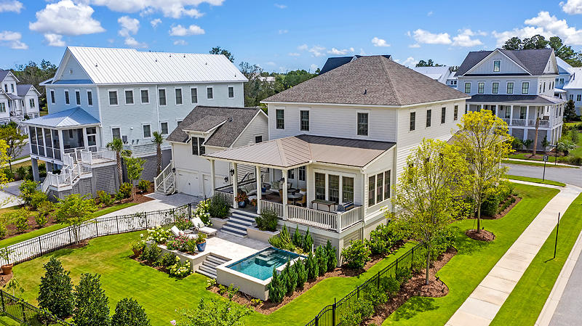

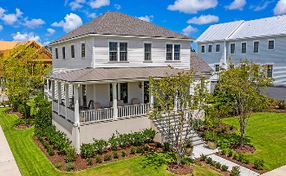
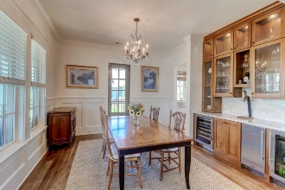
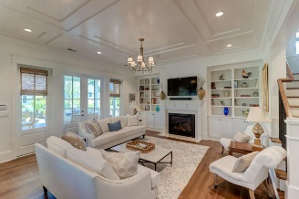
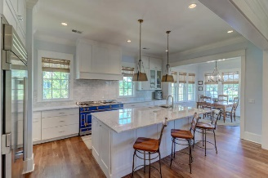
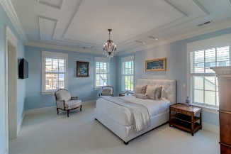
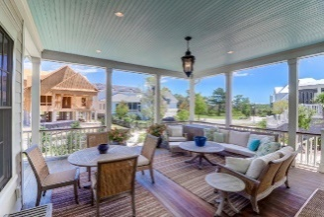
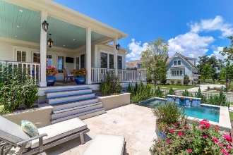
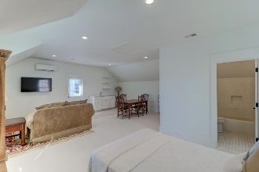
Daniel Island Park With Pool - $1,400,000
202 Foundry Street Daniel Island Park | Charleston | MLS# 20021048 | $1,400,000
Entertainer's dream home nestled on a quiet street in the Lowcountry's premier golf course community of Daniel Island. Custom built in 2018, this 4 bed, 3.5 bath coastal home is located on a corner lot in Nobel's Point and is perfectly situated between the golf course, the marsh and Ralston Creek. It's also walking distance to the private boat dock accessible only to homeowners of Nobel's Point and the newly finished play park. Features of this home include the open floor plan with an abundance of natural light, white oak flooring throughout the main level, and a gourmet kitchen with large center island, top of the line appliances, a walk-in pantry, and a cozy eat-in area. This home also has a first floor home office with custom built-in desk and cabinets, and a separate dining room with custom built-in cabinet with glass front doors and a stainless TRUE commercial style wine fridge, beverage fridge and ice maker. The highlight of this home is the amazing outdoor space, which is perfect for enjoying year round. The expansive back porch and grilling deck overlook a backyard oasis with a 9 x 12 elevated saltwater pool with fountain feature, raised planters, and travertine patio. Enjoy a cup of tea or a glass of wine in the evening with friends and family while watching the sunset from the large bluestone wraparound front porch. The spacious light filled second floor master suite boasts a custom designed ceiling and his/her walk-in closets with custom built-ins. The luxurious master bath features dual vanities, walk-in shower and a stand alone tub. The detached FROG with private entrance, has a full bathroom, closet with custom built-ins and a kitchenette making it the perfect space for teens, guests, second home office or potential rental income. Daniel Island Park amenities include 2 private golf courses, 2 resort style pools with cabana bar and fire pit area, 15 tennis courts, and a state of the art fitness center. Community amenities include miles of walking/biking trails, multiple playgrounds, shops, restaurants and the Family Circle Tennis Center - a great venue for concerts and sporting events.
Video Tour: https://vimeo.com/441516978
Paige Rhodes 843-830-3281 paige.rhodes@carolinaoneplus.com

