Slide 1
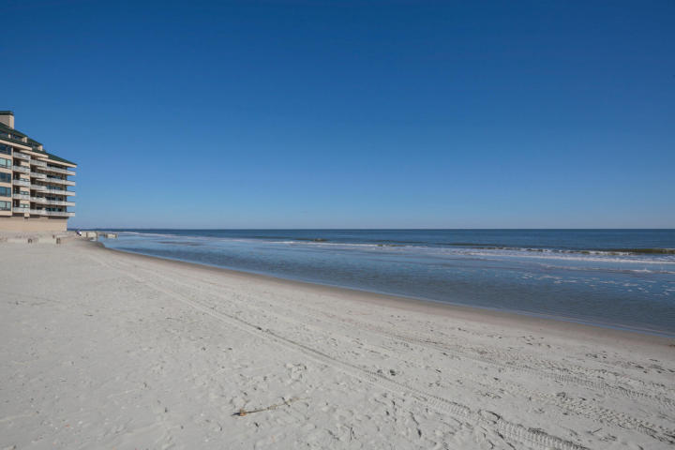
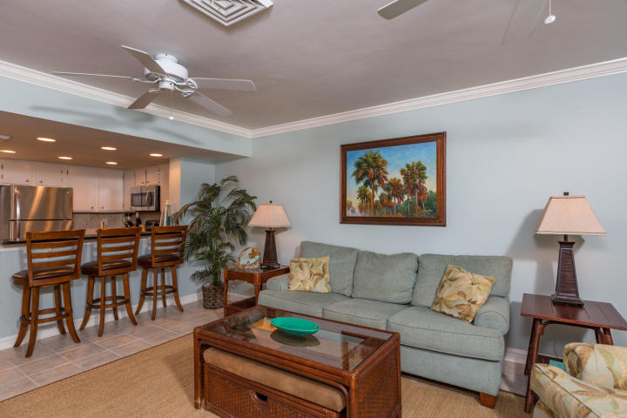
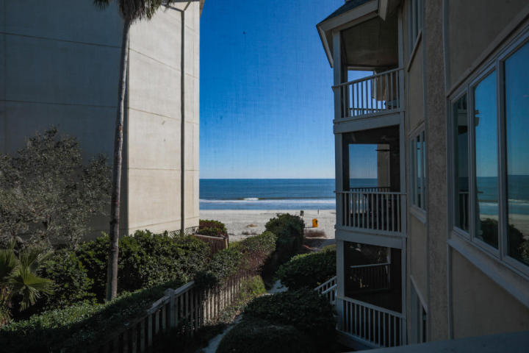
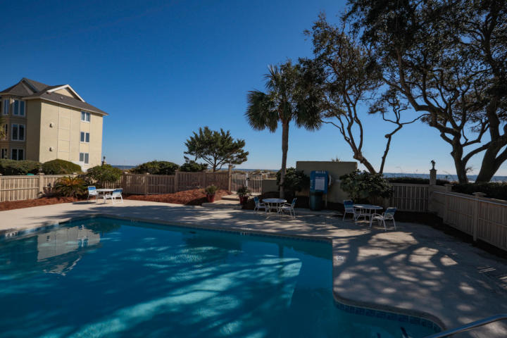
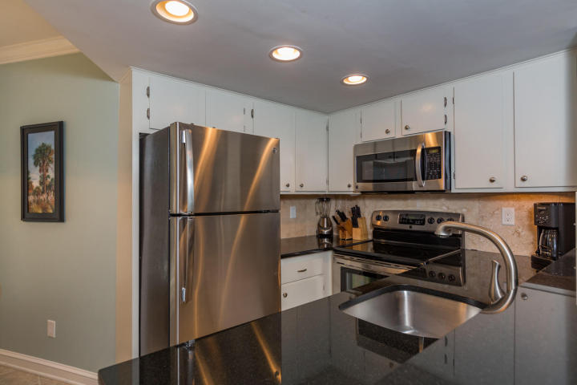
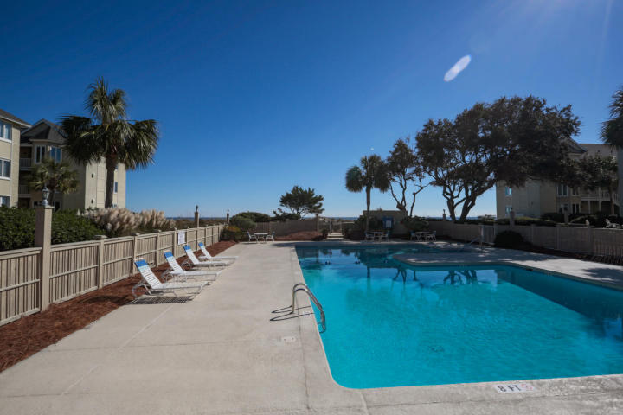
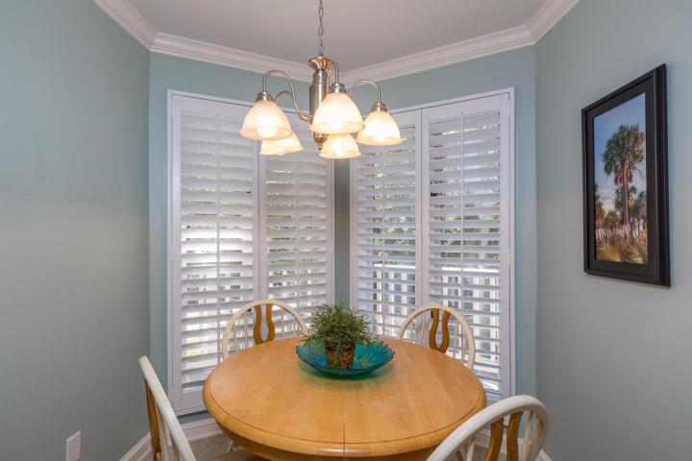
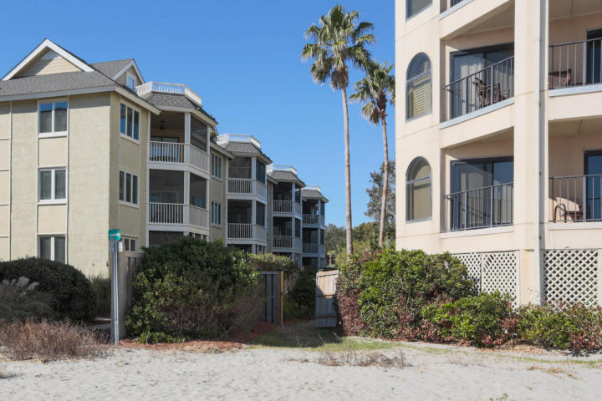
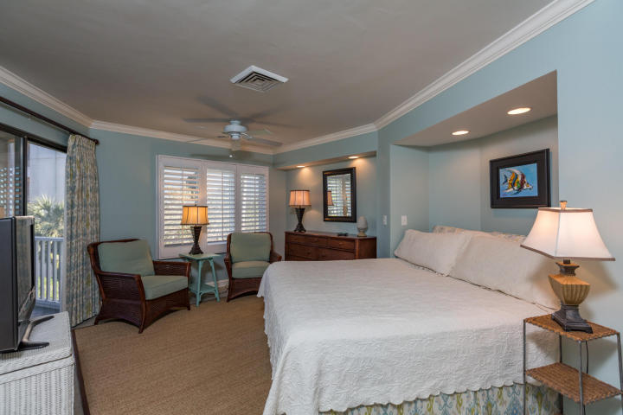
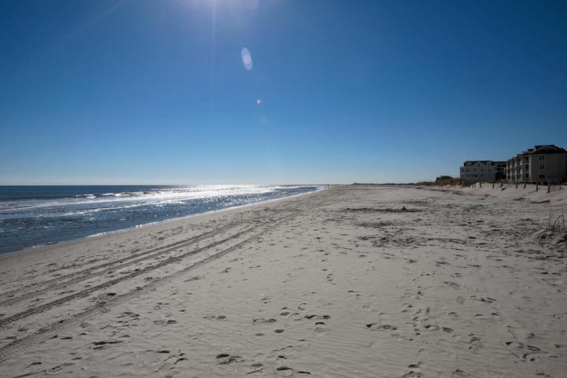
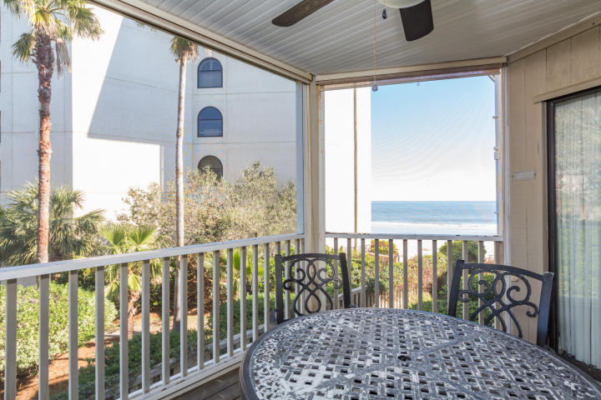
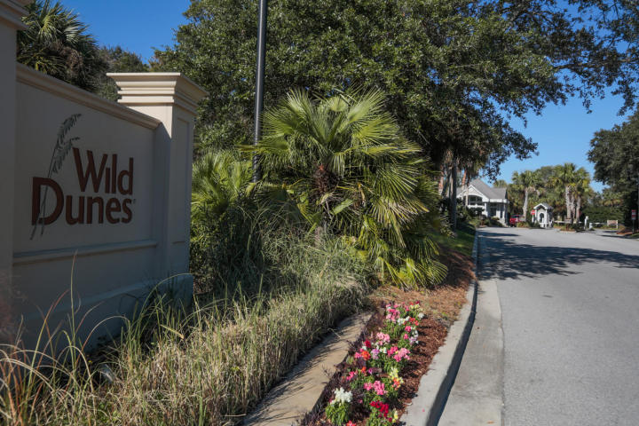


Oceanview Condo Wild Dunes- Great Rental!!
202 Port O'Call G
Isle of Palms, SC 29451
MLS# 16030030 ~ $404,900
Gorgeously furnished, turnkey condo with a killer oceanview! This second floor unit is just steps from the ocean. Listen to the waves crash as you relax and enjoy the view. Fantastic rental income! Have a place of your own at the beach for when you like and let someone else pay for it the rest of the time. Completely updated the unit features crown molding and plantation shutters throughout, granite counters and stainless appliances in the kitchen, can lighting, and tiled floors. The furniture has a subtle coastal flair and is accented with soft blues and greens. New HVAC system Jan 2016/new washer April 2016/new refrigerator Aug 2015/new dryer Sept 2014. Sold furnished. Buildings have elevators. Buyer to pay 1/2 of 1% transfer fee to Wild Dunes at closing.
Keller Williams Realty Charleston West Ashley
1180 Sam Rittenberg Ste 105
Charleston, SC 29407
Amy Zonarich
Realtor
(843) 534-3523
amy@amyzonarich.com
www.liveandlovecharleston.com

