Slide 1
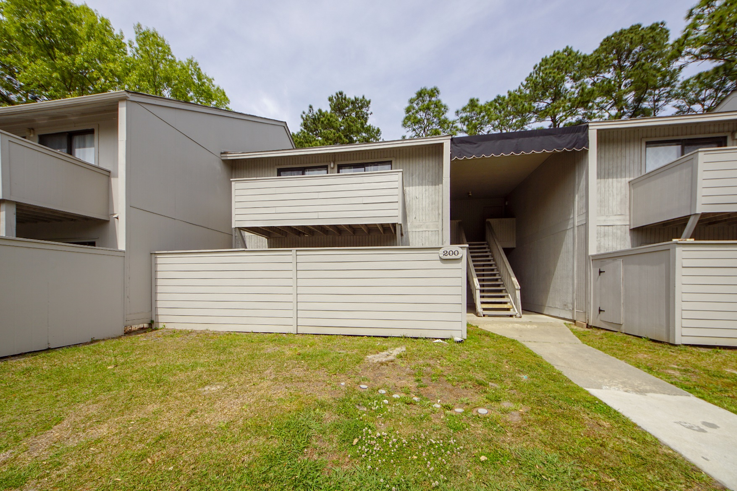
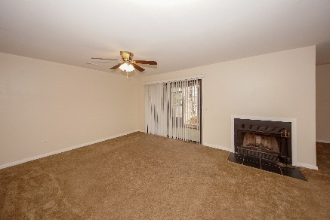
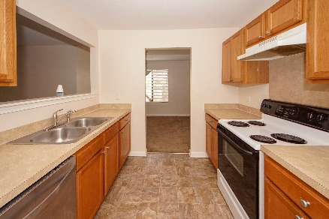
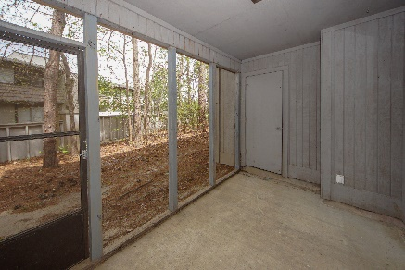


202 Green Castle Drive Greenslake Condominiums :: Goose Creek MLS# 19009487 :: $82,000 2 Bed / 2 Bath
Clean and move in ready!
2.67 Acres!
First floor condo has a spacious living room with fire place, dining room and is a 2 bedroom 2 bath.
New carpet and fresh paint make this condo ready for the new owner!
Connie White, Broker
843-532-3356
connie@chrepros.com · conniewhiterealestate.com
Charleston Homes · 597 Old Mt. Holly Road · Suite 301 · Goose Creek, SC 29445

