Slide 1

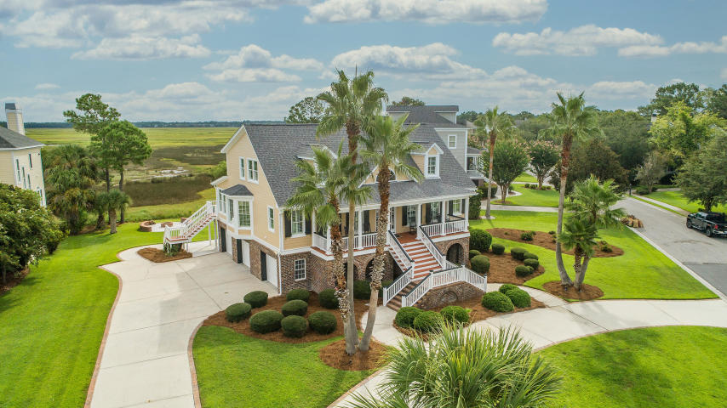
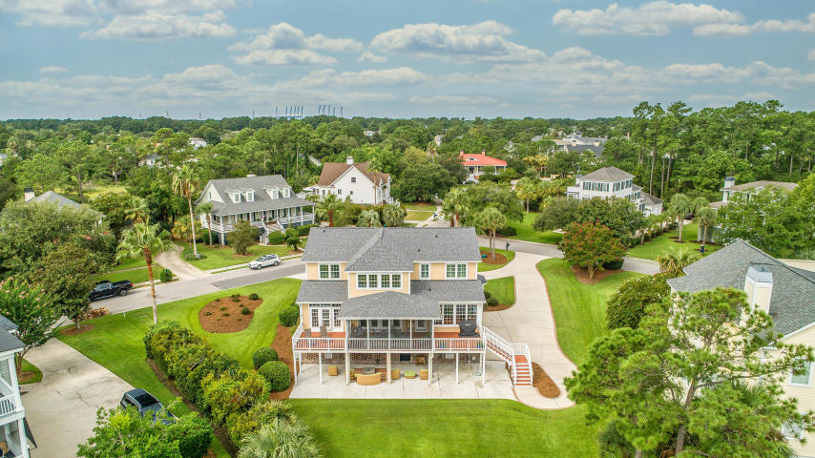
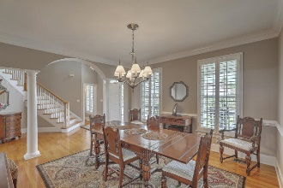
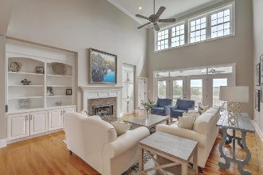
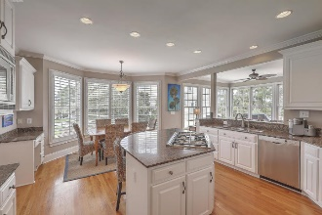
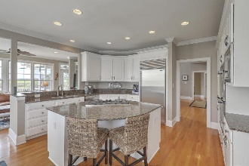
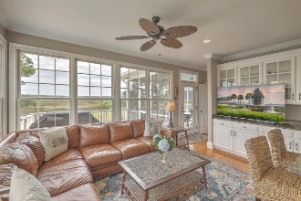
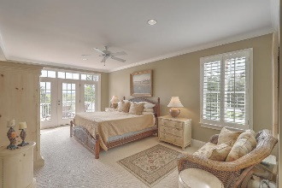
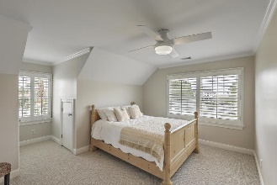
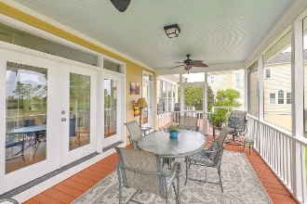
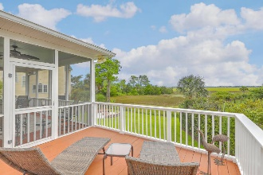
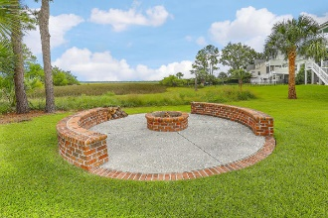


Amazing Views and Location
202 Island Point Court
Belle Hall | Mount Pleasant, SC 29464 | MLS# 20023472 | $1,100,000
Timeless Elegance and stunning views from almost every room in the house! Welcome to The Island at Belle Hall Plantation and this classic southern home designed by award-winning designer Hilton Googe. Graciously situated on over half an acre to soak in the expansive views of the Lowcountry marshes and Wando River. This well built home has been exceptionally maintained by its one owner. Enter the vaulted foyer into the large family room complete with gas fireplace and built-ins and see the amazing views through large windows and french doors. The well appointed kitchen is equipped with a Counter Depth SUBZERO Refrigerator, Double Dacor Wall ovens, a five-burner gas Dacor Cooktop, Bosch Dishwasher, stainless steel sink and plenty of cabinet space. Just off the kitchen is a Wet Bar for entertaining and a cozy sitting area to relax with your guests. There are two open decks and a large screened porch across the back of the home as well as a very spacious, 2200 sq ft, 3 car garage and extensive driveway space. First floor Master ensuite includes jetted tub, tiled shower and vanity with dual sinks.
New Roof in 2016, New 3 1/2 ton and 2 1/2 ton HVAC in 2018 as well as new ductwork in attic. Exterior painted in 2019. Underground electric fence for two dogs in place. Large, custom built fire pit and outdoor entertaining area with beautiful tabby concrete patio to enjoy an evening with friends and family.
Belle Hall amenities include an Olympic pool, Tennis Courts, Clubhouse, a playground, parks and walking/jogging trails.
Located right off of 1-526 with shopping nearby including Chick-Fil-A, Starbucks, grocery store, retail stores and restaurants. 20 minutes to downtown Charleston and the airport.
Video Tour: https://vimeo.com/451197160
Robin Windham
843-991-6672
robinwindham67@gmail.com
The Boulevard Company, LLC
806 Johnnie Dodds Blvd Ste 100
Mt Pleasant, SC 29464

