Slide 1

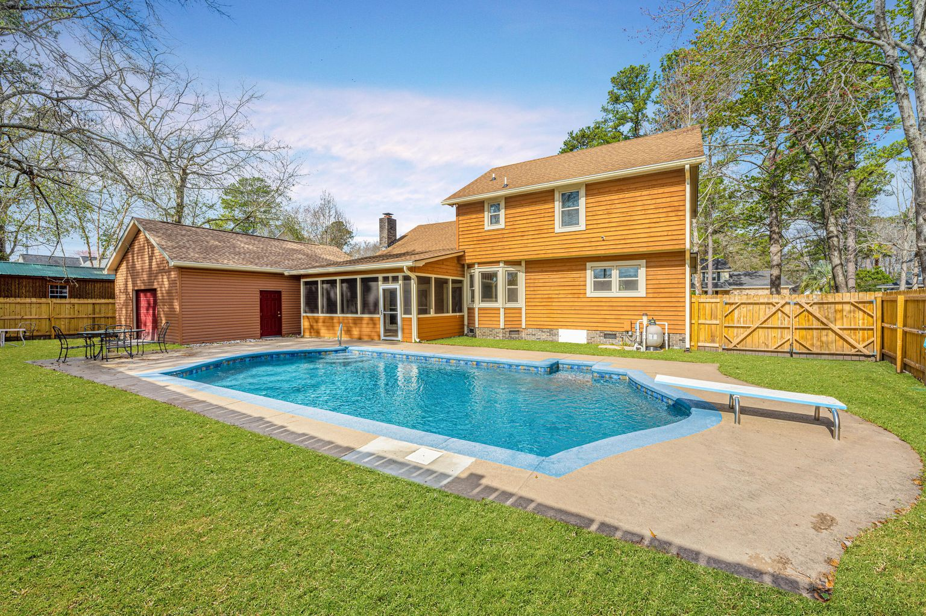
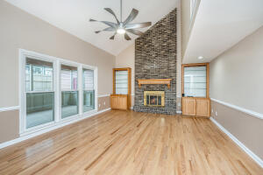
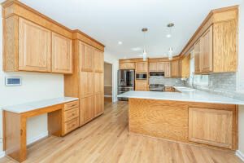
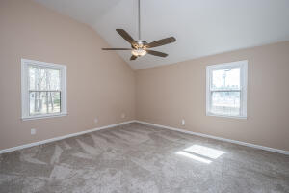
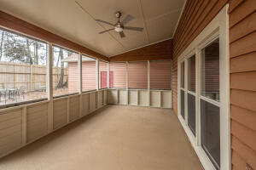
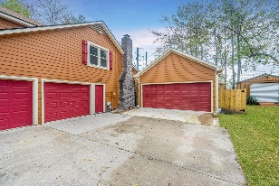


Totally Remodeled!! Inground Gunite Pool!! 4 Car Garage/Workshop!!
202 Dundee Street
South Pointe ~ Summerville, SC 29483
MLS# 22004514 ~ $575,000
Located conveniently off 78 near downtown Summerville and Hwy 26, in Southpoint neighborhood. Sellers planned on staying and spared no expense on renovating this beautiful home. From the real hardwood flowing throughout the main floor and living areas, up the stairs and hallway, to the gorgeous new kitchen with quartz counters, new LG appliances, marble tile backsplash, new light fixtures, new sink... all New! Windows have been replaced in entire house. New carpet. All 3 bathrooms were remodeled. Whole house was painted. Complete list of updates is available. Upon arrival you are greeted by the full front porch, inviting you in. Enter the spacious foyer, to the left is coat closed and formal dining room. To the Right is garage, stairs and entrance to the main living areas. Half bath is also located here. Enter into the kitchen which is a cooks dream! Gas range, plenty of cabinets and counter space, eat-in kitchen allowing for conversing with the cook at the bar area or table. Looking out the back at the inground pool will relax you! Family room is large with stone fireplace and shelving on each side. Entertaining can continue onto the screened porch or patio. This is the ideal home for entertaining! The detached 2 car garage 20' X 31' is set up with electric for workshop capabilities. Back inside and upstairs you will find the 4 bedrooms. Over the garage is a large bedroom with closet and storage, also where the laundry is located. Down the hall find the remodeled full bath, 2 large secondary bedrooms and the spacious owners suite. Master bedroom has vaulted ceiling, remodeled bath and walk in closet. Attached garage is epoxied and has hook up for laundry as another option. Crawl space is encapsulated! This home is ready for you to just move in! Call today for a showing and list of upgrades.
Laurie Loparo (843) 442-1290 | laurieloparo@gmail.com
www.lauriesellscharleston.com
Carolina One Real Estate | 873 Orleans Road, Ste 102 | Charleston, SC 29407-5753

