Slide 1
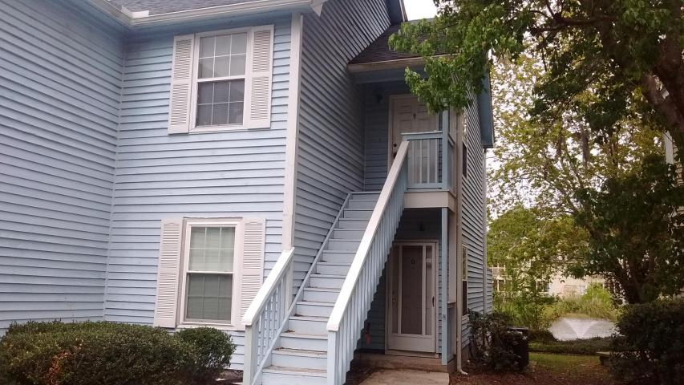
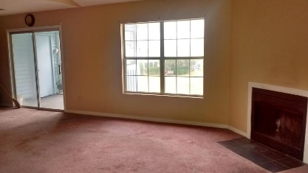
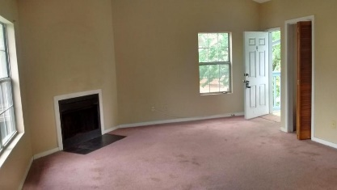
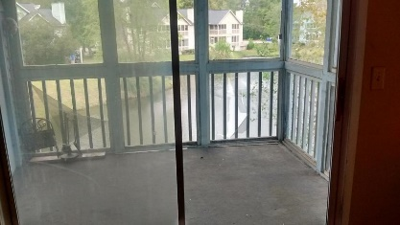
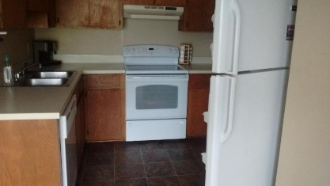
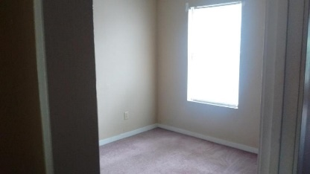
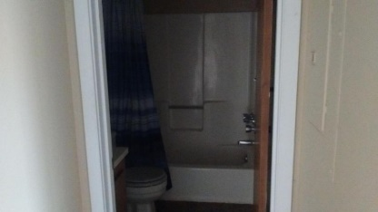
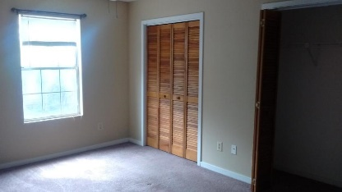
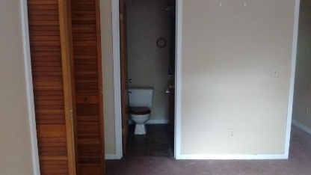

2030 Coldspring Drive H Woodhill Place ~ North Charleston ~ MLS# 17008931 ~ $59,900 2 Bedroom - 2 Bath - 945 Sq Ft
Adorable Condo Overlooking Duck Pond
Cute 2 bedroom, 2 bath condo with fireplace in quiet neighborhood.
Private screened in patio overlooks duck pond.
2nd floor unit.
Close to interstate, airport and shopping.
This is a short sale.
Edie Ashley
(843) 469-4355 M | (843) 261-7115 O edie.ashley@agentownedrealty.com
AgentOwned Realty Co. Premier Group, Inc. | 141 A N. Main St | Summerville, SC 29483

