Slide 1
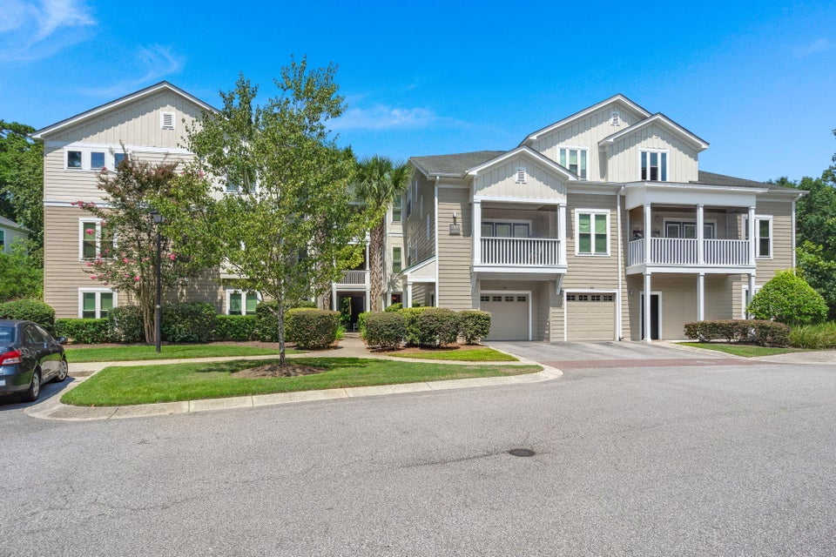
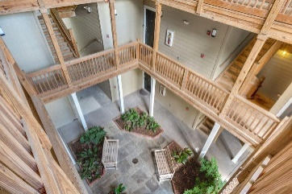
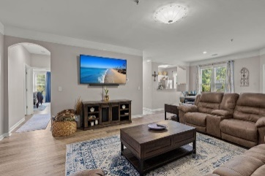
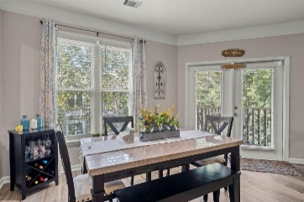
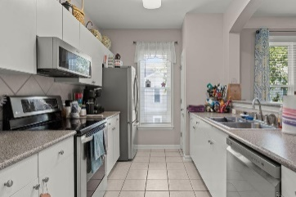
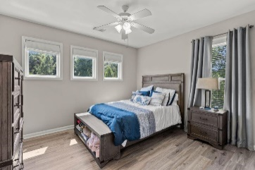
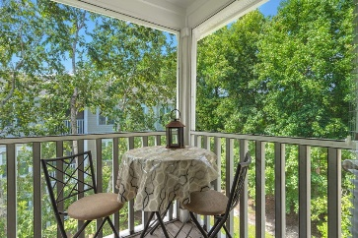
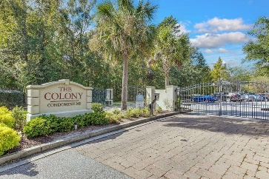
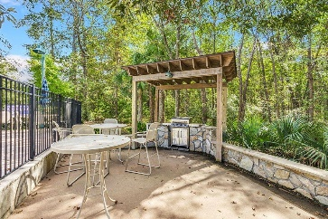
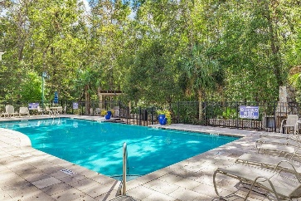
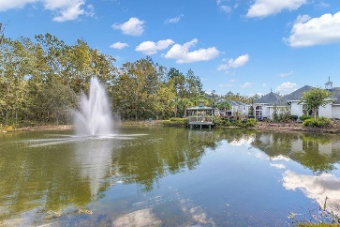



Top Floor Furnished Condo in West Ashley
2031 Egret Crest Lane
The Colony at Heron Reserve
Charleston, SC 29414
MLS# 24019829
$365,000
3 Bed | 2 Bath | 1,416 sf
Welcome to luxury living at The Colony at Heron Reserve! This stunning top floor 3-bedroom, 2-bathroom condo epitomizes comfort and style, boasting an array of modern upgrades and fantastic community amenities. The condo features spacious bedrooms, well-appointed bathrooms, and a charming screened-in porch perfect for enjoying serene views and fresh air without the bother of insects. You'll love the modern touches, including all-new appliances, fresh paint, stylish LVP flooring, and a brand new HVAC unit installed in 2020, ensuring your comfort year-round. As a bonus, the price includes all furniture, making this a truly turnkey opportunity.
Nestled within a gated community, this home offers peace of mind and security. Enjoy leisurely days by the pool, strolls through the park, and social gatherings at the club house. Additional storage space is available for your convenience. Don't miss your chance to own a beautifully updated condo in a desirable community with exceptional amenities. Contact us today to schedule a viewing and make this incredible home yours!
Nick Mazzilli
(843) 640-5575
nick@themazzilliteam.com
nickmavencharleston.com
Maven Realty
2180 McMillan Ave
#71672
Charleston, SC 29405

