Slide 1
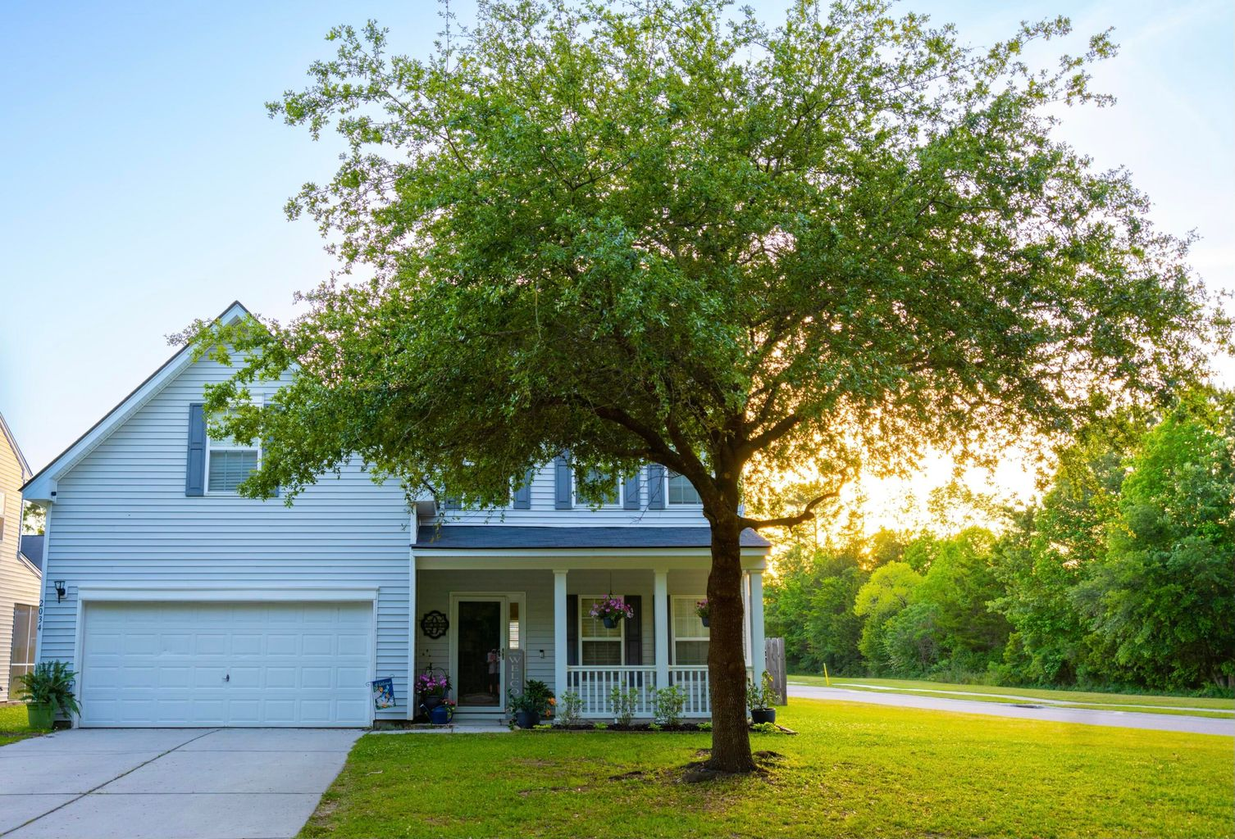
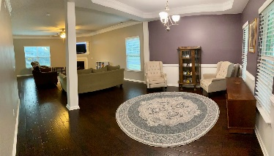
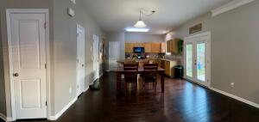
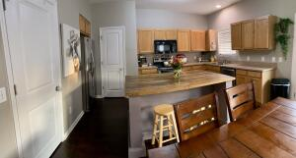
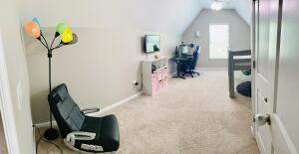
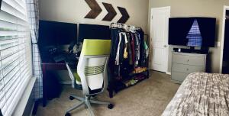
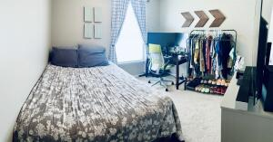
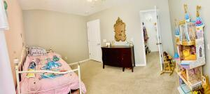
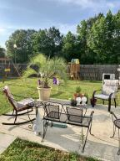


2034 Asher Loop Legend Oaks Plantation Summerville, SC 29485 MLS# 22011408 ~ $399,900
Just Listed
Home located in Legend Oaks Plantation on large corner lot. Has open floor plan with 4 bedroom and 2.5 baths. Engineered hardwood throughout downstairs and carpet upstairs in all bedrooms. Kitchen has 42 inch cabinets with a pantry. All appliances including washer and dryer stay with home. Roof and HVAC were both replaced in 2021.
Bonnie Dickson 864-219-1674
bonnie.dickson@gmail.com
AgentOwned Realty Co. Premier Group, Inc.
141 A N. Main Street
Summerville, SC 29483

