Slide 1
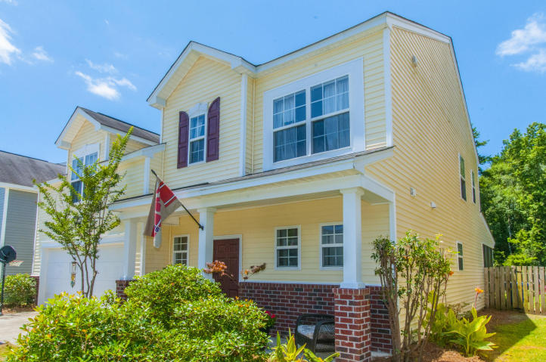
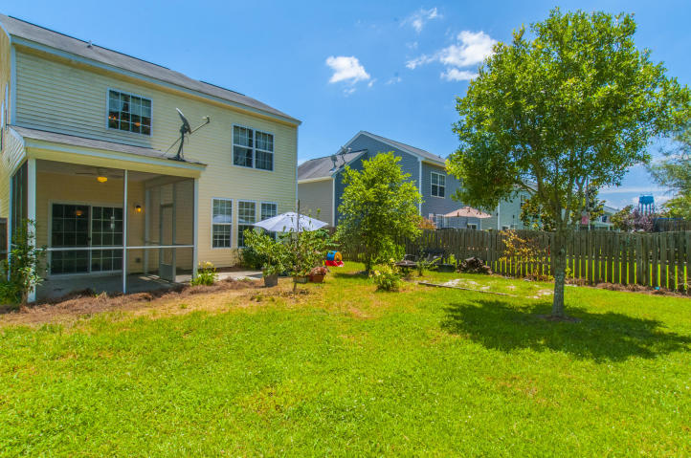
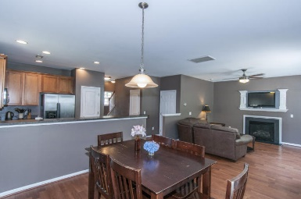
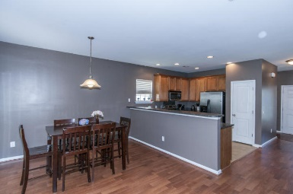
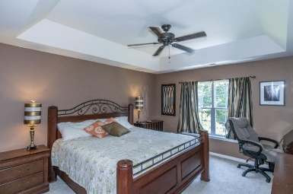
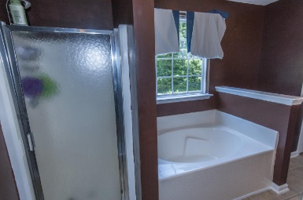
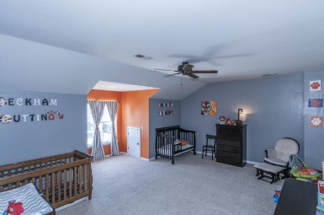
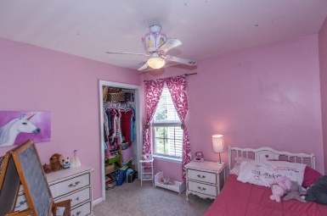
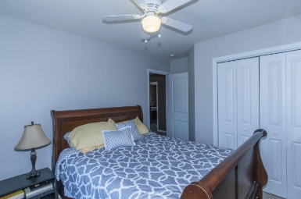
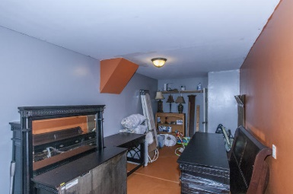


2035 Asher Loop
Summerville, SC 29485 ~ MLS# 16015848 ~ $225,000
Motivated seller in Legend Oaks
OPEN HOUSE CANCELED
Welcome to this lovely 2 story home on a quaint street in the desirable Legend Oak Community! It is located in the highly rated Dorchester District 2 schools and walking distance to the elementary school. Upon entering you will find an open, flowing floor plan that is perfect for family gatherings or entertaining! The spacious, open kitchen views the ample eat in and the family room. There is a gas fireplace, warm wood floors and also a screened rear patio. The garage has a conversion that can be for the children to play, a home office or an in law suite.Upstairs you will find a large master bed room with an over sized tray ceiling, large bath with dual vanities, garden tub and a stand up shower. There is a huge FROG / Bedroom, 2 nice sized bedrooms and full bath. This is a must see home.
Christopher McCormick
Office - 843-974-6200
Cell - 843-224-3204
cjmccormick@carolinaone.com
Carolina One Real Estate
900 N Main St
Summerville, SC 29483

