Slide 1
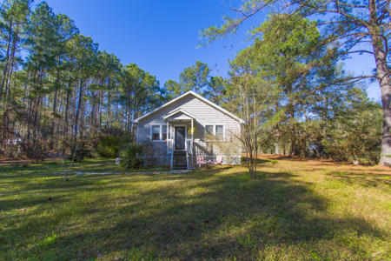


Virtual Open House
Fresh Air In The County
New Price!
2036 Charity Church Road
Huger, SC 29450 ~ MLS# 20003530 ~ $229,900
I will be hosting a virtual walkthrough this Sunday from 11am to 1pm. Please click the link below to join my Zoom presentation to explore this wonderful home and location and ask questions using the chat feature.
Join Zoom Meeting
https://us04web.zoom.us/j/2056785363
Listing info:
https://www.flexmls.com/share/3HMEj/2036-Charity-Church-Road-Huger-SC-29450
Christine DeCocker
(843) 860-9972
ttlrealtor@gmail.com
ERA Wilder Realty, 125-F Wappoo Creek Dr, Charleston, SC 29412

