Slide 1
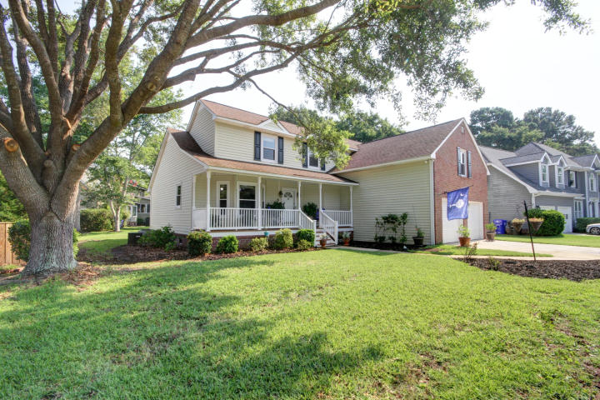
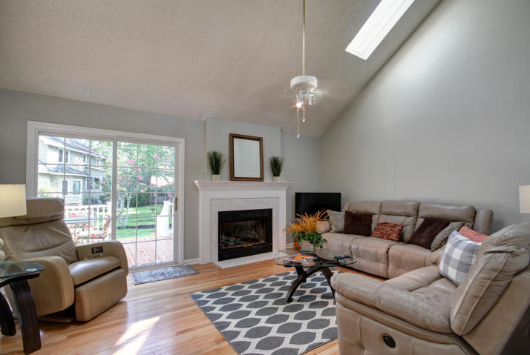
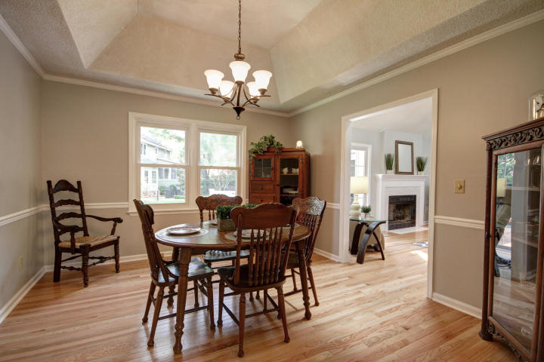
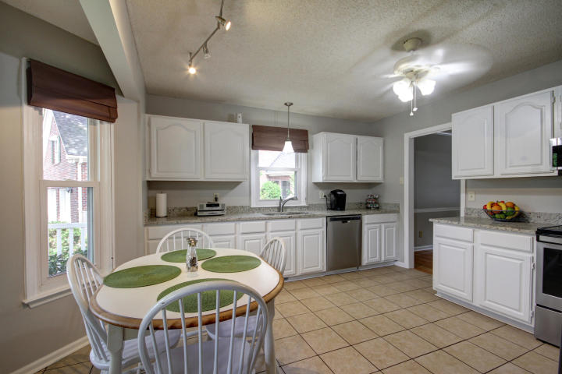
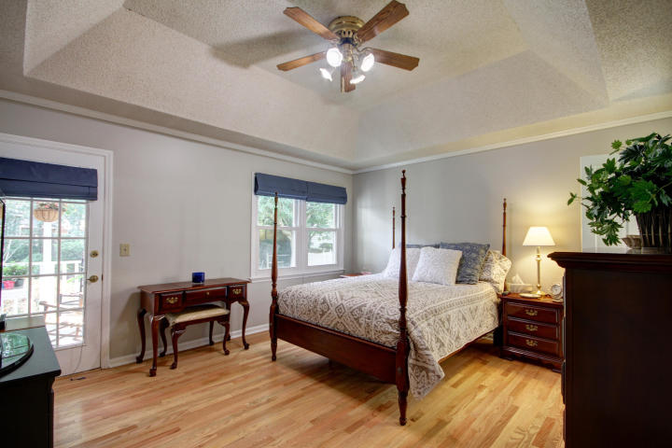
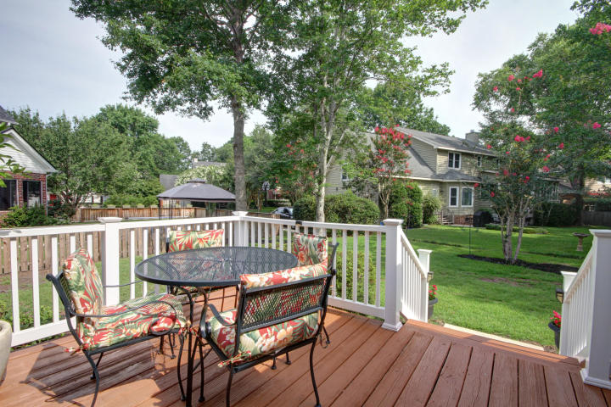

Updated Beautiful Home in Longpoint
This Beautiful Home Is Move In Ready!
Centrally located minutes to downtown or the beach, Longpoint is the perfect location! And this house feels and looks new but NO WAIT ON NEW CONSTRUCTION for you buyer. This is LowCountry Living at its finest in beautiful Longpoint. Bring your buyer today!
A Lender Credit of $2,000 is available and will be applied towards the buyer's closing and pre-paid costs if the buyer chooses to use the seller's preferred lender. This credit is in addition to any negotiated seller concessions.
2036 Middleburg Lane
Mount Pleasant, SC 29464
MLS# 19019519 | $475,000
Geri Lipps Carolina One Real Estate
843.810.8398 glipps@carolinaone.com

