Slide 1
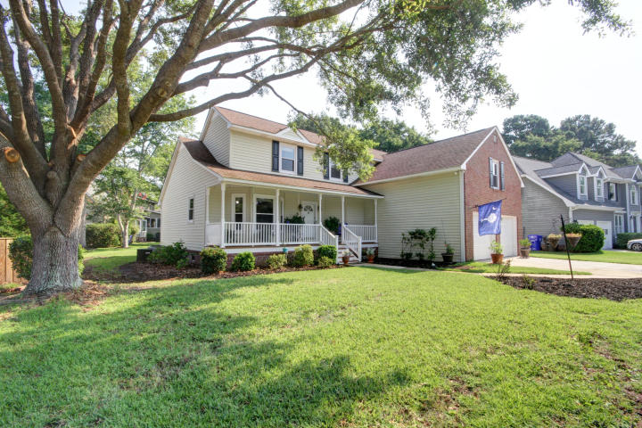
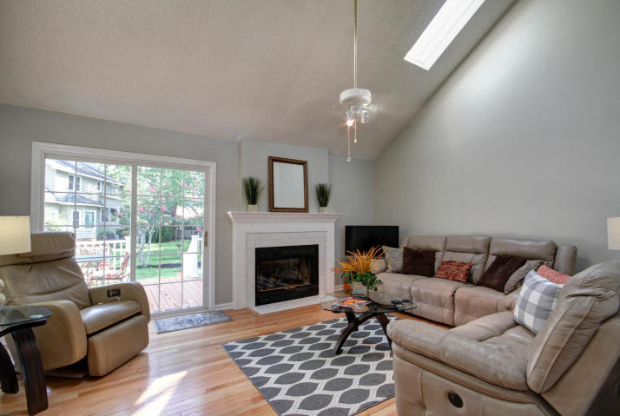
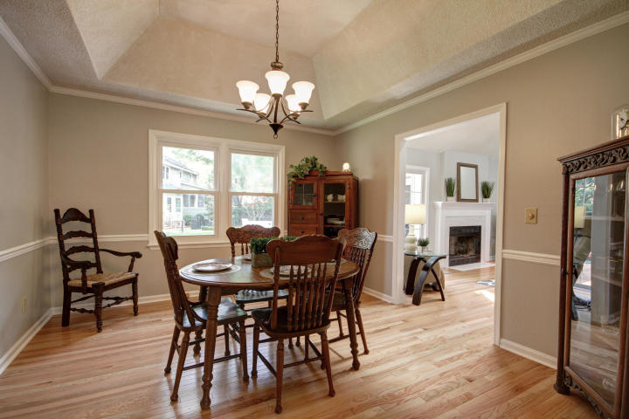
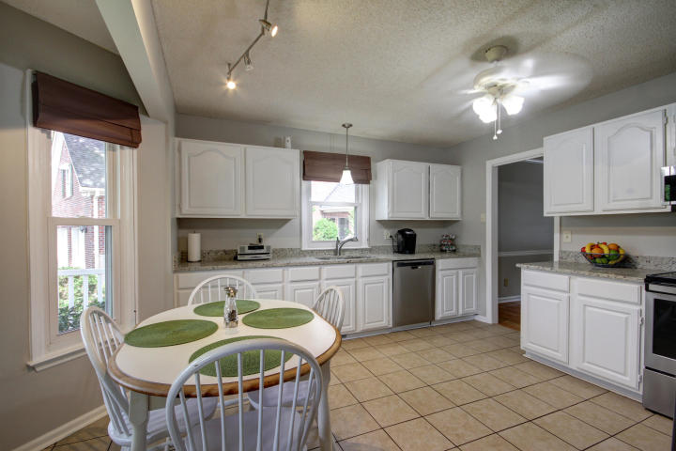
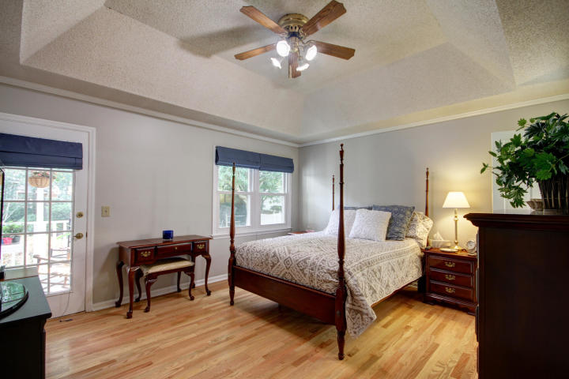
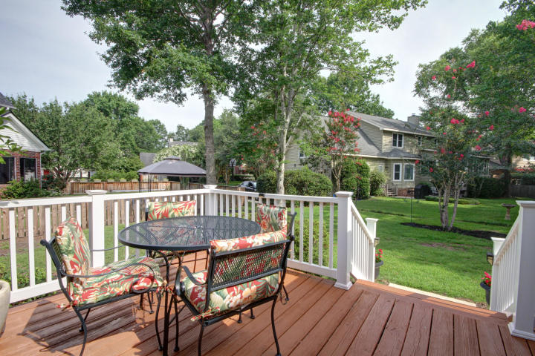

Updated Beautiful Home in Longpoint
Price Reduced to $470,000
This Beautiful Home Is Move In Ready!
This beautiful HOME is Move in Ready with updates throughout! True hardwoods and high level engineered hardwoods on the main level. MBR down, newer vinyl windows, fresh paint throughout on walls and trim, updated cabinets and appliances, screen porch and 2 car garage-EVERYTHING on your buyers list!
A Lender Credit of $2,000 is available and will be applied towards the buyer's closing and pre-paid costs if the buyer chooses to use the seller's preferred lender. This credit is in addition to any negotiated seller concessions.
2036 Middleburg Lane
Mount Pleasant, SC 29464
MLS# 19019519
Geri Lipps Carolina One Real Estate
843.810.8398 glipps@carolinaone.com

