Slide 1
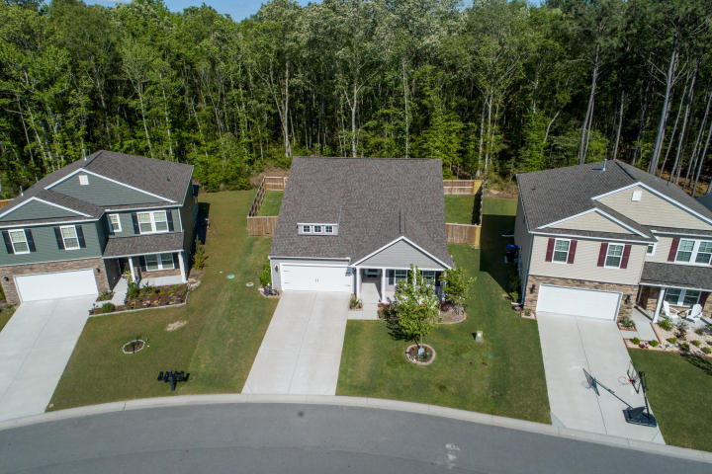
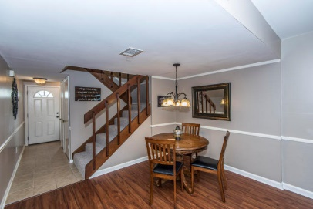
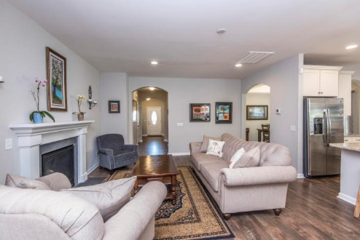
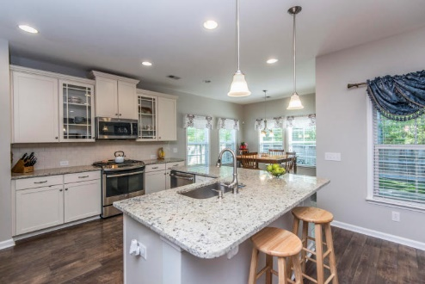
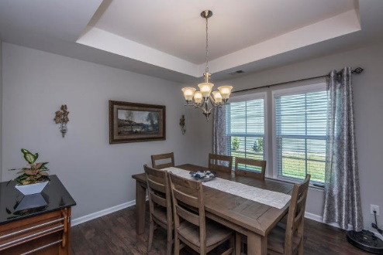
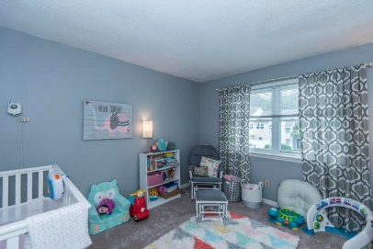
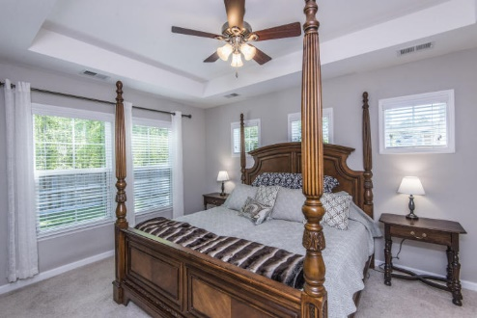
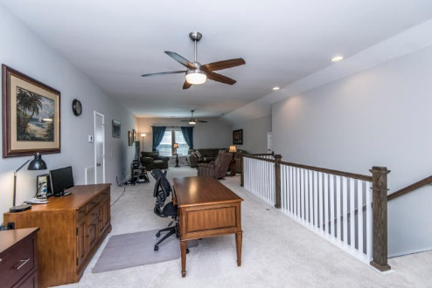
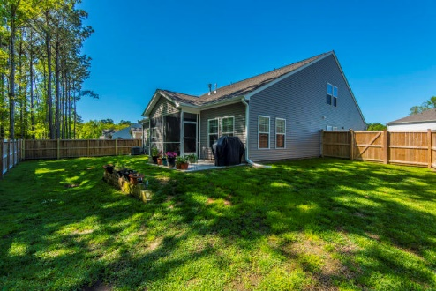


Why wait for new construction?
This Mt. Pleasant home is 2 years old and looks like a model.
2036 Welsh Pony Dr
Tupelo Plantation
Mt Pleasant, SC 29429
MLS# 18010643
$450,000
This townhouse is the perfect LOCATION. You are close to Shem Creek, Trader Joe's and Whole Foods.
This townhouse has been freshly painted and just had a new hot water heater installed. The backyard has been regraded and added new sod and a new fence.
Downstairs has Smartcore luxury vinyl waterproof tile and upstairs has new carpet. Home has been inspected and repairs made. Roof was replaced in 2014 and HVAC in 2012.
This is the Litchfield floorplan by Cal Atlantic Homes and was at one time going to be the model home. It shows like a model! This 3 bedroom, 2 bath home boasts an open floor plan as well as a master bedroom downstairs. There is also a huge about 700 sq foot loft on the second story that sellers are using as an office and an entertainment room. I must also mention the beautiful kitchen with granite countertops, gas range, subway tile backsplash among other finishes.
Check out the virtual tour for more images:
https://my.matterport.com/show/?m=b65778rvdN3
Del Shaffer
843.408.6821
dshaffer@carolinaoneplus.com

