Slide 1
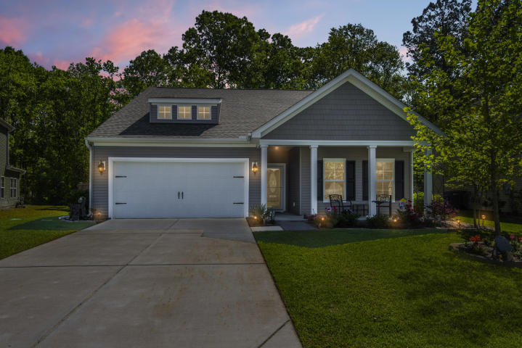
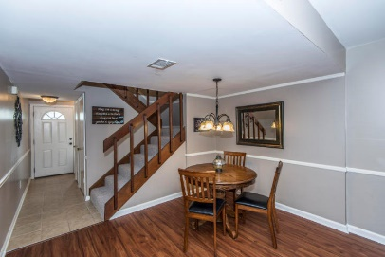
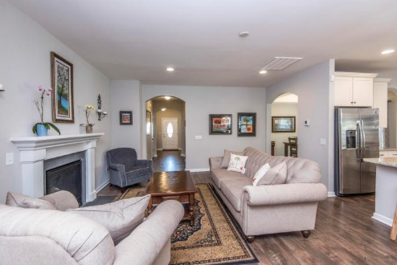
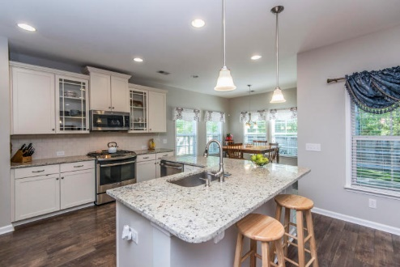
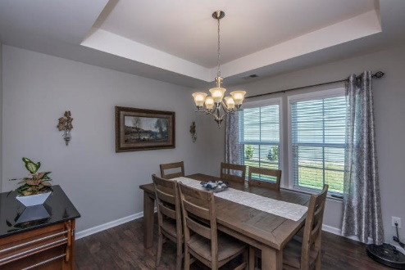
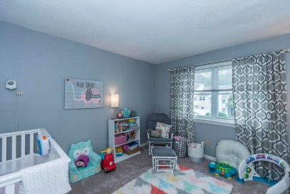
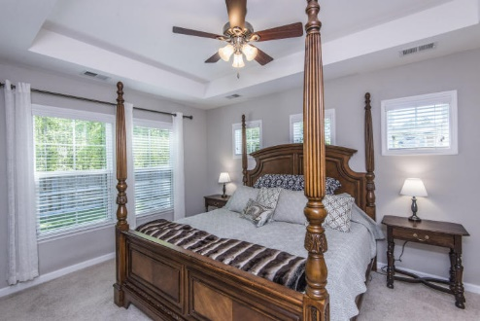
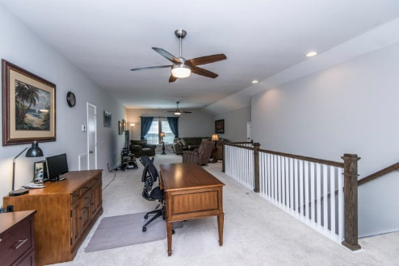
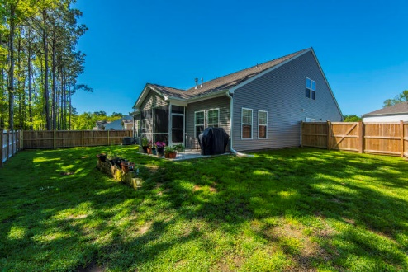


Why wait for new construction? This Mt. Pleasant home is 2 years old and looks like a model.
2036 Welsh Pony Dr
Tupelo Plantation
Mt Pleasant, SC 29429
MLS# 18010643
$447,900
This townhouse is the perfect LOCATION. You are close to Shem Creek, Trader Joe's and Whole Foods.
This townhouse has been freshly painted and just had a new hot water heater installed. The backyard has been regraded and added new sod and a new fence.
Downstairs has Smartcore luxury vinyl waterproof tile and upstairs has new carpet. Home has been inspected and repairs made. Roof was replaced in 2014 and HVAC in 2012.
Welcome home to 2036 Welsh Pony Drive! This immaculate like-new home is turnkey ready. You'll appreciate the fully fenced large private back yard that backs up to woods and blinds on all the windows. The floor plan is open and perfect for entertaining. Upgrades include white kitchen cabinets, granite countertops, & stainless appliances. The master bedroom is down and features a walk-in closet, ceiling fan, dual vanity, linen closet and a large standup shower. The upstairs features a large, about 700 sq ft open loft space which would make a great media room or playroom and office as you can see. Tupelo is just 2 miles to Wando High School and a short drive to restaurants and shopping. Amenities include a neighborhood pool, covered picnic area, play park and walking trails. New Costco almost finished nearby as well as Carolina Park Library being built. Check out the virtual tour for more images: https://my.matterport.com/show/?m=b65778rvdN3
Del Shaffer
843.408.6821
dshaffer@carolinaoneplus.com

