Slide 1
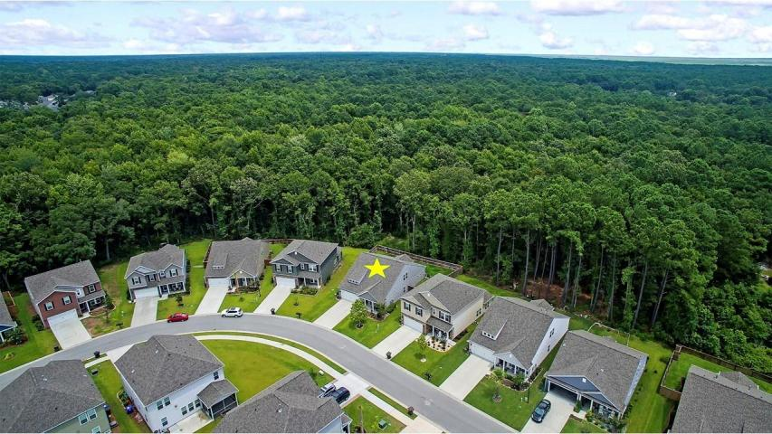
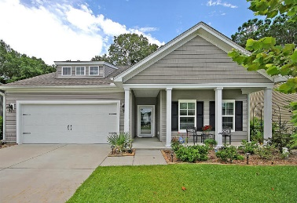
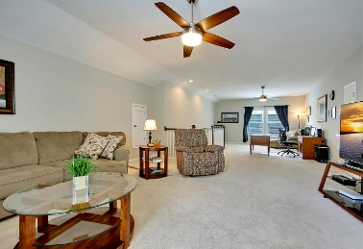
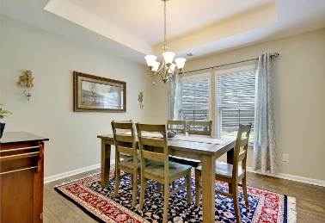

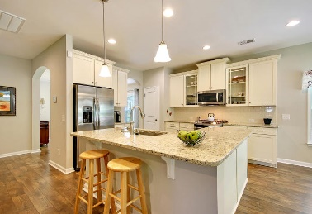

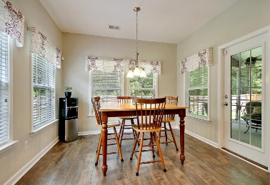
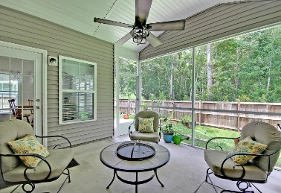

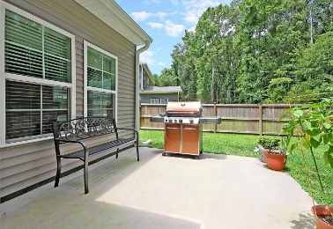
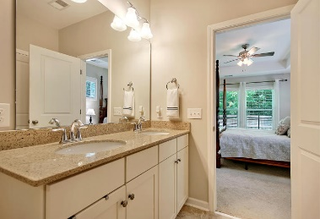
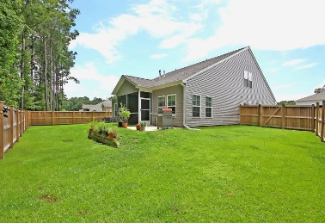
Great Downtown Investment Opportunity
Open House! Saturday, Sept 8 12:00-3:00
2036 Welsh Pony Drive
Tupelo ~ Mount Pleasant, SC 29429 ~ MLS# 18021821 ~ $445,000
When you buy a home that was going to be the model home for a community, there are two things you can expect: a superior location and upgrades galore. That's exactly what you get with this stunning home in Tupelo. The fenced-in yard backs to wetlands and is so private you can't even see the neighbors homes! The highlights in this home include hardwood floors, crown molding, hurricane impact glass windows, a fireplace in the living room, tray ceiling in the dining room, SS appliances and a breakfast bar in the kitchen, self-cleaning toilets and an irrigation system. This layout is the best of both worlds in that you have all of the bedrooms on the first level but also have a massive, bonus area on the 2nd level currently set up as a media room and office. Do not miss out on this beauty!
Additional features include:
Front porch, back screened-in porch and patio are great spots to enjoy the outdoors
Master bedroom has a tray ceiling
Master bath has a dual vanity, walk-in shower with built-in bench and a walk-in closet
Amazing storage area on the second level
Second level is perfect as is but could also be converted into a second master suite
Gutters with Leafguard
Book your showing today!
Book your viewing today!
Paige Rhodes 843-830-3281
paige@mattoneillteam.com
Ben Laaper 843-642-3546
ben@mattoneillteam.com

