Slide 1
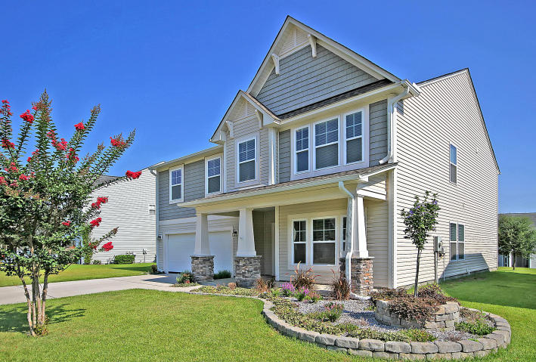
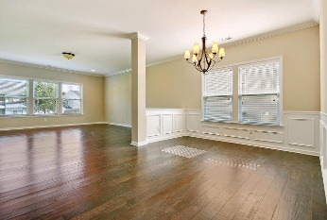
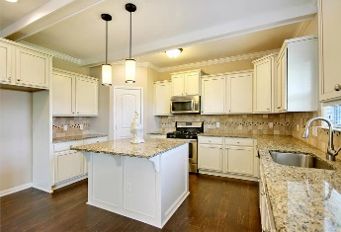
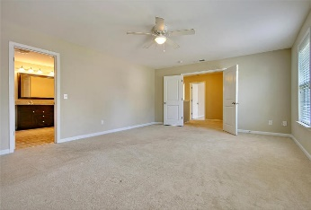
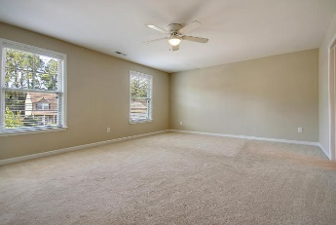
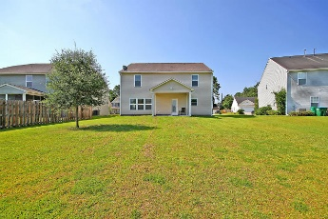


5 BEDROOM MOVE IN READY!
$15,000 Agent Bonus
with ratified contract by 4/15/18
203 Balsam Circle
Madison Ridge
Summerville, SC 29485
MLS# 18019985
$285,000
DISCOVERED! This Sensational fully detached 2 story home is situated on a large professionally landscaped lot. The Magnificent Madison Ridge home offers a lovely front porch, 9 ft.+ ceilings, has 4 large bedrooms with plush carpet upstairs including the spacious master bedroom suite that offers a glamorous Hollywood style bathroom with granite counter-tops, double sinks, ceramic tile floors, separate huge walk-in shower, an amazing garden tub and a vast walk-in closet. There are several large rooms on the main floor which feature selected wood flooring throughout including the charming Formal Dining with beautifully designed wainscoting, a designer kitchen showcasing granite counter tops, ceiling beams, stainless steel appliances, elegant tile back splash, custom cabinets, an amazing pantry, an eat-in kitchen that opens into an enormous living room with a lot of natural light. Upon entering the home a fifth bedroom, study or playroom awaits your imagination. The back covered patio has a gas connection for all of your family cookouts and gatherings.
Ginger Sanders
(843) 822-4618
ginger.sanders.remax@gmail.com
RE/MAX Pro Realty, 9209 University Blvd, Charleston, SC 29406

