Slide 1
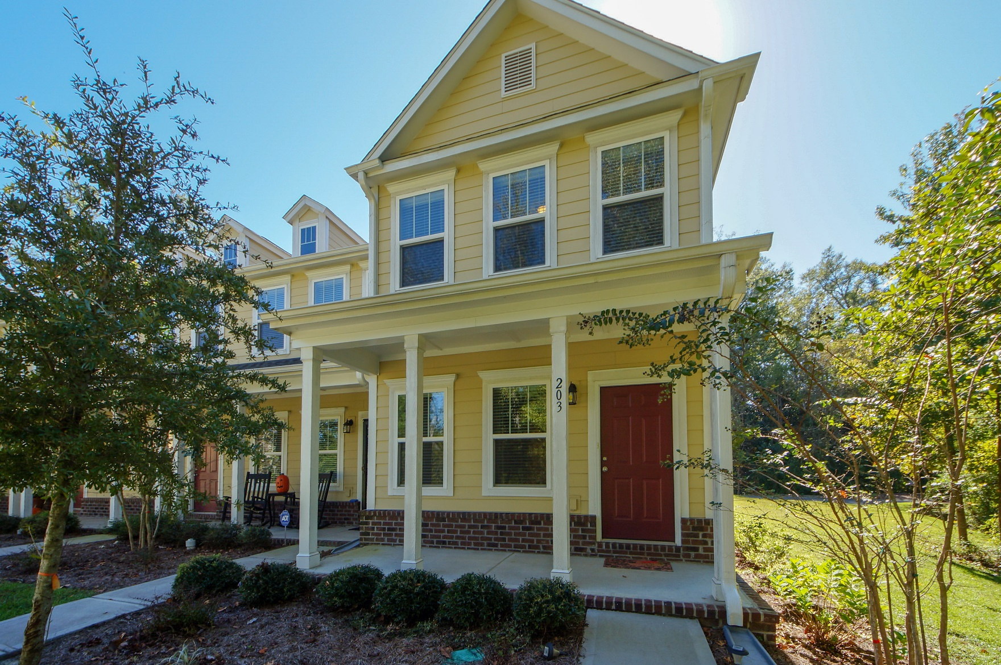
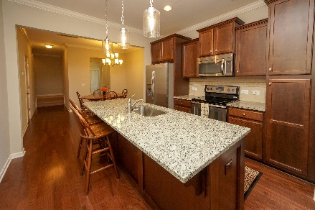
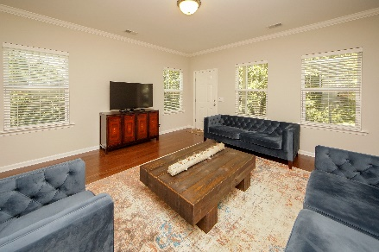
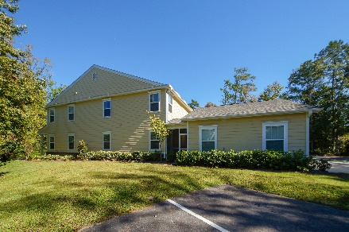


203 Bennett Lane
Branch Creek :: Summerville, SC 29483
MLS# 18029150 :: $199,900
3 Bed / 2½ Bath
3 Bedroom Townhome
Price Reduced!
Just Reduced!
Gorgeous and Move In Ready! 3 bedroom 2.5 bath town home located in the exclusive community of Branch Creek. This town home is 2 years old and features engineered wood flooring, upgraded lighting fixtures, staggered cabinets and features an oversized granite island with granite counter tops. Mudroom, screen porch, two car detached garage with two parking places beside the drive way make this end unit premiere! Pond view and private setting make this a must see and must own!!! We are priced to sell!
Connie White, Broker
843-532-3356
connie@chrepros.com · conniewhiterealestate.com
Charleston Homes · 597 Old Mt. Holly Road · Suite 301 · Goose Creek, SC 29445

