Slide 1
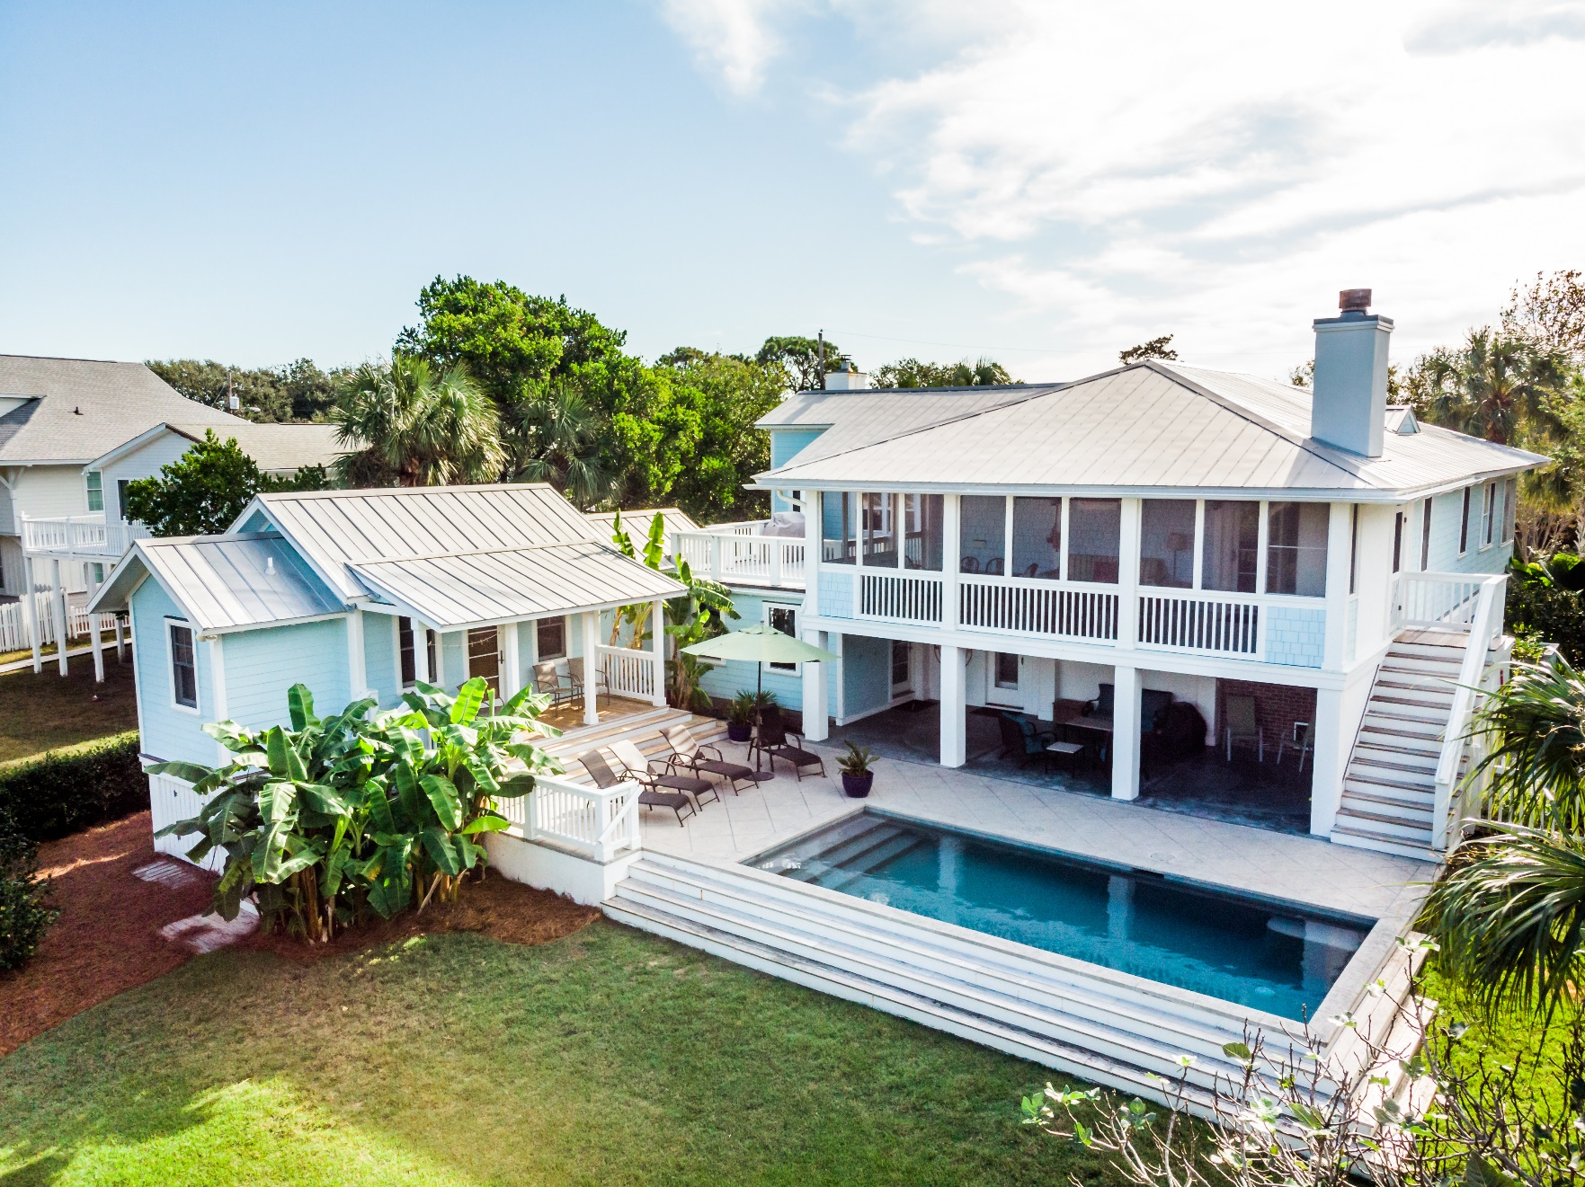
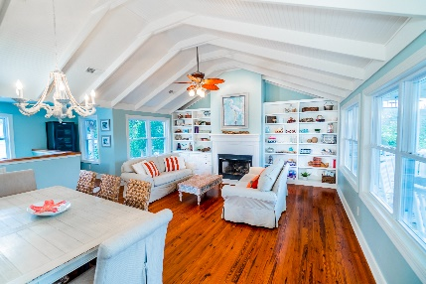
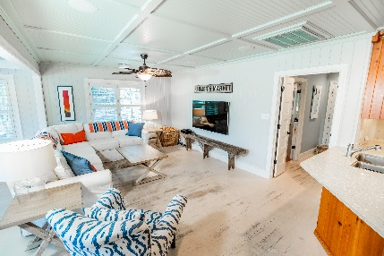
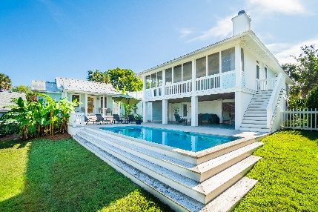
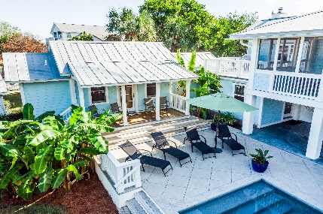


203 Carolina Boulevard Isle of Palms, SC 29451 MLS# 19002349 :: $1,695,000
Beach Paradise Available Now!
New
Construction
5 Bedrooms, 4.5 Baths
Resort Style Pool and Patio Areas
Exceptional Rental History
Rare Double Lot
Block from Beach
2 Huge Great Rooms
Expansive Screened Porches
Separate Grilling and Observatory Decks
Multiple Fireplaces
Short walk to Restaurants & Shopping
***Agents!! This home was rented June 1, 2019 - October 15 solid. Showings were a challenge! Home is NOT on the rental market now and can convey at closing! No longer subject to the SC Vacation Home Act!
Wendy Arnsdorff
843-364-8619 – M :: 843-284-1800 – O
wendy.arnsdorff@carolinaone.com www.wendyarnsdorff.com
Carolina One Real Estate :: Mt. Pleasant North Office :: 2713 N Highway 17 :: Mt. Pleasant, SC 29466

