Slide 1
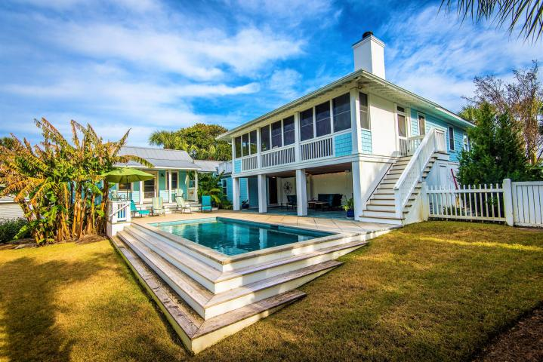
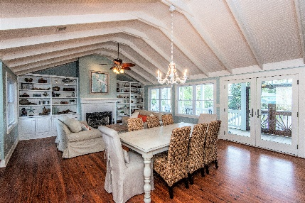
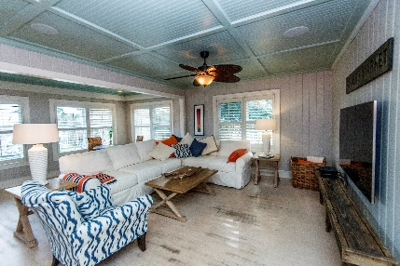
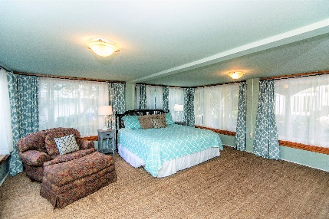
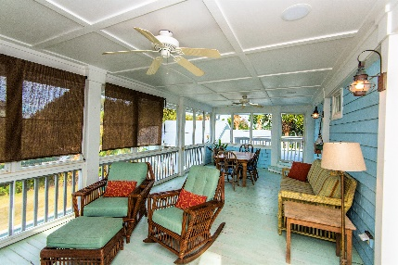


203 Carolina Boulevard
Isle of Palms, SC 29451 :: MLS# 19002349 :: $1,775,000
New
Construction
The Ultimate Beach House!
This is the Ultimate Beach House! Located a half block from the beach, it is a short walk or golf cart ride to restaurants and shopping.
It has 5 Bedrooms, 4.5 Bathrooms, 2 Huge Great/Gathering/Dining Rooms, fresh paint, perfect for the young and old to enjoy at the same time but have their own space, Resort style Pool and Patio areas, Separate Grilling and Observatory Decks, multiple Fireplaces, Expansive screened Porches, and gorgeous Double Lot and gardens!
Three to four families can enjoy the home and each have their own private wing.
Rental history is exceptional and can be provided.
Welcome to Paradise!
Wendy Arnsdorff
843-364-8619 – M :: 843-284-1800 – O
wendy.arnsdorff@carolinaone.com
www.wendyarnsdorff.com
Carolina One Real Estate :: Mt. Pleasant North Office :: 2713 N Highway 17 :: Mt. Pleasant, SC 29466

