Slide 1
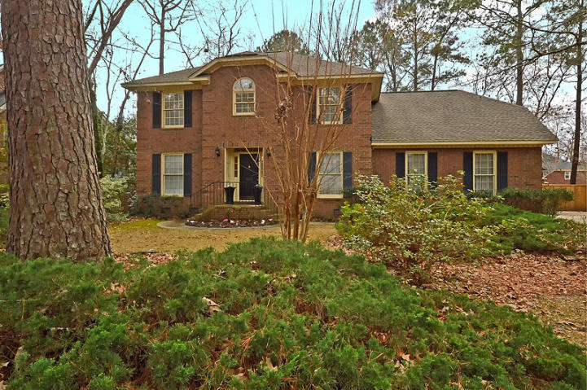
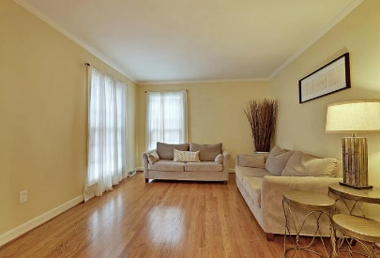
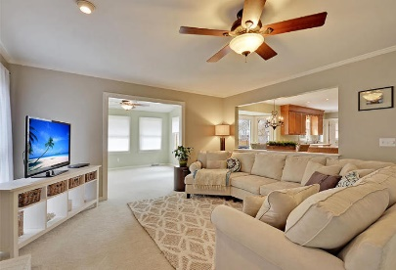
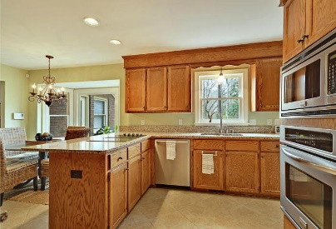
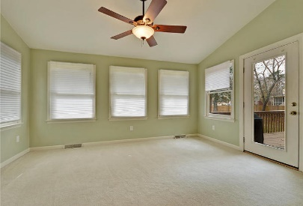
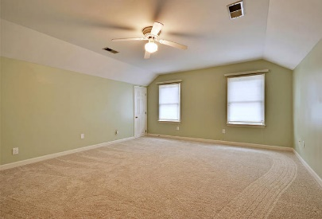
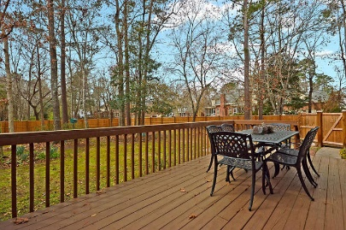
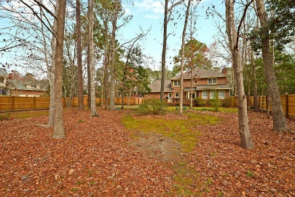
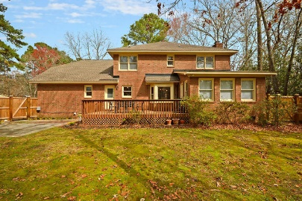


Summerville Beauty in Ashborough East
203 Folkstone Way
Ashborough East
Summerville, SC 29485
MLS# 18005136
$379,000
4 Bedrooms | 2½ Baths | 3,103 sf
Get ready to be impressed with this lovely home located in the established neighborhood of Ashborough East. This four bedroom home is move in ready! Freshly painted, new carpeting upstairs, completely fenced in yard, this home looks barely lived in! Upon entering you'll notice the gorgeous wood floors in the formal living, which can be an office, and the dining room. The large family room has a beautiful fireplace and is open to the sunroom. The kitchen has tons of cabinet space, a large eat in area and breakfast bar. Off the kitchen is the laundry room with more cabinet space as well as a second stair case! Upstairs, you'll find brand new carpeting throughout! The master bedroom is a great size and the master bath has been updated. It has dual vanities, separate tub and shower and a large walk in closest! There are three more bedrooms upstairs as well as a full bath. Back downstairs, you can head out back to find a deck, patio and huge fenced in yard! The crawl space of the home has been encapsulated as well, to prevent any moisture damage under the home. This home has been well maintained and is in move in condition. Ashborough East has a clubhouse, neighborhood pool and playground, tennis courts and walking trails. The neighborhood is conveniently located close to tons of shopping as well as many large companies such as Boeing, Bosch, Mercedes, etc.. It's also in Dorchester District 2!! Come see this home today!
Larry & Kathy Mazalatis
Larry Cell 843-693-0529
Kathy Cell 843-693-0159
Office 843-871-9133
AGENTOWNED PREMIERE GROUP | 1800 TROLLEY RD | SUMMERVILLE, SC 29485

