Slide 1
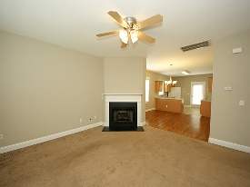
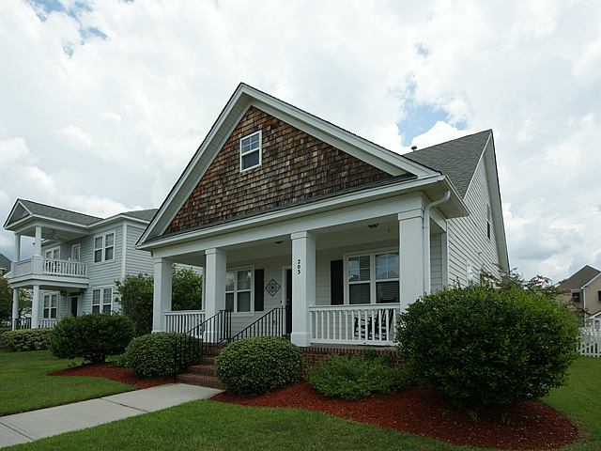
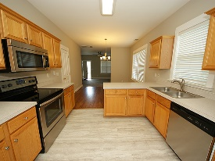
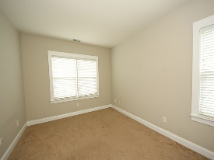
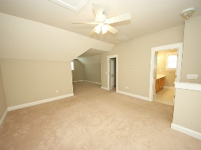
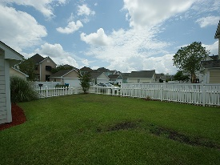
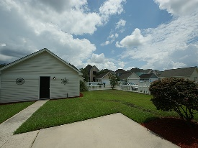
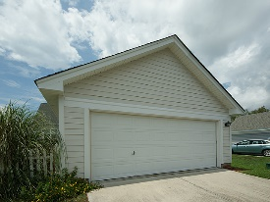


Move in ready!
203 Hydrangea Street
White Gables
Summerville, SC 29483
Open House Canceled!
Under Contract In 3 Days!
MLS# 16021906 | $189,900
3 Beds / 2 Baths
Lovely cottage home in White Gables!
This home has an open floor concept and the seller has installed new stainless appliances, new flooring and freshly painted the interior. Master suite is up stairs and offers additional space for a sitting area of home office. Picket fenced yard and two car detached garage top off the elegance of this cottage home.
Connie White, Broker
C: 843-532-3356
conniesyouragent@gmail.com
Charleston Homes
111 Spring Hall Dr
Goose Creek, SC 29445

