Slide 1
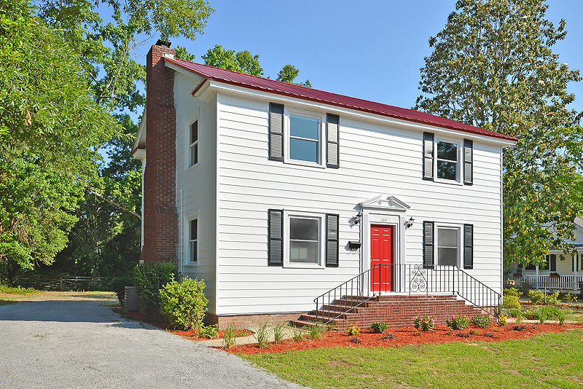
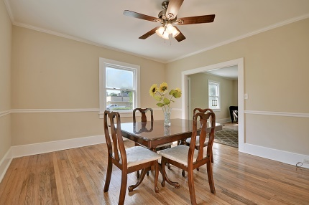
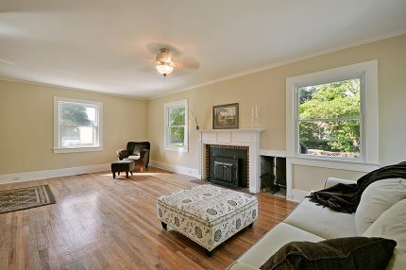
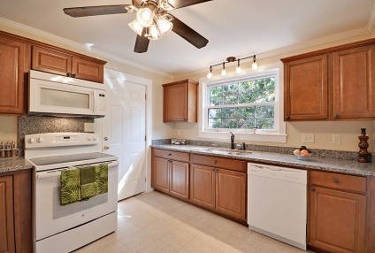
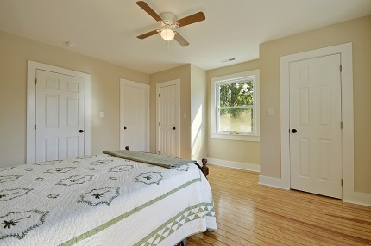
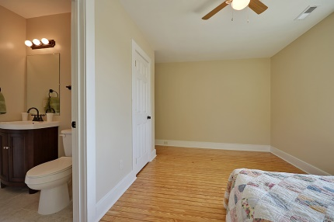
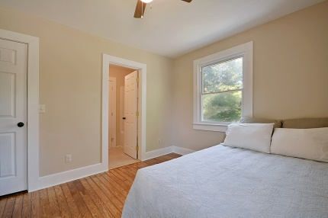
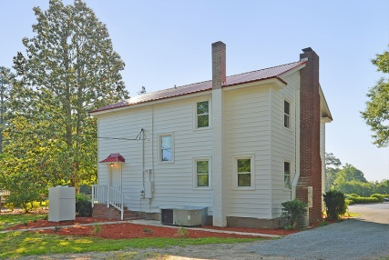


$2,500 Agent Bonus THIS WEEKEND ONLY!!
203 Library St
Moncks Corner ~ MLS# 1416300 ~ $159,900
Welcome to your dream home 203 Library Street. This charming home is located in the heart of historic Moncks Corner making it convenient to everything. The attention to detail by our old world craftsman during this extensive restoration has left no surface untouched, returning this classic home to its former glory with exquisite hard wood floors, and original crown molding throughout. From the outside, you will notice the quality new red metal roof, fresh paint, new landscaping and the inviting grand front entrance. Inside, The over sized living room is complete with a brick fireplace and firewood storage accessible from the outside of the house and is great for casual get together. The dining room is large enough for the larges of family gatherings while the gourmet kitchen is sure to please with a pantry, plenty of cabinets, granite counters and a full appliance package. The custom designed upstairs suite consists of three bedrooms and a full laundry room. The master retreat is spacious with a private bath. There are also two other nice sized bedrooms that are separated by a classic Jack and Jill bathroom. This house is ready and waiting for you to make it your home.
Nathan Henderson
843-574-3033 - O
843-822-0707 - M
nathanmhenderson@gmail.com
www.buyhendersonhomes.com
Carolina One Real Estate | 567 Crowfield Blvd | Goose Creek, SC 29445

