Slide 1
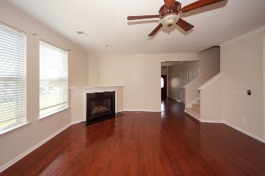
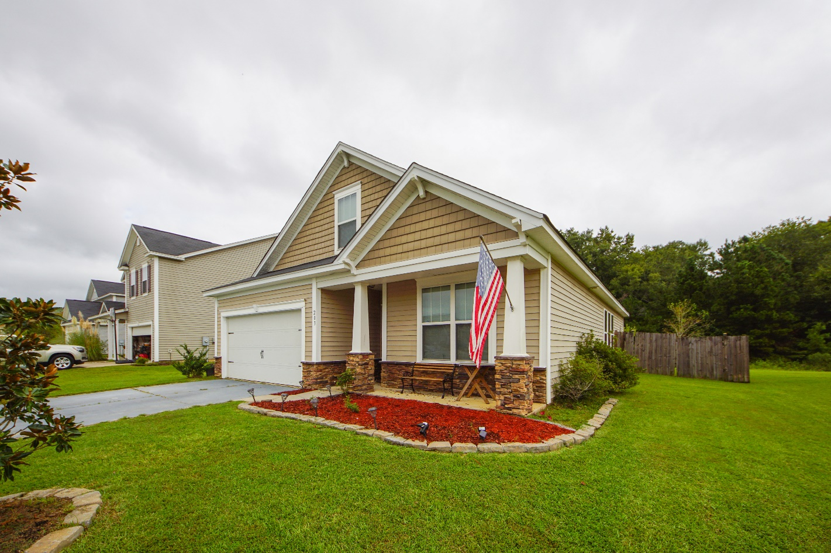
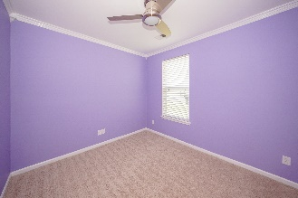
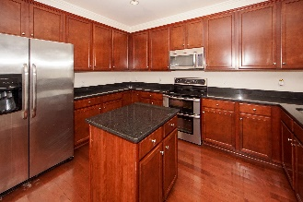
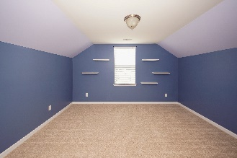
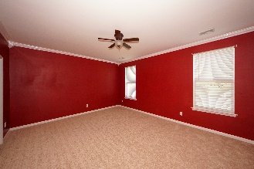
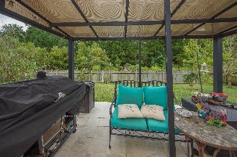
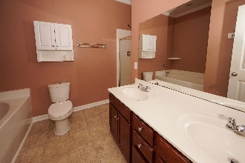
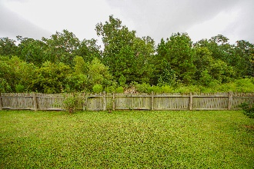
Come See This Move In Ready Home!
Close To The New Volvo Plant!!
203 Meadow Wood Road
Felder Creek ~ Summerville, SC 29486
MLS# 19025361 ~ $255,000
Lovely 5 Bedroom, 3 Full Bath home that is conveniently located to schools & shopping. You will love the open layout, the downstairs master and large, private backyard. Built in 2012, the downstairs living room and kitchen have wood floors. The kitchen features quartz counter tops, an island and nice wood cabinets. The living area has a gas fireplace and plenty of natural light. The master suite and two other bedrooms are all downstairs. Upstairs you have 2 more bedrooms and a full bath. There's plenty of space in the private, fenced backyard and there is a storage building for lawn tools, etc.
Mike Goldston, Realtor
mikesellscharleston@gmail.com | 843-343-7026 | www.cometocharlestonsc.com
Brand Name Real Estate | 4 Carriage Lane, Suite 106 | Charleston, SC 29407

