Slide 1
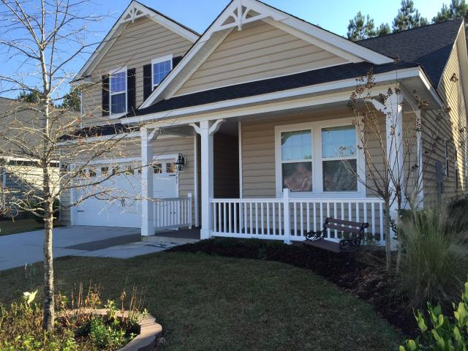
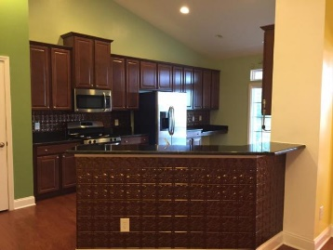
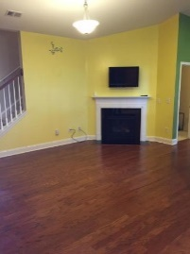
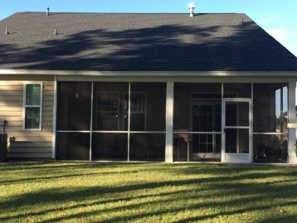
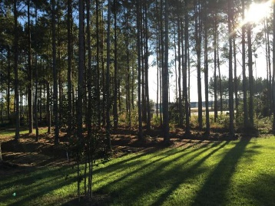
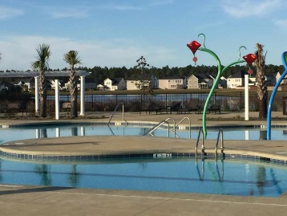


Open House Saturday Feb 6th 1-3p
Price Reduced!
203 Overcup Loop
Cane Bay Plantation ~ Summerville
MLS# 15029118 ~ $260,000
WHY WAIT TO BUILD IN LINDERA PRESERVE at Cane Bay Plantation?
The Crepe Myrtle floor plan by Lennar Is a Ranch style home with a Bonus Room, full bath & closet upstairs. Spacious Master Bedroom is Downstairs. Large open kitchen and breakfast area with Beautiful Maple cabinets and granite countertops and stainless steel appliances. Arched openings throughout the home. Nexia Home Security system. Screened in Back Porch. Walking path in the back that can take you to the shops and grocery store. Dog Parks and Retreat style Amenity center with Large pool and play area. Many upgrades!
Robyn Lane, Realtor
843-222-5599
robynlane01@icloud.com
ERA Wilder Realty, 125-F Wappoo Creek Dr, Charleston, SC 29412

