Slide 1
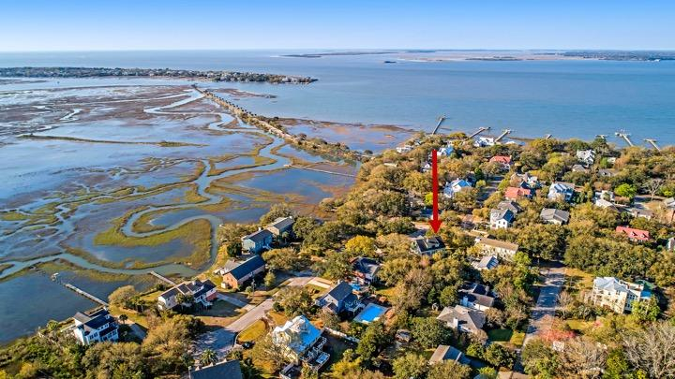

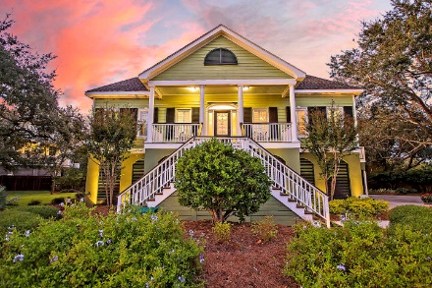
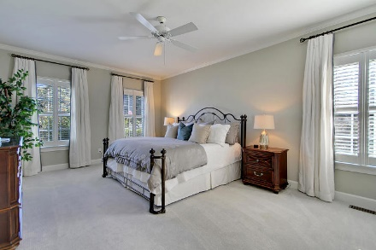
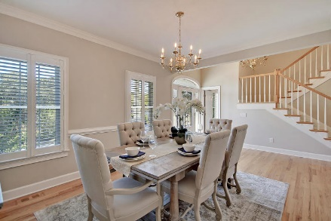
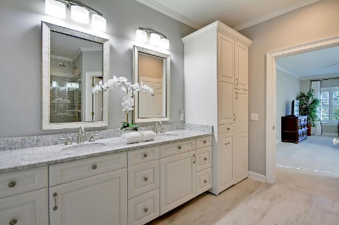
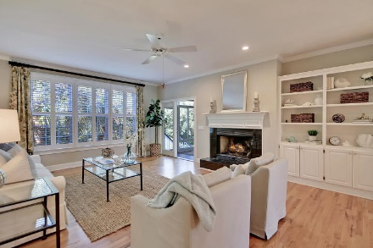
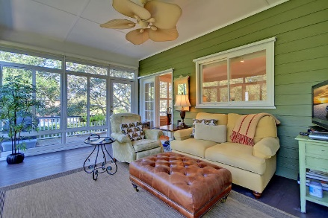
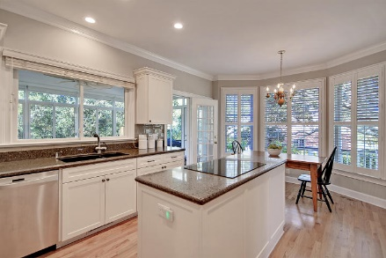
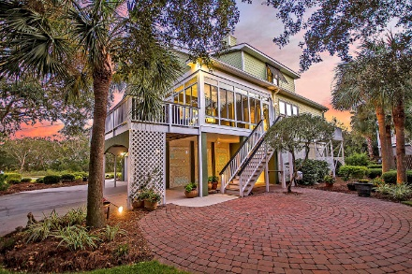
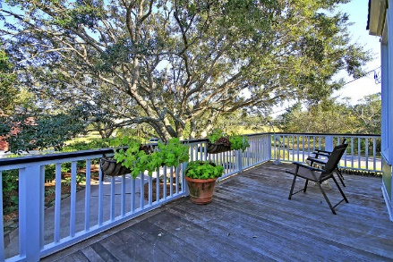

Seller Offering $5,000 Agent Bonus For Closing By 5/1/18
Old Village Jewel
203 William Street Old Village ~ Mount Pleasant, SC 29464 ~ MLS# 19027529 ~ $1,500,000
You will love hearing the faint sounds of fog horns on foggy nights from this immaculate home in Old Village with views of The Cove and the Sullivan's Island lighthouse. There are many areas to enjoy the parklike setting of this large corner lot tucked away in a quaint area of the village. The side deck is the perfect place to view the marsh while being shaded by the canopy of a gorgeous oak tree. The 4 seasons room provides a wonderful place to relax and view the pristine landscape of the backyard with its beautiful 30 ft diameter paved patio. You will appreciate the efficient flow between the home's indoor and outdoor living spaces. The master suite is conveniently located on the first floor of this home. This gorgeous home shows like a model with gleaming hardwood floors, high ceilings and crown molding, a fireplace and built-ins in the living room and a spacious Silestone cultured marble eat-in kitchen with center island. There is no shortage of storage space with four spacious areas inside the home and a four car, 1750 sq ft garage with efficient 100 linear foot shelf storage system. Within walking distance, you will have two parks with harbor views, shopping, dining and an award winning school. Sullivan's Island beach is a bicycle ride away and historic Charleston is just a short drive. Boat landings are also nearby.
Book your showing today!
Lisa Quick lisa@mattoneillteam.com 843-452-6688

