Slide 1
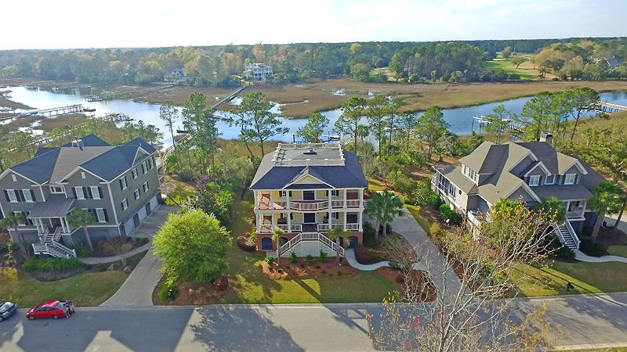
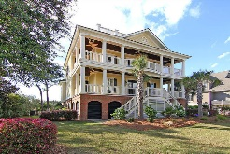
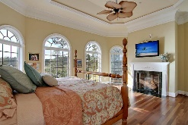
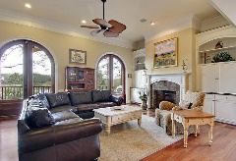
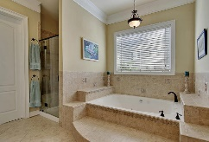
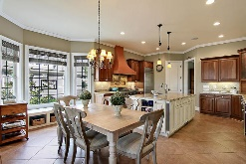
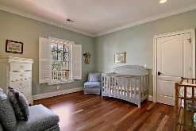
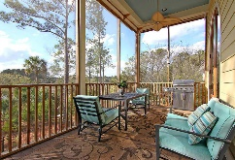
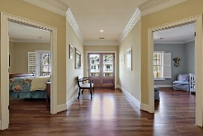
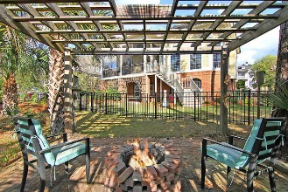
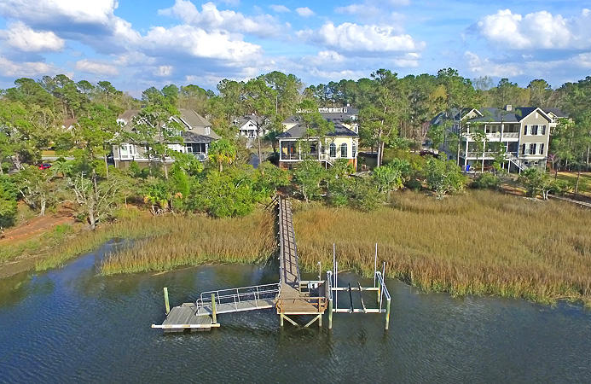
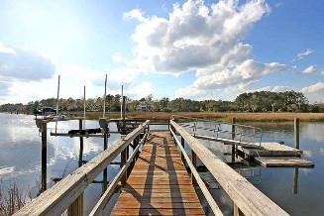


2040 Ashburton Way
Andover at Park West ~ Mount Pleasant
Significant Price Reduction!
Stunning custom retreat with private boat dock! This home was the builder's private residence and no detail was left unattended. Impressive double piazzas welcome you into this grand southern-coastal style home and it only gets better from there. The home features extensive moldings and gorgeous hardwoods throughout. The foyer opens to a formal dining room with wainscoting and trey ceiling, perfect for hosting holiday dinners. Opposite the dining room is a home office or study with French doors and built-in desk and cabinetry. The great room is a spacious yet cozy place to relax and features a gas log fireplace, custom built-ins and floor to ceiling palladium glass doors which offer access to the screened porch and gorgeous views out back. The gourmet kitchen is truly impressive and the chef in the family will love to prepare everything from small family dinners to large dinner parties. As amazing as the home itself is, the true beauty in this property is found in the outdoor space. In addition to those beautiful front piazzas and the screened-in porch there is a covered patio, perfect for hanging a hammock and napping or simply a shaded place to sit and watch the kids and pets play in the private, fenced backyard! Once the sun sets, light the firepit under the trellis and enjoy an evening glass of wine under the stars looking out to your very own private dock complete with lift and floater.
Asking $1,175,000
MLS# 17007225
4,117 SqFt
5 Bed/3½ Baths
Move-in Ready!
Don Dawson
843-514-0452
ddawson@carolinaone.com
Carolina One Real Estate • 2713 Highway 17 North • Mount Pleasant, SC 29466
www.TeamDawsonSC.com

