Slide 1
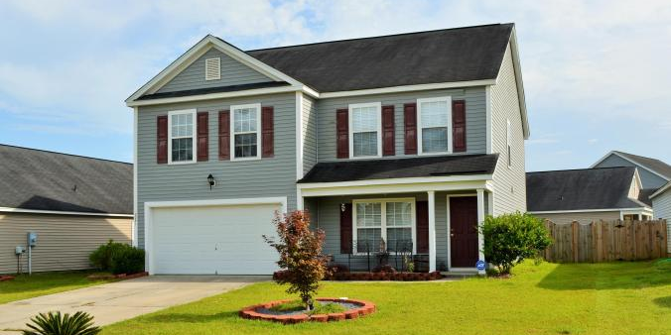
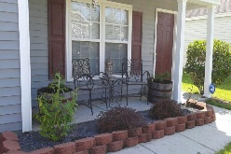
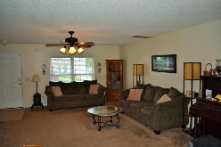
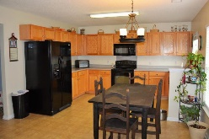
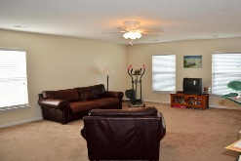
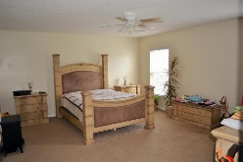
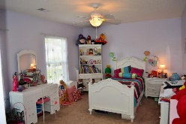
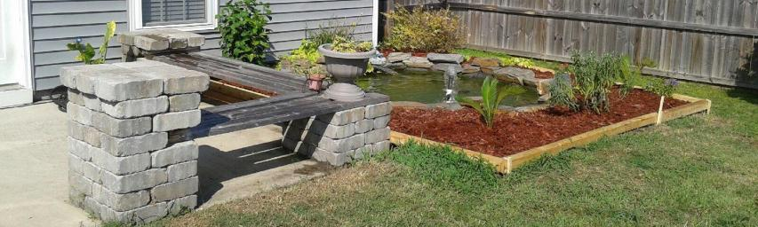


Motivated Seller Price Reduced
2041 Clipstone Drive
Hunters Bend
Ladson, SC 29456
MLS# 15017752
$184,900
Beazer's Madison floor plan offers lots of open space. Downstairs has large kitchen with separate dining, living room and laundry room. 2 car garage. Patio and wooden enclosed fenced make backyard oasis. All 3 bedrooms are upstairs. Master suite is 18'x15' and features ceiling fan and HUGE walk in closet. Master bath has separate shower and garden tub. Large loft upstairs offers 2nd living space or great flex space.
Jennifer Frampton Pait
843-568-9509
jenniferfp@carolinaone.com

