Slide 1
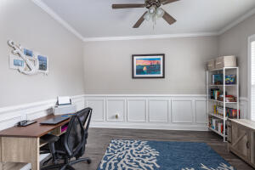
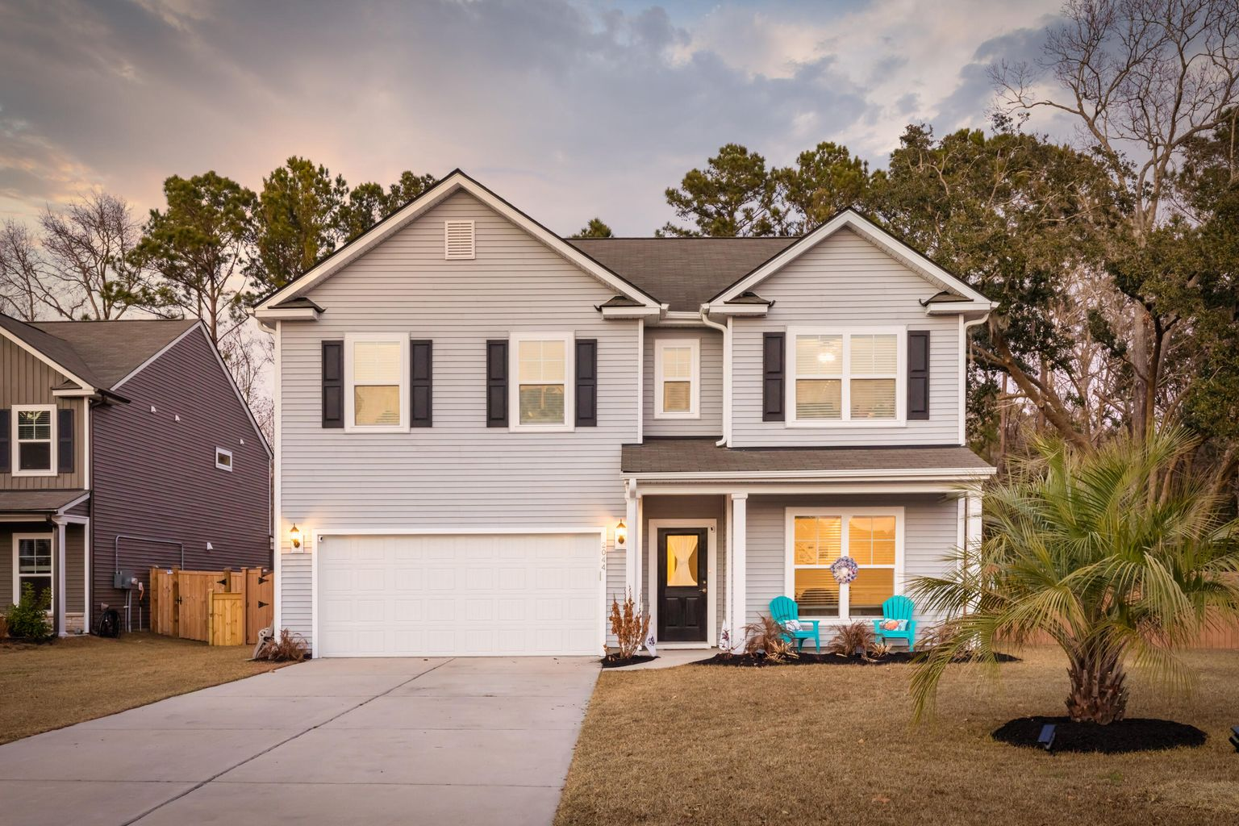
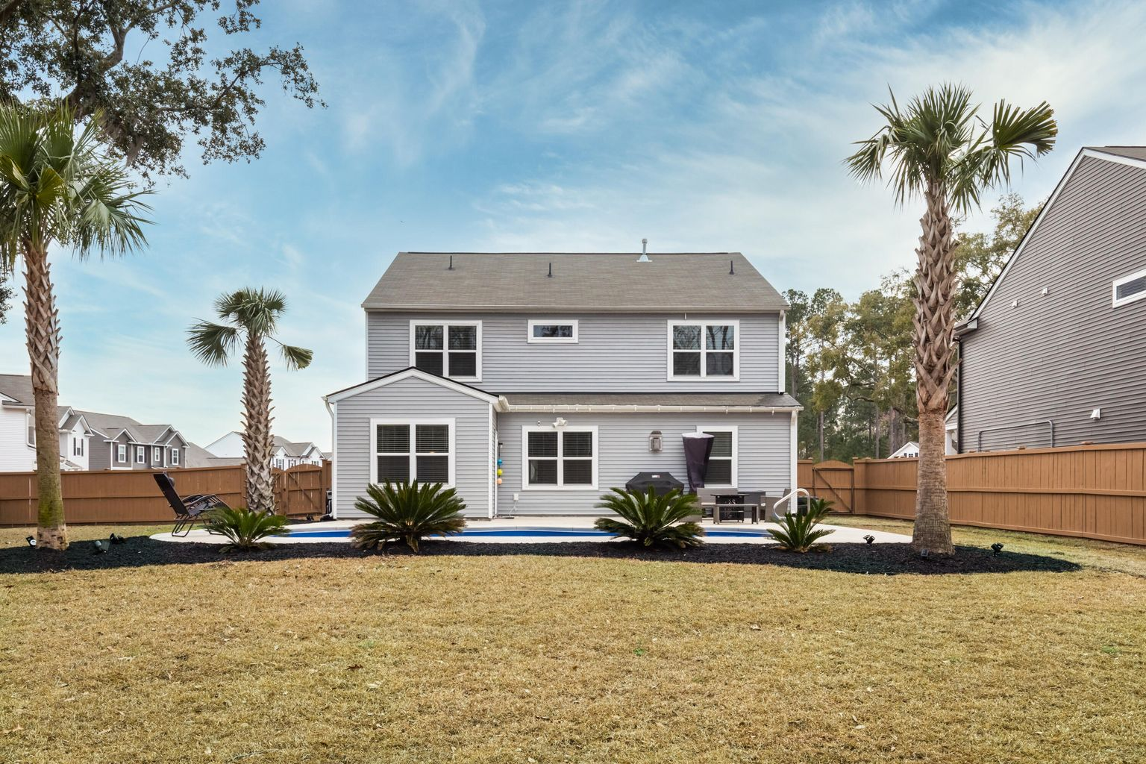
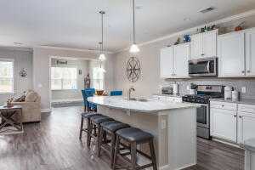
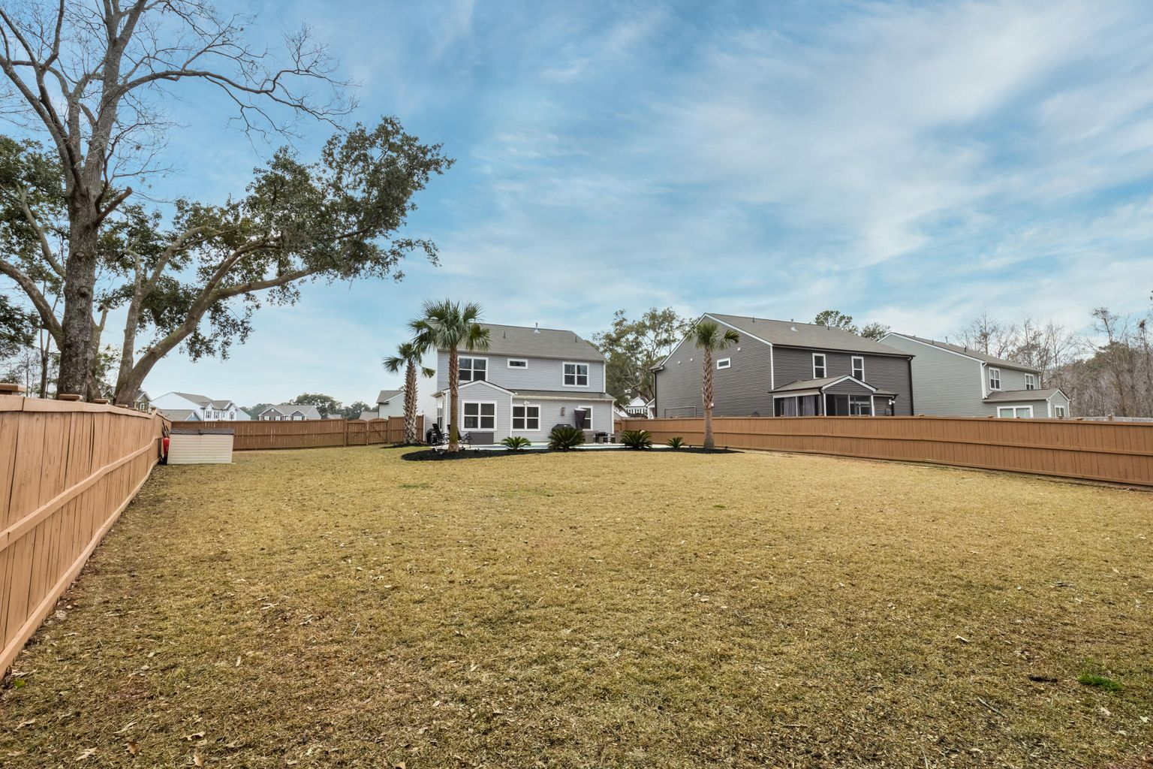
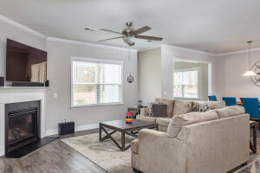
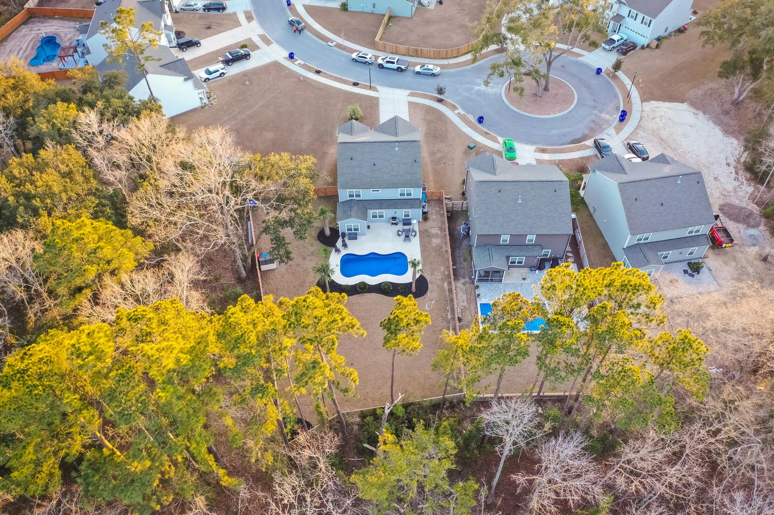
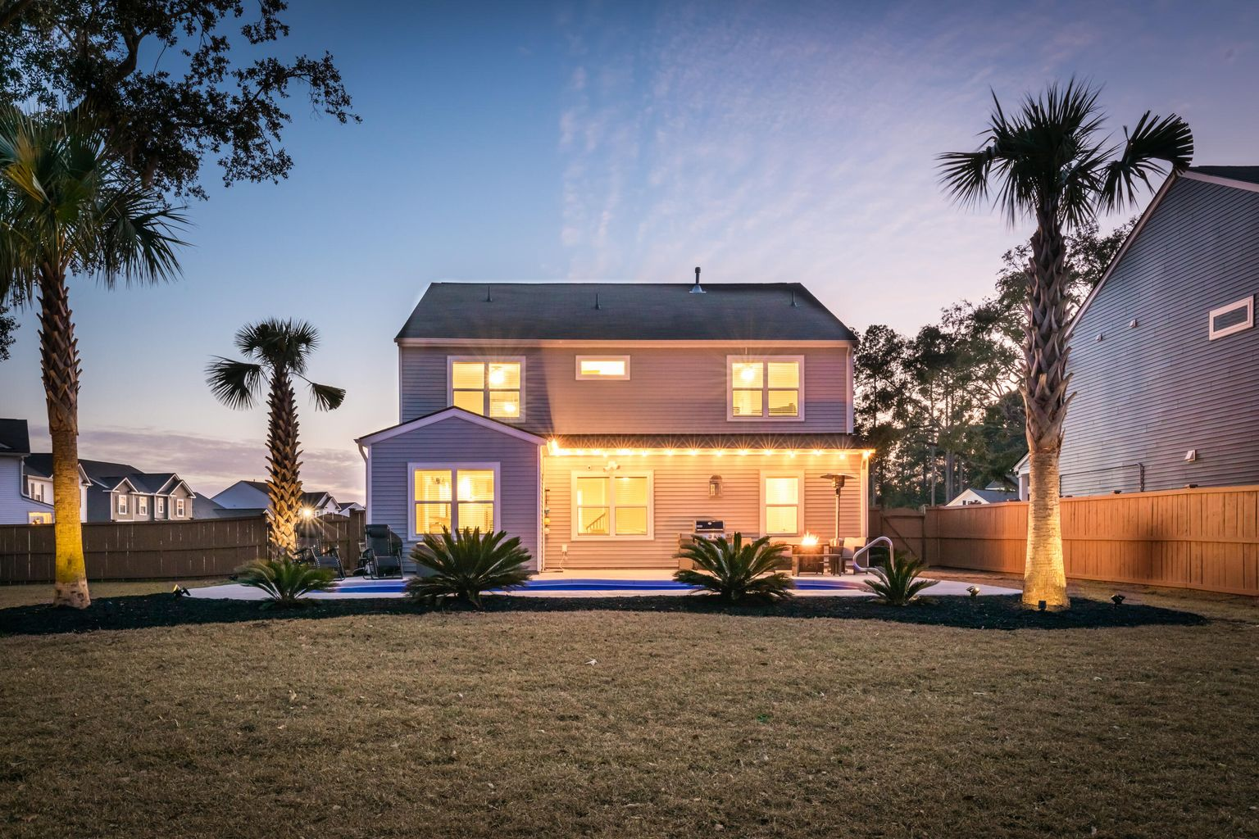
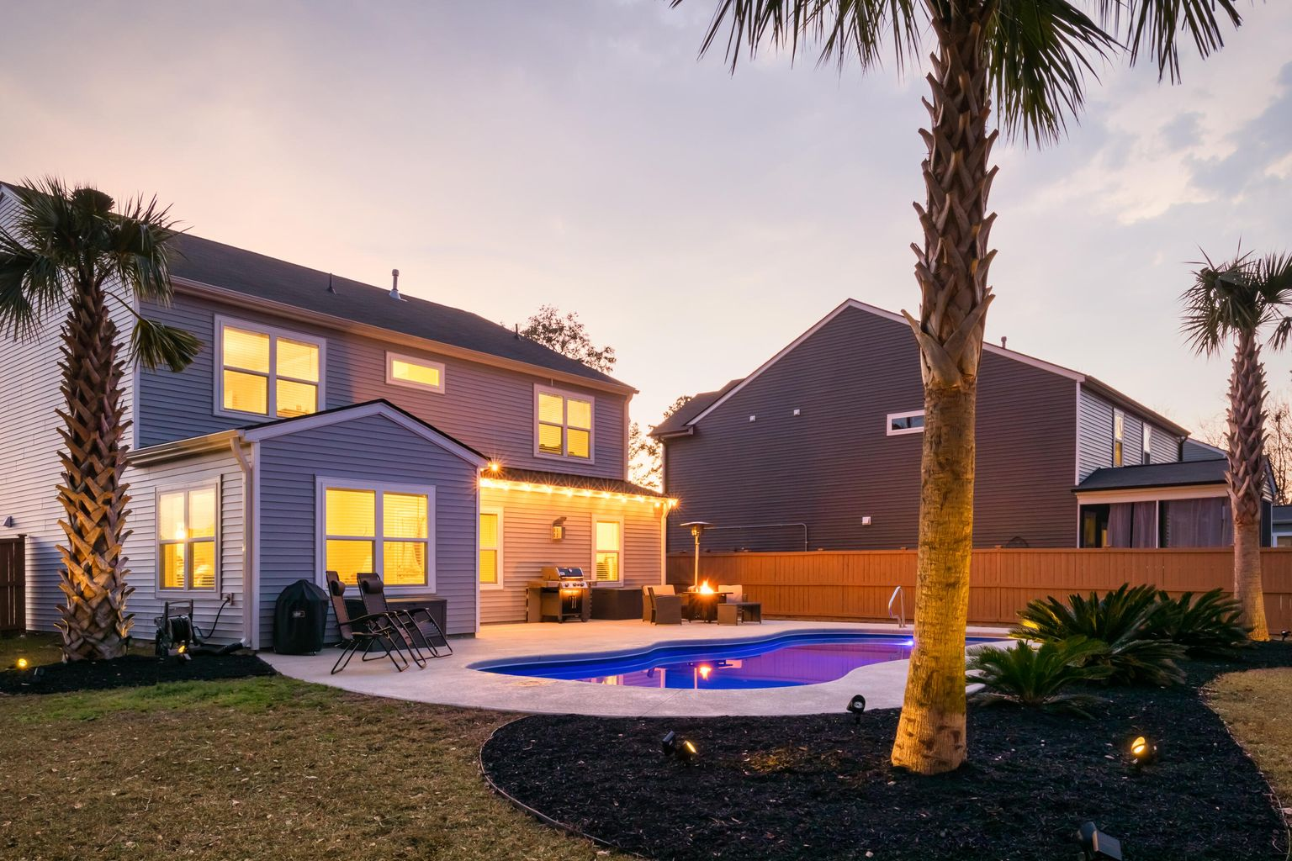
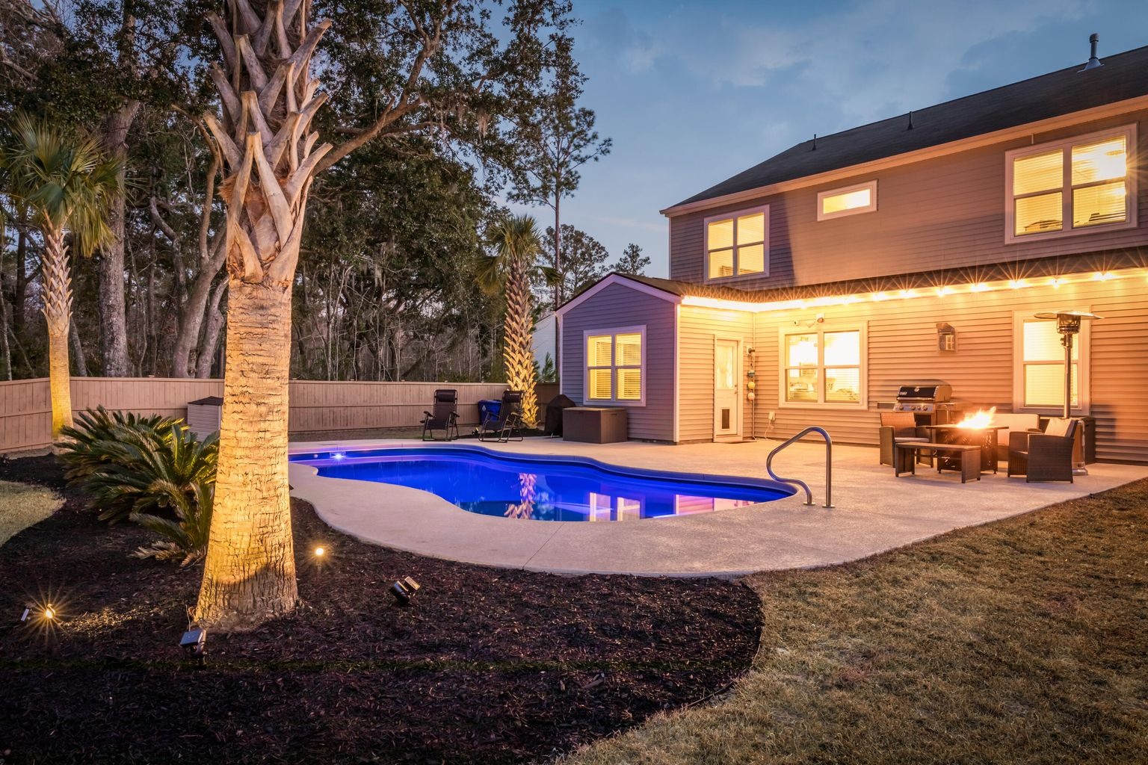
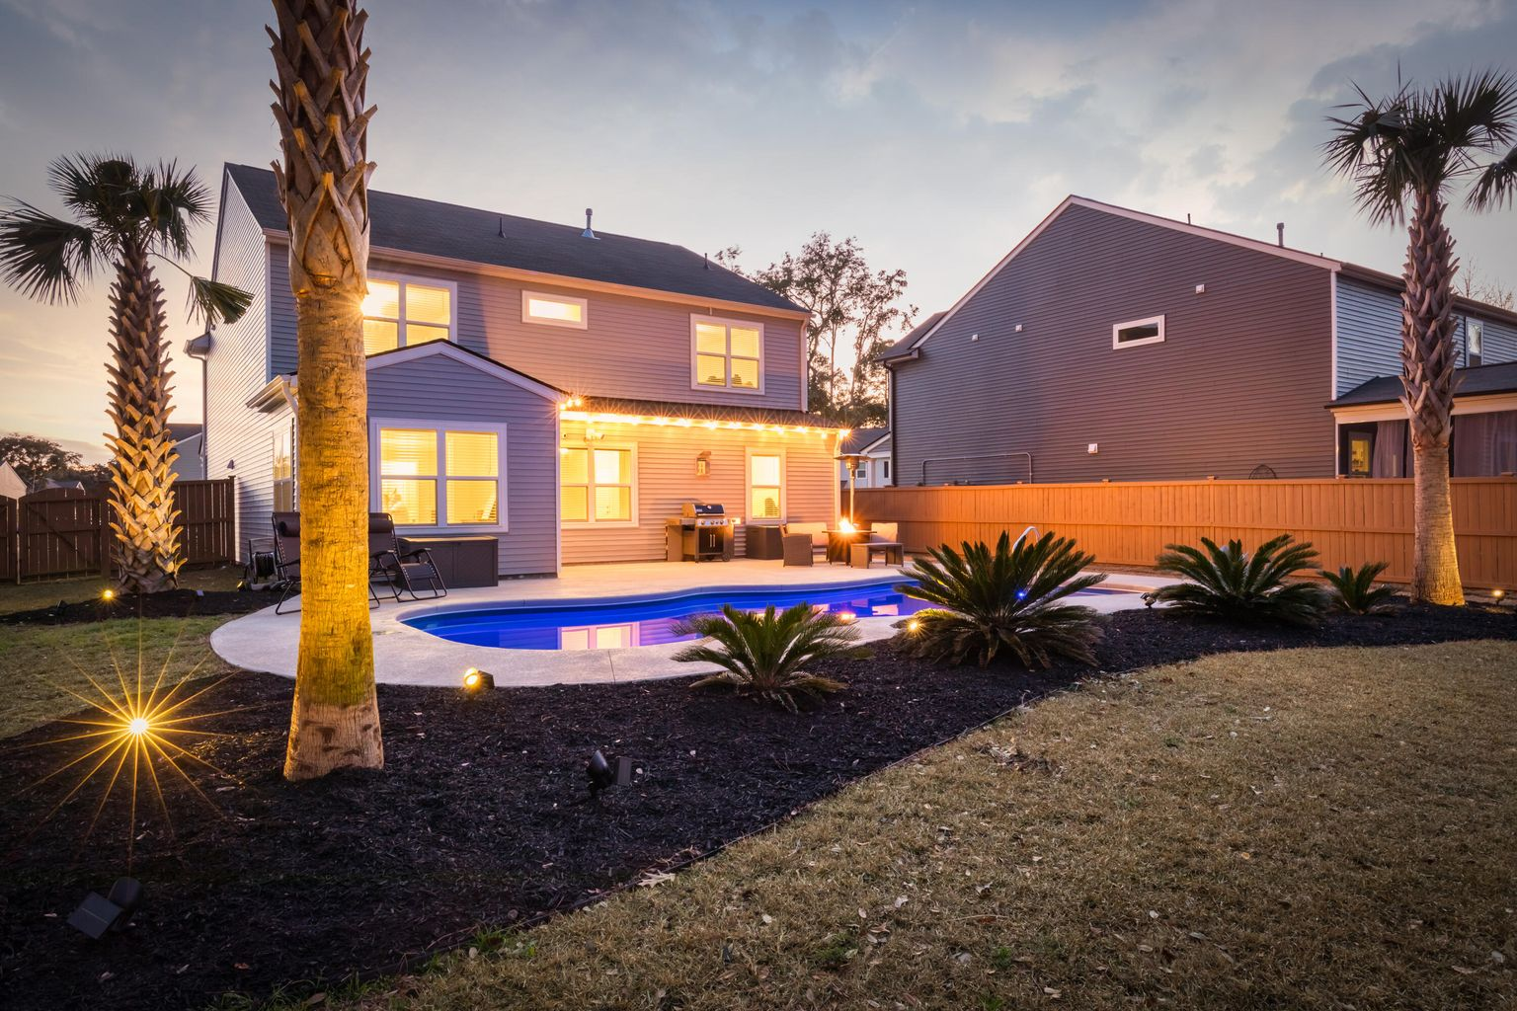



Welcome Home to Lanneau Lane!
4 bedrooms, 2.5 bathrooms, 1,800 sq ft, .85 of an acre
No HOA
X Flood Zone, no flood insurance required
Original heart pine floors and beadboard are continuous throughout the home
9+ foot coffered ceilings in living room
7 inch crown molding and baseboards throughout the home.
New HVAC, plumbing and electrical
Tankless water heater
Roof has been inspected and was repaired where necessary
Large kitchen island has room for seating with butcher block countertops & top of the line, stainless steel, Samsung appliances (includes upgraded refrigerator), a push button disposal and a commercial faucet
Luxurious owner’s suite which features its own en suite bathroom, complete with a mirrored double vanity with quartz countertops, custom tile, a clawfoot tub, an oversized shower and a massive, custom walk-in closet with separate space for a stackable washer and dryer
2044 Lanneau Lane, Johns Island
$799,000
5 Bedrooms | 3 Bathrooms | 2,970 sf | 0.44 Acre
Don't miss this chance to purchase your dream home in Oakfield, one of Johns Island's most highly desirable neighborhoods. This stunning home sits on almost half an acre (one of the largest lots in Oakfield if not the largest), is located on a private and quiet cul-de-sac and features an in-ground, heated saltwater pool. If that's not enough, the property backs up to wetlands adding ultimate privacy. This home literally has it all and shows like a model home, likely because the current owners chose every upgrade option available when they had this home built.
This peaceful property has it all and is an absolute must see.
Keller Williams Realty Charleston West Ashley
1180 Sam Rittenberg Ste 105
Charleston, SC 29407
Celeste Jones
Realtor
843-345-9387
welcomingyouhomecharleston@gmail.com

